Slide 1
Big Data I: Graph Processing, Distributed Machine Learning
CS 240: Computing Systems and Concurrency
Lecture 21
Marco Canini
Credits: Michael Freedman and Kyle Jamieson developed much of the original material.
Selected content adapted from J. Gonzalez.

Slide 2
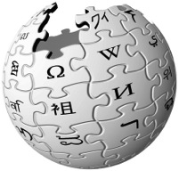



Big Data is Everywhere
10 Billion
Flickr Photos
Avg. 1 Million/day
1.4 Billion daily active Facebook Users
400 Hours a Minute
YouTube
44 Million
Wikipedia Pages
Machine learning is a reality
How will we design and implement “Big Learning” systems?
Notes:
Huge amounts of data are everywhere, and machine learning algorithms are turning data that once may have been useless into actionable data.
Identify trends, create models, discover patterns. So today we’ll look at how to process this data at these massive scales.
SEGUE: We’ve seen from the smaller problems in the datacenter that processing at these scales DEMANDS PARALLELISM – many processors working on the data at the same time.

Slide 3
Threads, Locks, & Messages
We could use ….
“Low-level parallel primitives”
Notes:
One way of doing this is to use the basic low-level primitives you’ve learned about in your classes on programming languages & architecture to coordinate different machines working on the same problem.

Slide 4
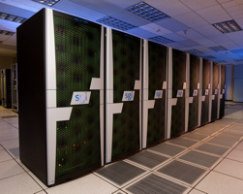
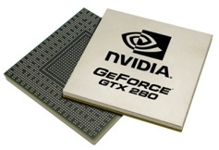
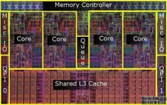
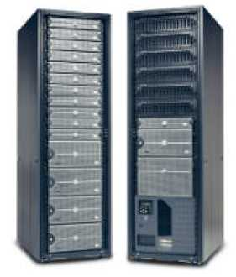

Shift Towards Use Of Parallelism in ML and data analytics
GPUs
Multicore
Clusters
Clouds
Supercomputers
Programmers repeatedly solve the same parallel design challenges:
Race conditions, distributed state, communication…
Resulting code is very specialized:
Difficult to maintain, extend, debug…
Idea: Avoid these problems by using
high-level abstractions
Notes:
And in fact this is what has been happening over the past decade or so...
>>> So there is a clear need for programming at a higher level of abstraction.

Slide 5
MapReduce / Hadoop
... a better answer:
Build learning algorithms on top of high-level parallel abstractions
Notes:
So one obvious thing to try is to use MapReduce to build these types of learning algorithms.
Hadoop is a Java implementation of MapReduce with a file system.

Slide 6
Data-Parallel Computation

Slide 7
Ex: Word count using partial aggregation
Compute word counts from individual files
Then merge intermediate output
Compute word count on merged outputs

Slide 8
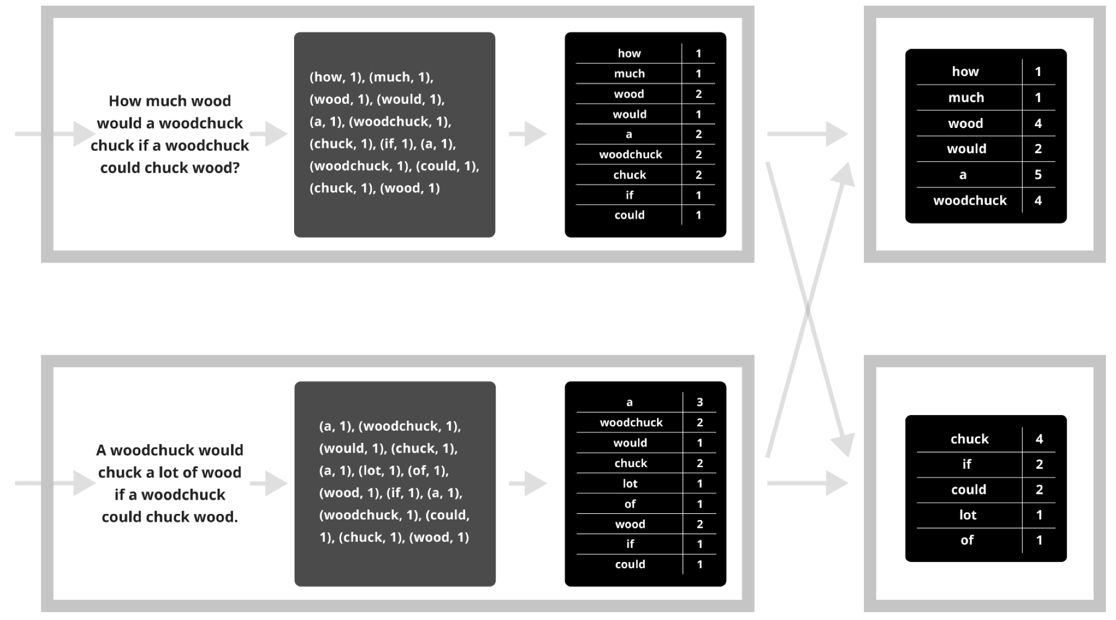
Putting it together…
map
combine
partition
(“shuffle”)
reduce

Slide 9
Synchronization Barrier

Slide 10
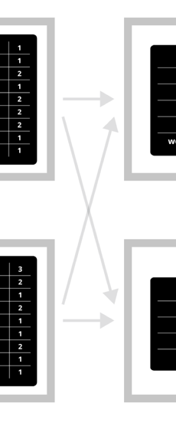
Fault Tolerance in MapReduce
Map worker writes intermediate output to local disk, separated by partitioning. Once completed, tells master node
Reduce worker told of location of map task outputs, pulls their partition’s data from each mapper, execute function across data
Note:
“All-to-all” shuffle b/w mappers and reducers
Written to disk (“materialized”) b/w each stage

Slide 11
MapReduce: Not for Every Task
MapReduce greatly simplified large-scale data analysis on unreliable clusters of computers
Brought together many traditional CS principles
functional primitives; master/slave; replication for fault tolerance
Hadoop adopted by many companies
Affordable large-scale batch processing for the masses
But increasingly people wanted more!

Slide 12
MapReduce: Not for Every Task
But increasingly people wanted more:
More complex, multi-stage applications
More interactive ad-hoc queries
Process live data at high throughput and low latency
Which are not a good fit for MapReduce…

Slide 13
Iterative Algorithms
MR doesn’t efficiently express iterative algorithms:
Iterations
Data
Data
Data
Data
CPU 1
CPU 1
CPU 1
Data
Data
Data
Data
Data
Data
Data
Data
Slow
Processor
CPU 2
CPU 2
CPU 2
Data
Data
Data
Data
Data
Data
Data
Data
CPU 3
CPU 3
CPU 3
Data
Data
Data
Data
Data
Data
Data
Data
Barrier
Barrier
Barrier
Notes:
Many ML algorithms ITERATIVELY REFINE their variables during operation.
MR doesn’t provide a mechanism to directly encode iterative computation, so you are forced to do something like this: put barriers in where all the computation waits for the barrier before proceeding.
If one processor is slow (common case) then whole system runs slowly.

Slide 14
MapAbuse: Iterative MapReduce
System is not optimized for iteration:
Iterations
Data
Data
Data
Data
CPU 1
CPU 1
CPU 1
Data
Data
Data
Data
Data
Data
Data
Data
CPU 2
CPU 2
CPU 2
Startup Penalty
Disk Penalty
Startup Penalty
Disk Penalty
Startup Penalty
Data
Data
Disk Penalty
Data
Data
Data
Data
Data
Data
CPU 3
CPU 3
CPU 3
Data
Data
Data
Data
Data
Data
Data
Data
Notes:
Finally there is a startup penalty associated with the storage and network delays of reading and writing to disk to make this barrier between stages. So the system isn’t optimized for iteration from a performance standpoint.

Slide 15
In-Memory Data-Parallel Computation

Slide 16
Spark: Resilient Distributed Datasets
Let’s think of just having a big block of RAM, partitioned across machines…
And a series of operators that can be executed in parallel across the different partitions
That’s basically Spark
A distributed memory abstraction that is both fault-tolerant and efficient

Slide 17
Spark: Resilient Distributed Datasets
Restricted form of distributed shared memory
Immutable, partitioned collections of records
Can only be built through coarse-grained deterministic transformations (map, filter, join, …)
They are called Resilient Distributed Datasets (RDDs)
Efficient fault recovery using lineage
Log one operation to apply to many elements
Recompute lost partitions on failure
No cost if nothing fails

Slide 18
Spark Programming Interface
Language-integrated API in Scala (+ Python)
Usable interactively via Spark shell
Provides:
Resilient distributed datasets (RDDs)
Operations on RDDs: deterministic transformations (build new RDDs), actions (compute and output results)
Control of each RDD’s partitioning (layout across nodes) and persistence (storage in RAM, on disk, etc)

Slide 19

Example: Log Mining
Load error messages from a log into memory, then interactively search for various patterns
Base RDD
Msgs. 1
lines = spark.textFile(“hdfs://...”)
errors = lines.filter(_.startsWith(“ERROR”))
messages = errors.map(_.split(‘\t’)(2))
messages.persist()
Transformed RDD
Worker
results
tasks
Block 1
Master
Action
messages.filter(_.contains(“foo”)).count
messages.filter(_.contains(“bar”)).count
Msgs. 2
Worker
Msgs. 3
Worker
Block 2
Block 3

Slide 20
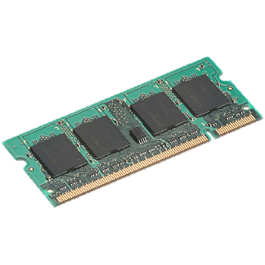
In-Memory Data Sharing
iter. 1
iter. 2
. . .
Input
query 1
one-time processing
query 2
query 3
Input
. . .

Slide 21
Efficient Fault Recovery via Lineage
Maintain a reliable log of applied operations
iter. 1
iter. 2
. . .
Input
Recompute lost partitions on failure
query 1
one-time processing
query 2
query 3
Input
. . .

Slide 22
Generality of RDDs
Despite their restrictions, RDDs can express many parallel algorithms
These naturally apply the same operation to many items
Unify many programming models
Data flow models: MapReduce, Dryad, SQL, …
Specialized models for iterative apps: BSP (Pregel), iterative MapReduce (Haloop), bulk incremental, …
Support new apps that these models don’t
Enables apps to efficiently intermix these models
Notes:
Similarity to GFS/HDFS: large blocks, append only.

Slide 23
Spark Operations
Transformations (define a new RDD) | map filter sample groupByKey reduceByKey sortByKey | flatMap union join cogroup cross mapValues
Actions (return a result to driver program) | collect reduce count save lookupKey take

Slide 24
Task Scheduler
Wide dependencies
DAG of stages to execute
Pipelines functions within a stage
Locality & data reuse aware
Partitioning-aware to avoid shuffles
A:
B:
G:
Stage 1
groupBy
C:
D:
F:
map
E:
join
Stage 2
union
Stage 3
Narrow dependencies
= cached data partition
Notes:
NOT a modified version of Hadoop

Slide 25
Spark Summary
Global aggregate computations that produce program state
compute the count() of an RDD, compute the max diff, etc.
Loops!
Spark makes it much easier to do multi-stage MapReduce
Built-in abstractions for some other common operations like joins
See also Apache Flink for a flexible big data platform

Slide 26
Graph-Parallel Computation

Slide 27
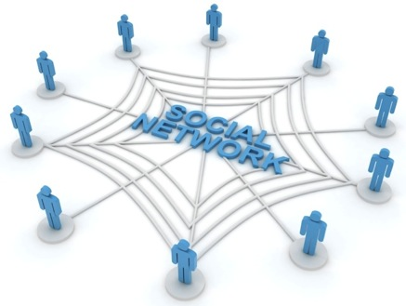
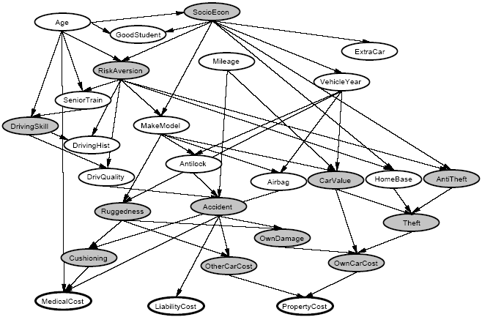
Graphs are Everywhere
Social Network
Collaborative Filtering
Users
Netflix
Movies
Probabilistic Analysis
Text Analysis
Docs
Wiki
Words
Notes:
This idea has lots of applications. Might be infering interests about people in a social network,
>>> Collaborative filtering: trying to predict movie ratings of each user given a sparse matrix of movie ratings from all users. Matrix = BIPARTITE GRAPH where you have users on one side and movies on the other.
>>> Textual analysis: e.g. detecting user sentiment regarding product reviews on a website like Amazon.
>>> relate random variables.

Slide 28







Properties of Graph Parallel Algorithms
Dependency
Graph
Factored
Computation
Iterative
Computation
What I Like
What My Friends Like
Notes:
Taking a step back – the big picture here is that this is one example of many GRAPH PARALLEL algorithms that have the following properties.
There is significant information in the dependencies between different pieces of data, and we can represent those dependencies very naturally using a graph.
As a result computation factors into different local vertex neighborhoods in the graph, depends directly only on those neighborhoods.
And because the graph has many chains of connections, we need to ITERATE the local computation, PROPAGATING information around the graph.

Slide 29
ML Tasks Beyond Data-Parallelism
Data-Parallel Graph-Parallel
Map Reduce
?
Feature
Extraction
Cross
Validation
Graphical Models
Gibbs Sampling
Belief Propagation
Variational Opt.
Semi-Supervised Learning
Label Propagation
CoEM
Computing Sufficient
Statistics
Collaborative
Filtering
Tensor Factorization
Graph Analysis
PageRank
Triangle Counting
Notes:
There’s a large universe of applications that fit nicely into graph-parallel algorithms
What kind of framework would be a good target for these applications?

Slide 30
The GraphLab Framework
Graph Based
Data Representation
Update Functions
User Computation
Consistency Model
Notes:
So the high-level view of GraphLab is that it has three main parts, first a graph based data representation. Second, a way for the user to express computation through update functions, and finally a consistency model. So let’s take the three parts in turn.

Slide 31
Data Graph
Data is associated with both vertices and edges
Graph:
Social Network
Vertex Data:
User profile
Current interests estimates
Edge Data:
Relationship
(friend, classmate, relative)
Notes:
GraphLab stores the program state as a directed graph called the Data Graph.

Slide 32
Distributed Data Graph
Partition the graph across multiple machines:
Notes:
Cut along edges
SEGUE: So we have missing pieces of data from each node’s viewpoint. So this means that a LOCAL data fetch becomes a REMOTE data fetch.

Slide 33
Distributed Data Graph
Ghost vertices maintain adjacency structure and replicate remote data.
“ghost” vertices
Notes:
So the ghost vertices live locally, maintaining adjacency. They replicate data locally so that it can be read quickly.

Slide 34
The GraphLab Framework
Graph Based
Data Representation
Update Functions
User Computation
Consistency Model
Notes:
Given the data at each node, what can the user do with it? The update function lets the user express that.

Slide 35
Update Function
A user-defined program, applied to a vertex; transforms data in scope of vertex
Pagerank(scope){
// Update the current vertex data
// Reschedule Neighbors if needed
if vertex.PageRank changes then
reschedule_all_neighbors;
}
Update function applied (asynchronously)
in parallel until convergence
Many schedulers available to prioritize computation
Selectively triggers computation at neighbors
Notes:
An update function is a stateless procedure that modifies the data within the
>>> SCOPE of a vertex (all edges and adjacent nodes). The update function also SCHEDULES the future execution of update functions on OTHER VERTICES.
>>> So for e.g. if we are computing the Google PageRank of a web page, each vertex = a web page, each edge = hyperlink from one web page to another.
>>> PageRank is a weighted sum. When one page's PageRank changes, ONLY its neighbors needs to be recomputed!
>>> SEGUE: GraphLab applies the update functions in parallel until the entire computation converges.

Slide 36

Distributed Scheduling
Each machine maintains a schedule over the vertices it owns
a
f
b
d
a
b
c
h
c
g
e
f
g
h
i
j
k
i
j
Distributed Consensus used to identify completion
Notes:
Each machine maintains a separate SCHEDULE of vertices waiting to be run. Serially pulls tasks from its local scheduler queue and runs the user update functions.
>>> One machine's scheduler may result in added tasks on another's schedule if it processes a vertex adjacent to ghost vertices.

Slide 37
Ensuring Race-Free Code
How much can computation overlap?
Notes:
So we are in an asynchronous, dynamic computation environment.
We mostly want to prevent race conditions, where two updates are writing or reading/writing to the same vertex or edge.

Slide 38
The GraphLab Framework
Graph Based
Data Representation
Update Functions
User Computation
Consistency Model
Notes:
To address this, let’s now move on to the consistency model.

Slide 39
PageRank Revisited
Pagerank(scope) {
…
}
Notes:
So let’s revisit the core piece of computation and see how it behaves if we allow it to race.

Slide 40
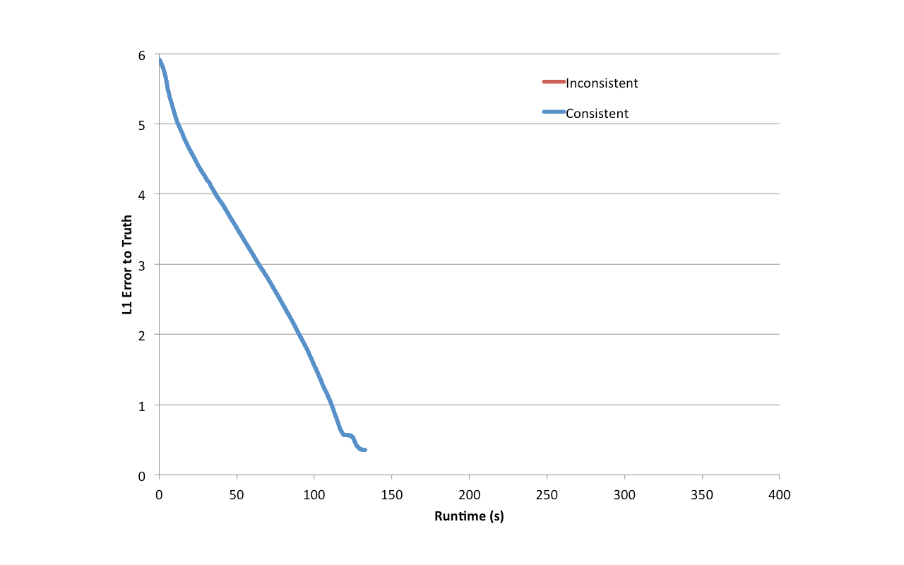
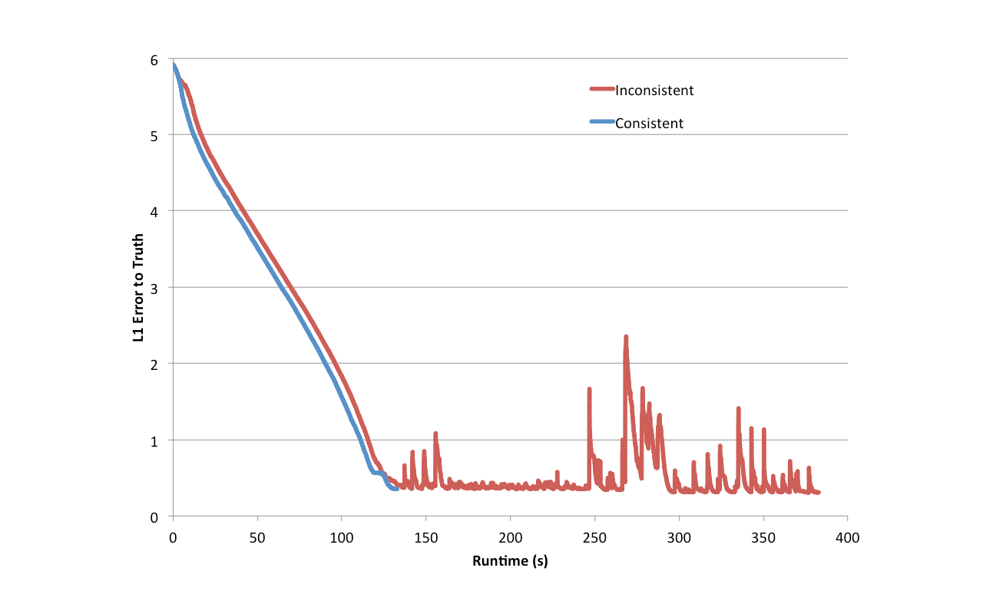
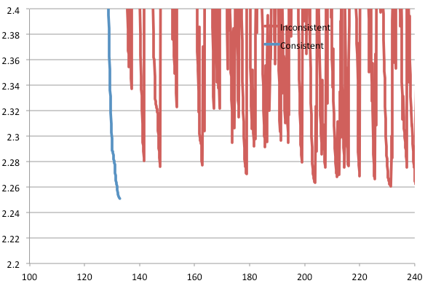
PageRank data races confound convergence
Notes:
This was actually encountered in user code!
Plot error to ground truth over time. If we can run consistently. Converges just fine; but if we don’t:
>>> zoom in. Fluctures near convergence and never quite gets there.
SEGUE: Now, PageRank is provably convergent under inconsistency, yet it does not converge. Why?

Slide 41
Racing PageRank: Bug
Pagerank(scope) {
…
}
Notes:
Take a look at the code again. Can we see the problem?
A vertex’s PageRank fluctuates when its neighbors read it because we are writing directly to the vertex PageRank value. This results in the propagation of bad values.

Slide 42
Racing PageRank: Bug Fix
Pagerank(scope) {
…
}
tmp
tmp
Notes:
Solution is to store in a TEMPORARY variable, and only modify the vertex ONCE at the end.
- First problem: without consistency, the programmer has to be constantly aware of that fact and be careful to code around it.

Slide 43
Throughput != Performance
No Consistency
Higher Throughput
(#updates/sec)
Potentially Slower Convergence of ML
Notes:
Conventional wisdom is that ML algorithms are robust to inconsistency, so ignore this issue (allow computation to race) and it will still work out.
BUT higher throughput does not mean that the algorithm converges faster.

Slide 44
Serializability
For every parallel execution, there exists a sequential execution of update functions which produces the same result.
CPU 1
time
Parallel
CPU 2
Sequential
Single
CPU
Notes:
So as we saw before in this class, we can define race free operation using the notion of SERIALIZABILITY.
>>> Suppose we have a graph with three vertices, and two CPUs are running update functions on these three vertices IN PARALLEL.
>>> The execution is serializable there exists a corresponding serial schedule of update functions that when executed sequentially produces the SAME VALUES in the data-graph.

Slide 45
Serializability Example
Write
Stronger / Weaker
consistency levels available
User-tunable consistency levels
trades off parallelism & consistency
Read
Overlapping regions
are only read.
Update functions one vertex apart can be run in parallel.
Edge Consistency
Notes:
So if we ensure each update function has exclusive read-write access to its vertex and adjacent edges but read only access to adjacent vertices, then
>>> there will be NO conflicts if update functions separate by one vertex apart from each other run at the same time
>>> (both are READING from the overlapping regions).
>>> GraphLab calls this EDGE CONSISTENCY.

Slide 46
Distributed Consistency
Solution 1: Chromatic Engine
Edge Consistency via Graph Coloring
Solution 2: Distributed Locking
Notes:
So to achieve edge consistency GraphLab has TWO algorithms. The first is called the Chromatic Engine.
Vertices of the same color are all at least one vertex apart.
Therefore, all vertices of the same color can be run in parallel!

Slide 47
Chromatic Distributed Engine
Execute tasks
on all vertices of
color 0
Execute tasks
on all vertices of
color 0
Ghost Synchronization Completion + Barrier
Time
Execute tasks
on all vertices of
color 1
Execute tasks
on all vertices of
color 1
Ghost Synchronization Completion + Barrier
Notes:
The chromatic distributed engine takes turns with different colors, executing tasks on all vertices of the same color in parallel.
>>> It puts a synchronization BARRIER after every color, so waits for all the tasks for a certain color to finish before proceeding.
>>> Iterates with successive colors.

Slide 48
Matrix Factorization
Netflix Collaborative Filtering
Alternating Least Squares Matrix Factorization
Model: 0.5 million nodes, 99 million edges
Users
Users
Movies
Netflix
D
D
Movies
Notes:
Let's now look at an application that uses the Chromatic Engine, it's the Netflix collaborative filtering application.
Here the bipartite graph can be represented equivalently as this red sparse matrix relating users to movies they like.
We seek a FACTORIZATION of the RED Netflix matrix into two narrower matrices, each of dimension D on one side.

Slide 49

Netflix Collaborative Filtering
vs 4 machines
Ideal
MPI
Hadoop
D=100
D=20
GraphLab
# machines
# machines
(D = 20)
Notes:
Higher D produces higher accuracy while increasing computational cost. X-AXIS is number of machines. Y-AXIS is the speedup relative to FOUR machines. RED curve shows the ideal speedup relative to four machines, linear with slope 1/4. The gap to ideal is the amount of OVERHEAD GraphLab’s chromatic engine introduces.
>>> Now comparing on the Y-AXIS the absolute RUNTIME of the collaborative filtering task, we see that GraphLab is able to slightly outperform the hand-coded MPI implementation! Surprising! Also two orders of magnitude better than the Hadoop MapReduce framework.

Slide 50
Distributed Consistency
Solution 1: Chromatic Engine
Edge Consistency via Graph Coloring
Requires a graph coloring to be available
Frequent barriers → inefficient when only some vertices active
Solution 2: Distributed Locking
Notes:
For complex and/or very large graphs, the user cannot provide a graph coloring, it's too computationally expensive. And we cannot use the chromatic engine to find a graph coloring.
Frequent Barriers make it extremely inefficient for highly dynamic systems where only a small number of vertices are active in each round.

Slide 51

Distributed Locking
Edge Consistency can be guaranteed through locking.
: RW Lock
Notes:
We associate a rw-lock with each vertex.

Slide 52
Consistency Through Locking
Acquire write-lock on center vertex, read-lock on adjacent.
Performance problem: Acquiring a lock from a neighboring machine incurs a latency penalty
Notes:
- write on center, read on adjacent, taking care to acquire locks in canonical ordering
- read lock acquired more than once
minor variations.
SEGUE: But a problem with this is that the communication required to grab a lock on a piece of data that a neighboring machine owns is significant.

Slide 53
Simple locking
lock scope 1
Process request 1
Time
scope 1 acquired
update_function 1
release scope 1
Process release 1
Notes:
- visualize
- acquire a remote lock, send a message.
- only when locks are acquire then machine can run the update function.

Slide 54
Pipelining hides latency
GraphLab Idea: Hide latency using pipelining
lock scope 1
lock scope 2
Process request 1
Time
lock scope 3
Process request 2
scope 1 acquired
Process request 3
scope 2 acquired
scope 3 acquired
update_function 1
release scope 1
update_function 2
Process release 1
release scope 2
Notes:
- large number (10K) simultaneous.
- update function when locks ready. In flight.
- Hide latency of individual.

Slide 55
Distributed Consistency
Solution 1: Chromatic Engine
Edge Consistency via Graph Coloring
Requires a graph coloring to be available
Frequent barriers → inefficient when only some vertices active
Solution 2: Distributed Locking
Residual BP on 190K-vertex/560K-edge graph, 4 machines
No pipelining: 472 sec; with pipelining: 10 sec
Notes:
47 times speedup.

Slide 56
How to handle machine failure?
What when machines fail? How do we provide fault tolerance?
Strawman scheme: Synchronous snapshot checkpointing
Stop the world
Write each machines’ state to disk

Slide 57
Snapshot Performance
No Snapshot
Snapshot
How can we do better, leveraging GraphLab’s consistency mechanisms?
Snapshot time
One slow machine
Slow machine
Notes:
- evaluate behavior. Plot progress.
- linear progress
- Introduce one slow machine into the system
Because we have to stop the world, one slow machine slows everything down!

Slide 58
Chandy-Lamport checkpointing
Step 1. Atomically one initiator
(a) Turns red, (b) Records its own state (c) sends marker to neighbors
Step 2. On receiving marker non-red node atomically: (a) Turns red,
(b) Records its own state, (c) Sends markers along all outgoing channels
First-in, first-out channels between nodes
Implemented within GraphLab as an Update Function
Notes:
Bank balance example -- describe.

Slide 59
Async. Snapshot Performance
No Snapshot
Snapshot
One slow machine
No system performance penalty incurred from the slow machine!
Notes:
Lets see the behavior of this Asynchronous Snapshot procedure.
Instead of a flat-line, we get a little curve.

Slide 60
GraphLab Summary
Two different methods of achieving consistency
Graph Coloring
Distributed Locking with pipelining
Efficient implementations
Asynchronous FT w/fine-grained Chandy-Lamport
Notes:
Extended GraphLab abstraction to distributed systems

Slide 61
Next topic:
Streaming Data Processing
and Cluster Coordination

