Slide 1
Consensus and Paxos
CS 240: Computing Systems and Concurrency
Lecture 12
Marco Canini
Credits: Michael Freedman and Kyle Jamieson developed much of the original material.

Slide 2
Today
Consensus in distributed systems
FLP impossibility
Paxos

Slide 3

Recall the use of Views
Let different replicas assume role of primary over time
System moves through a sequence of views
How do the nodes agree on view / primary?
P
View #3, #6, …
P
View #1, #4, …
P
View #2, #5, …
Notes:
So the BIG IDEA is to allow different replicas to become PRIMARY, in other words the system moves through a SEQUENCE of what we call VIEWS.
In each VIEW there is a DIFFERENT DESIGNATED PRIMARY, and each view is numbered with a VIEW NUMBER.

Slide 4
Consensus
Definition:
A general agreement about something
An idea or opinion that is shared by all the people in a group

Slide 5
Consensus
Given a set of processes, each with an initial value:
Termination: All non-faulty processes eventually decide on a value
Agreement: All processes that decide do so on the same value
Validity: The value that has been decided must have been proposed by some process

Slide 6
Consensus used in systems
Group of servers attempting:
Make sure all servers in group receive the same updates in the same order as each other
Maintain own lists (views) on who is a current member of the group, and update lists when somebody leaves/fails
Elect a leader in group, and inform everybody
Ensure mutually exclusive (one process at a time only) access to a critical resource like a file

Slide 7
Can we achieve consensus?

Slide 8
Step one: Define your system model
Network model:
  Synchronous (time-bounded delay) or asynchronous (arbitrary delay)
  Reliable or unreliable communication
  Unicast or multicast communication
Node failures:
  Crash (correct/dead) or Byzantine (arbitrary)
(Left options indicate an “easier” setting.)

Slide 9
Step one: Define your system model
Network model:
  Synchronous (time-bounded delay) or asynchronous (arbitrary delay)
  Reliable or unreliable communication
  Unicast or multicast communication
Node failures:
  Crash (correct/dead) or Byzantine (arbitrary)
(Left options indicate an “easier” setting.)

Slide 10
Consensus is impossible

Slide 11
Today
Consensus in distributed systems
FLP impossibility
Paxos

Slide 12
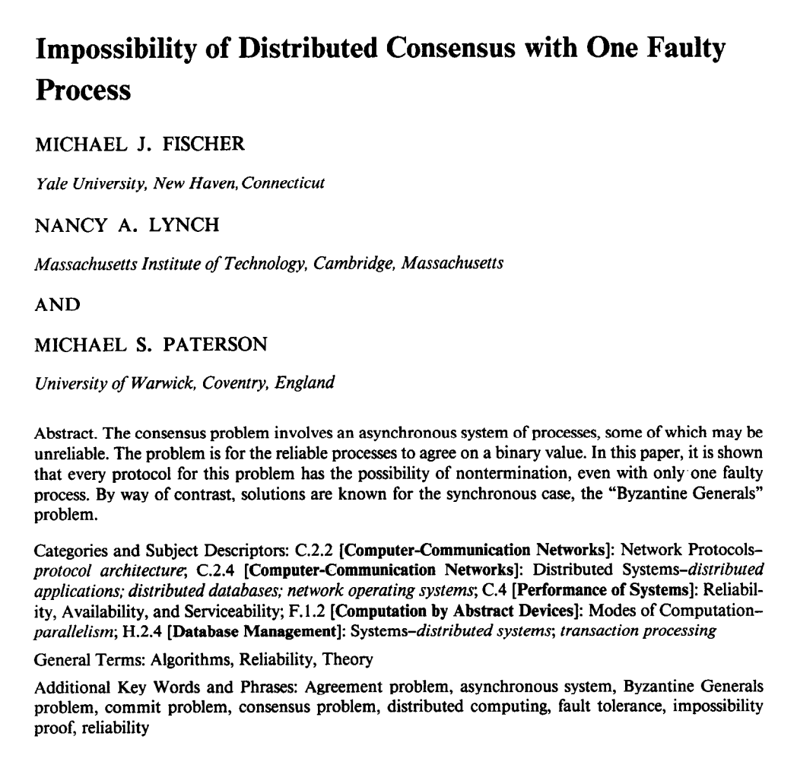
“FLP” result
No deterministic 1-crash-robust consensus algorithm exists with asynchronous communication

Slide 13
FLP’s weak assumptions
Only 1 failure
  Also impossible for more failures
For “weak” consensus (only some process needs to decide)
  Also impossible for real consensus
For reliable communication
  Also impossible for unreliable communication
For only two states: 0 and 1
  Also impossible for more failures
For crash failures
  Also impossible for Byzantine failures

Slide 14
FLP’s strong assumptions
Deterministic actions at each node
Asynchronous network communication
All “runs” must eventually achieve consensus

Slide 15
Main technical approach
Initial state of system can end in decision “0” or “1”
Consider 5 processes, each in some initial state
    [ 1,1,1,1,1 ] → 1
    [ 1,1,1,1,0 ] → ?
    [ 1,1,1,0,0 ] → ?
    [ 1,1,0,0,0 ] → ?
    [ 1,0,0,0,0 ] → 0
Must exist two configurations here which differ in decision

Slide 16
Main technical approach
Initial state of system can end in decision “0” or “1”
Consider 5 processes, each in some initial state
    [ 1,1,1,1,1 ] → 1
    [ 1,1,1,1,0 ] → 1
    [ 1,1,1,0,0 ] → 1
    [ 1,1,0,0,0 ] → 0
    [ 1,0,0,0,0 ] → 0
Assume decision differs between these two processes

Slide 17
Main technical approach
Goal: Consensus holds in face of 1 failure
    [ 1,1,0,0,0 ] →
    [ 1,1,1,0,0 ] →
One of these configurations must be “bi-valent” (i.e., undecided):
Both futures possible
1 | 0
0

Slide 18
Main technical approach
Goal: Consensus holds in face of 1 failure
    [ 1,1,0,0,0 ] →
    [ 1,1,1,0,0 ] →
Inherent non-determinism from asynchronous network
Key result: All bi-valent states can remain in bi-valent states after performing some work
One of these configurations must be “bi-valent” (i.e., undecided):
Both futures possible
1
0 | 1

Slide 19
Staying bi-valent forever
  System thinks process p failed, adapts to it…
  But no, p was merely slow, not failed…
  (Can’t tell the difference between slow and failed.)
  System think process q failed, adapts to it…
  But no, q was merely slow, not failed…
  Repeat ad infinitum …

Slide 20
Consensus is impossible
But, we achieve consensus all the time…

Slide 21
FLP’s strong assumptions
Deterministic actions at each node
  Randomized algorithms can achieve consensus
Asynchronous network communication
  Synchronous or even partial synchrony is sufficient
All “runs” must eventually achieve consensus
  In practice, many “runs” achieve consensus quickly
  In practice, “runs” that never achieve consensus happen vanishingly rarely
    Both are true with good system designs

Slide 22
Consensus is possible
With Paxos!

Slide 23
Today
Consensus in distributed systems
FLP impossibility
Paxos

Slide 24
Consensus
Given a set of processes, each with an initial value:
Termination: All non-faulty processes eventually decide on a value ← Good thing that eventually should happen
Agreement: All processes that decide do so on the same value ← Bad thing that should never happen
Validity: The value that has been decided must have been proposed by some process ← Bad thing that should never happen

Slide 25
Recall: Safety vs liveness properties
Safety (bad things never happen)
Liveness (good things eventually happen)

Slide 26
Paxos properties
Safety
  Only a single value is chosen
  Only chosen values are learned by processes
  Only a proposed value can be chosen
Liveness
  Some proposed value eventually chosen if fewer than half of processes fail
  If value is chosen, a process eventually learns it
agreement
validity
termination

Slide 27
Paxos’ safety and liveness
Paxos is always safe
Paxos is very often live
  But not always live

Slide 28
Roles of a process
Three conceptual roles
  Proposers propose values
  Acceptors accept values, where chosen if majority accept
  Learners learn the outcome (chosen value)
In reality, a process can play any/all roles

Slide 29
Strawman
3 proposers, 1 acceptor
  Acceptor accepts first value received
  No liveness on failure
3 proposals, 3 acceptors
  Accept first value received, acceptors choose common value known by majority
  But no such majority is guaranteed
Notes:
No liveness w/ 1 failure -> need multiple acceptors
No majority guaranteed -> need acceptors to be capable of accepting multiple values

Slide 30
Paxos
Each acceptor accepts multiple proposals
  Hopefully one of multiple accepted proposals will have a majority vote (and we determine that)
  If not, rinse and repeat (more on this)
How do we select among multiple proposals?
  Ordering: proposal is tuple (proposal #, value) = (n, v)
  Proposal # strictly increasing, globally unique
  Globally unique?
    Trick: set low-order bits to proposer’s ID

Slide 31
Paxos Protocol Overview
Proposers:
  Choose a proposal number n
  Ask acceptors if any accepted proposals with n_{a} < n
  If existing proposal v_{a} returned, propose same value (n, v_{a})
  Otherwise, propose own value (n, v)
  Note altruism: goal is to reach consensus, not “win”
Acceptors try to accept value with highest proposal n
Learners are passive and wait for the outcome

Slide 32
Paxos Phase 1
Proposer:
  Choose proposal number n, send <prepare, n> to acceptors
Acceptors:
  If n > n_{h}
    n_{h} = n ← promise not to accept any new proposals n’ < n
    If no prior proposal accepted
      Reply < promise, n, Ø >
    Else
      Reply < promise, n, (n_{a ,} v_{a}) >
  Else
    Reply < prepare-failed >

Slide 33
Paxos Phase 2
Proposer:
  If receive promise from majority of acceptors,
    Determine v_{a} returned with highest n_{a}, if exists
    Send <accept, (n, v_{a} || v)> to acceptors
Acceptors:
  Upon receiving <accept, (n, v)>, if n ≥ n_{h},
    Accept proposal and notify learner(s)
      n_{a} = n_{h} = n
      v_{a} = v

Slide 34
Paxos Phase 3
Learners need to know which value chosen
Approach #1
  Each acceptor notifies all learners
  More expensive
Approach #2
  Elect a “distinguished learner”
  Acceptors notify elected learner, which informs others
  Failure-prone

Slide 35
Paxos: Well-behaved Run
1
1
1
1
1
2
2
2
.
.
.
<accept,
(1,v₁)>
.
.
.
.
.
.
decide
v₁
<prepare, 1>
<promise, 1>
n
n
n
<accepted, (1 ,v₁)>

Slide 36
Paxos is safe
Intuition: if proposal with value v decided, then every higher-numbered proposal issued by any proposer has value v.
Majority of acceptors accept (n, v):
v is decided
Next prepare request with proposal n+1

Slide 37
Race condition leads to liveness problem
Process 0
Process 1
Completes phase 1 with proposal n0
Starts and completes phase 1 with proposal n1 > n0
Performs phase 2, acceptors reject
Restarts and completes phase 1 with proposal n2 > n1
Performs phase 2, acceptors reject
… can go on indefinitely …

Slide 38
Paxos summary
Described for a single round of consensus
Often implemented with nodes playing all roles
Always safe
  Quorum intersection
Often live
  “FLP Scenario” prevents it from always being live
Acceptors accept multiple values
  But only one value is ultimately chosen
Once a value is accepted by a majority it is chosen
Can tolerate failures f < N / 2 (aka, 2f+1 nodes)

Slide 39
Flavors of Paxos
Terminology is a mess
Paxos loosely, and confusingly defined…
We’ll stick with
  Basic Paxos
  Multi-Paxos

Slide 40
Flavors of Paxos: Basic Paxos
Run the full protocol each time
  e.g., for each slot in the command log
Takes 2 rounds until a value is chosen
“FLP Scenario” is dueling proposers

Slide 41
Flavors of Paxos: Multi-Paxos
Elect a leader and have it run the 2nd phase directly
  e.g., for each slot in the command log
  Leader election uses Basic Paxos
Takes 1 round until a value is chosen
  Faster than Basic Paxos
“FLP Scenario” is dueling proposers during leader election
  Rarer than Basic Paxos
Used extensively in practice!

Slide 42
Consensus takeaways
Consensus: Terminating agreement on a valid proposal
Consensus is impossible to always achieve
  FLP result
Consensus is possible to achieve in practice
  With Multi-Paxos
    Mostly happens in a single round to the nearest quorum
    Sometimes takes a single round to a further quorum
    Rarely takes multiple rounds to elect a new leader and for that node to get the request accepted
    Runs exist where no new leader is ever elected

Slide 43
Next topic:
Consensus protocol with group membership + leader election at core
RAFT (assignment 3)

