Slide 1
Concurrency Control
CS 240: Computing Systems and Concurrency
Lecture 17
Marco Canini
Credits: Michael Freedman and Kyle Jamieson developed much of the original material. Contents adapted from Wyatt Lloyd.

Slide 2
Let’s Scale Strong Consistency!
Transactions and Atomic Commit review
Serializability
Strict serializability
Concurrency Control:
Two-phase locking (2PL)
Optimistic concurrency control (OCC)

Slide 3
The transaction
Definition: A unit of work:
May consist of multiple data accesses or updates
Must commit or abort as a single atomic unit
Transactions can either commit, or abort
When commit, all updates performed on data are made permanent, visible to other transactions
When abort, data restored to a state such that the aborting transaction never executed
Notes:
The key technique we have for doing that is called a transaction. A transaction is a concept from databases, but useful to have in your distributed systems “toolbox.”

Slide 4
Transaction examples
Bank account transfer
A -= $100
B += $100
Maintaining symmetric relationships
A FriendOf B
B FriendOf A

Slide 5
Defining properties of transactions
Atomicity: Either all constituent operations of the transaction complete successfully, or none do
Consistency: Each transaction in isolation preserves a set of integrity constraints on the data
Isolation: Transactions’ behavior not impacted by presence of other concurrent transactions
Durability: The transaction’s effects survive failure of volatile (memory) or non-volatile (disk) storage
Notes:
The set of defining properties of transactions goes by the mnemonic ACID.
Consistency: e.g., we may stipulate the constraint that a bank account balance cannot be negative.

Slide 6
Atomic Commit
Atomic: All or nothing
Either all participants do something (commit) or no participant does anything (abort)
Common use: commit a transaction that updates data on different shards

Slide 7
Relationship with replication
Replication (e.g., RAFT) is about doing the same thing multiple places to provide fault tolerance
Sharding is about doing different things multiple places for scalability
Atomic commit is about doing different things in different places together

Slide 8
Relationship with replication
Replication Dimension
A-F
A-F
A-F
Sharding Dimension
G-L
G-L
G-L
M-R
M-R
M-R
S-Z
S-Z
S-Z

Slide 9
Focus on sharding for today
Replication Dimension
A-F
A-F
A-F
Sharding Dimension
G-L
G-L
G-L
M-R
M-R
M-R
S-Z
S-Z
S-Z

Slide 10
Atomic Commit
Atomic: All or nothing
Either all participants do something (commit) or no participant does anything (abort)
Atomic commit is accomplished with the Two-phase commit protocol (2PC)

Slide 11
Let’s Scale Strong Consistency!
Transactions and Atomic Commit review
Serializability
Strict serializability
Concurrency Control:
Two-phase locking (2PL)
Optimistic concurrency control (OCC)

Slide 12
Two concurrent transactions
transaction transfer(A, B):
begin_tx
a ← read(A)
if a < 10 then abort_tx
else write(A, a−10)
b ← read(B)
write(B, b+10)
commit_tx
transaction sum(A, B):
begin_tx
a ← read(A)
b ← read(B)
print a + b
commit_tx
Notes:
So let's think back to our TRANSFER transaction, and now let's think about how it may interact with another transaction SUM that reads both bank accounts.

Slide 13
Isolation between transactions
Isolation: sum appears to happen either completely before or completely after transfer
i.e., it appears that all operations of a transaction happened together
sometimes called before-after atomicity
Schedule for transactions is an ordering of the operations performed by those transactions

Slide 14
Problem for concurrent execution: Inconsistent retrieval
Serial execution of transactions—transfer then sum:
transfer: r_{A} w_{A} r_{B} w_{B} ©
sum: r_{A} r_{B} ©
Concurrent execution resulting in inconsistent retrieval, result differing from any serial execution:
transfer: r_{A} w_{A} r_{B} w_{B} ©
sum: r_{A} r_{B} ©
Time →
© = commit
debit
credit
debit
credit
Notes:
Initially accounts both have $100: expect sum to print $200. Any serial execution of the two transactions will print $200.
>>> BUT there are some operation interleavings that will result in the sum transaction seeing an inconsistent state of the database in which $10 is debited from account A but not yet credited into account B.

Slide 15
Isolation between transactions
Isolation: sum appears to happen either completely before or completely after transfer
i.e., it appears that all operations of a transaction happened together
sometimes called before-after atomicity
Given a schedule of operations:
Is that schedule in some way “equivalent” to a serial execution of transactions?
Notes:
So we’d like to formulate a way of understanding whether a schedule is equivalent in some kind of way to a serial schedule.

Slide 16
Equivalence of schedules
Two operations from different transactions are conflicting if:
They read and write to the same data item
The write and write to the same data item
Two schedules are equivalent if:
They contain the same transactions and operations
They order all conflicting operations of non-aborting transactions in the same way
Notes:
So to define equivalent schedules, let’s first start with the individual operations.

Slide 17
Serializability
Ideal isolation semantics: serializability
A schedule is serializable if it is equivalent to some serial schedule
i.e., non-conflicting operations can be reordered to get a serial schedule
Notes:
So b/c we're thinking about conflicts between ops, this way of thinking about isolation between transactions is called conflict serializability.

Slide 18
A serializable schedule
Ideal isolation semantics: serializability
A schedule is serializable if it is equivalent to some serial schedule
i.e., non-conflicting operations can be reordered to get a serial schedule
transfer: r_{A} w_{A} r_{B} w_{B} ©
sum: r_{A} r_{B} ©
Time →
© = commit
r_{A}
Serial schedule
Conflict-free!
Notes:
So, consider this schedule, where the sum transaction reads each account just after the transfer writes the respective account. Now I’ll show you why this schedule is SERIALIZABLE.
>>> Two reads don’t conflict
>>> A read and write to different data items don’t conflict
>>> So we can reorder the read from account A to get a serial execution, so the schedule we started with is serializable

Slide 19
A non-serializable schedule
Ideal isolation semantics: serializability
A schedule is serializable if it is equivalent to some serial schedule
i.e., non-conflicting operations can be reordered to get a serial schedule
transfer: r_{A} w_{A} r_{B} w_{B} ©
sum: r_{A} r_{B} ©
Time →
© = commit
But in a serial schedule, sum’s reads either both before w_{A} or both after w_{B}
Conflicting ops
Conflicting ops
Notes:
Now consider this schedule, where the SUM transaction reads BOTH accounts just after TRANSFER writes account A. Now I’ll show you why this schedule is NOT SERIALIZABLE.
>>> >>> The read and write to same respective data items DO CONFLICT
>>> So that means that we can’t move them there, so this schedule is NOT SERIALIZABLE.

Slide 20
Serializability versus linearizability
Linearizability: a guarantee about single operations on single objects
Once write completes, all later reads (by wall clock) should reflect that write
Serializability is a guarantee about transactions over one or more objects
Doesn’t impose real-time constraints
Strict serializability = Serializability + real-time ordering
Intuitively Serializability + Linearizability
Transaction behavior equivalent to some serial execution
And that serial execution agrees with real-time
Notes:
Strict serializability: The equivalent serial order cannot re-order commit-to-begin_tx ordering.

Slide 21
Consistency Hierarchy
Strict Serializability
e.g., Spanner
Linearizability
e.g., RAFT
Sequential Consistency
Causal+ Consistency
e.g., Bayou
Eventual Consistency
e.g., Dynamo

Slide 22
Testing for serializability
Each node t in the precedence graph represents a transaction t
Edge from s to t if some action of s precedes and conflicts with some action of t
Notes:
So an easy way of testing for serializability is by constructing a precedence graph.

Slide 23
Serializable schedule, acyclic graph
Each node t in the precedence graph represents a transaction t
Edge from s to t if some action of s precedes and conflicts with some action of t
transfer: r_{A} w_{A} r_{B} w_{B} ©
sum: r_{A} r_{B} ©
Time →
© = commit
Serializable
transfer
sum
Notes:
So in the first example schedule, there is an edge from the TRANSFER transaction to the SUM transaction because there are conflicting writes, in this case before each read.

Slide 24
Non-serializable schedule, cyclic graph
Each node t in the precedence graph represents a transaction t
Edge from s to t if some action of s precedes and conflicts with some action of t
transfer: r_{A} w_{A} r_{B} w_{B} ©
sum: r_{A} r_{B} ©
Time →
© = commit
Non-serializable
transfer
sum
Notes:
Whereas in the second example schedule, there's an edge from transfer to sum because of the conflicting write before read, then ANOTHER edge from SUM to TRANSFER because of sum's read before transfer's write.

Slide 25
Testing for serializability
Each node t in the precedence graph represents a transaction t
Edge from s to t if some action of s precedes and conflicts with some action of t
In general, a schedule is serializable if and only if its precedence graph is acyclic
Notes:
And so it turns out that this is true in general: a schedule is conflict serializable iff its precedence graph is acyclic.

Slide 26
Let’s Scale Strong Consistency!
Transactions and Atomic Commit review
Serializability
Strict serializability
Concurrency Control:
Two-phase locking (2PL)
Optimistic concurrency control (OCC)

Slide 27
Concurrency Control
Concurrent execution can violate serializability
We need to control that concurrent execution so we do things a single machine executing transactions one at a time would
Concurrency control

Slide 28
Concurrency Control Strawman #1
Big Global Lock
Acquire the lock when transaction starts
Release the lock when transaction ends
Provides strict serializability
Just like executing transaction one by one because we are doing exactly that
No concurrency at all
Terrible for performance: one transaction at a time

Slide 29
Locking
Locks maintained on each shard
Transaction requests lock for a data item
Shard grants or denies lock
Lock types
Shared: Need to have before read object
Exclusive: Need to have before write object
 | Shared (S) | Exclusive (X)
Shared (S) | Yes | No
Exclusive (X) | No | No
Notes:
So to improve performance, we let transactions run concurrently, but add another module to our system called lock manager that maintains locks on individual data items.

Slide 30
Concurrency Control Strawman #2
Grab locks independently, for each data item (e.g., bank accounts A and B)
transfer: ◢_{A} r_{A} w_{A} ◣_{A} ◢_{B} r_{B} w_{B} ◣_{B} ©
sum: ◿_{A} r_{A} ◺_{A} ◿_{B} r_{B} ◺_{B} ©
Time →
© = commit
◢ /◿ = eXclusive- / Shared-lock; ◣ / ◺ = X- / S-unlock
Permits this non-serializable interleaving
Notes:
So let's now try to use locking to guarantee a serializable schedule. A simple way of doing this is for each transaction to grab locks independently for each data item.
>>> SEGUE: Look at where TRANSFER releases its lock on A before writing B. This allowed SUM read B’s value TOO SOON.

Slide 31
Two-phase locking (2PL)
2PL rule: Once a transaction has released a lock it is not allowed to obtain any other locks
Growing phase when transaction acquires locks
Shrinking phase when transaction releases locks
In practice:
Growing phase is the entire transaction
Shrinking phase is during commit
Notes:
So that motivates the 2PL algorithm.

Slide 32
2PL provides strict serializability
2PL rule: Once a transaction has released a lock it is not allowed to obtain any other locks
transfer: ◢_{A} r_{A} w_{A} ◣_{A} ◢_{B} r_{B} w_{B} ◣_{B} ©
sum: ◿_{A} r_{A} ◺_{A} ◿_{B} r_{B} ◺_{B} ©
Time →
© = commit
◢ /◿ = X- / S-lock; ◣ / ◺ = X- / S-unlock
2PL precludes this non-serializable interleaving

Slide 33
2PL and transaction concurrency
2PL rule: Once a transaction has released a lock it is not allowed to obtain any other locks
transfer: ◿_{A} r_{A} ◢_{A} w_{A} ◿_{B} r_{B} ◢_{B} w_{B}✻©
sum: ◿_{A} r_{A} ◿_{B} r_{B}✻©
Time →
© = commit
◢ /◿ = X- / S-lock; ◣ / ◺ = X- / S-unlock; ✻ = release all locks
2PL permits this serializable, interleaved schedule
Notes:
On the other hand, 2PL allows transactions to execute concurrently, improving performance.

Slide 34
2PL doesn’t exploit all opportunities for concurrency
2PL rule: Once a transaction has released a lock it is not allowed to obtain any other locks
transfer: r_{A} w_{A} r_{B} w_{B} ©
sum: r_{A} r_{B} ©
Time →
© = commit
(locking not shown)
2PL precludes this serializable, interleaved schedule
Notes:
However 2PL doesn't exploit all opportunities for concurrency.
Once TRANSFER acquires an exclusive lock for its WRITE to A, sum can’t read in between transfer’s READ/WRITE to B.

Slide 35
Issues with 2PL
What do we do if a lock is unavailable?
Give up immediately?
Wait forever?
Waiting for a lock can result in deadlock
Transfer has A locked, waiting on B
Sum has B locked, waiting on A
Many ways to detect and deal with deadlocks
e.g., centrally detect deadlock cycles and abort involved transactions

Slide 36
Lets Scale Strong Consistency!
Atomic Commit
Two-phase commit (2PC)
Serializability
Strict serializability
Concurrency Control:
Two-phase locking (2PL)
Optimistic concurrency control (OCC)

Slide 37
2PL is pessimistic
Acquire locks to prevent all possible violations of serializability
But leaves a lot of concurrency on the table that is okay and available
Notes:
So that motivates the 2PL algorithm.

Slide 38
Be optimistic!
Goal: Low overhead for non-conflicting txns
Assume success!
Process transaction as if it would succeed
Check for serializability only at commit time
If fails, abort transaction
Optimistic Concurrency Control (OCC)
Higher performance when few conflicts vs. locking
Lower performance when many conflicts vs. locking

Slide 39
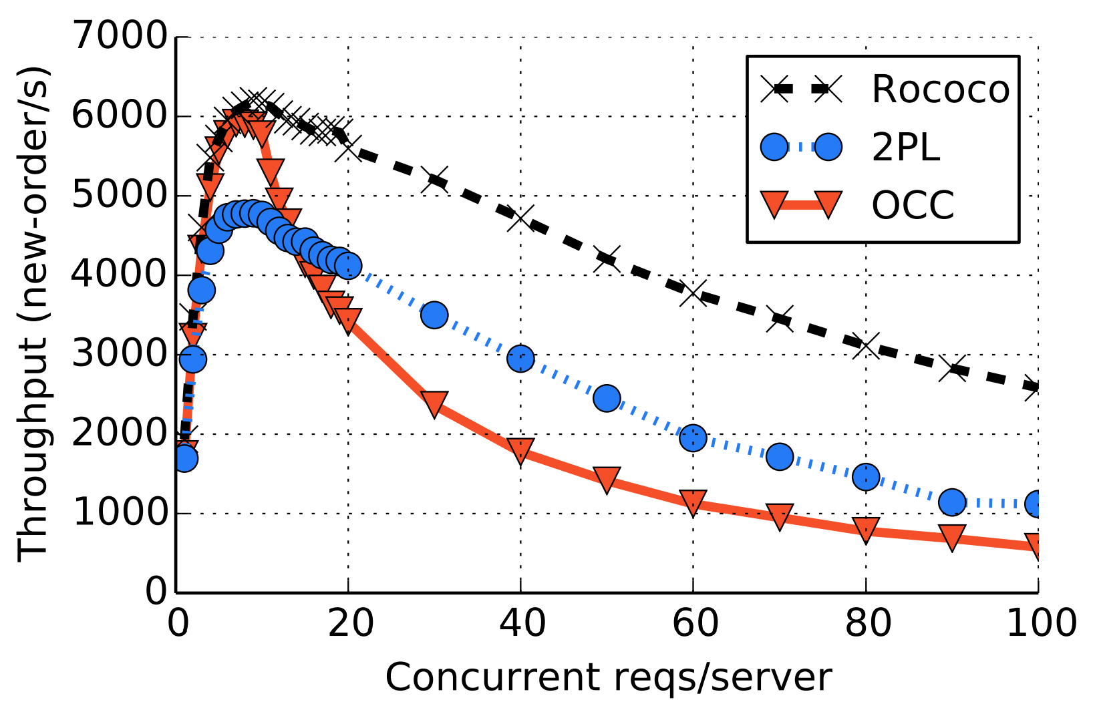
2PL vs OCC
Conflict Rate
From Rococo paper in OSDI 2014. Focus on 2PL vs. OCC.
Observe OCC better when write rate lower (fewer conflicts), worse than 2PL with write rate higher (more conflicts)

Slide 40
Optimistic Concurrency Control
Optimistic Execution:
Execute reads against shards
Buffer writes locally
Validation and Commit:
Validate that data is still the same as previously observed
(i.e., reading now would give the same result)
Commit the transaction by applying all buffered writes
Need this to all happen together, how?

Slide 41
Validation and Commit use 2PC
Client sends each shard a prepare
Prepare includes read values and buffered writes for each shard
Each shard acquires shared locks on read locations and exclusive locks on write locks
Each shard checks if read values validate
Each shard sends vote to client
If all locks acquired and reads validate => Vote Yes
Otherwise => Vote No
Client collects all votes, if all yes then commit
Client sends commit/abort to all shards
If commit: shards apply buffered writes
Shards release all locks
Notes:
Time to check t Time to use

