Slide 1
Big Data Processing
CS 240: Computing Systems and Concurrency
Lecture 19
Marco Canini
Credits: Michael Freedman and Kyle Jamieson developed much of the original material.
Selected content adapted from Wyatt Lloyd.

Slide 2
Data-Parallel Computation

Slide 3
Ex: Word count using partial aggregation
Compute word counts from individual files
Then merge intermediate output
Compute word count on merged outputs

Slide 4
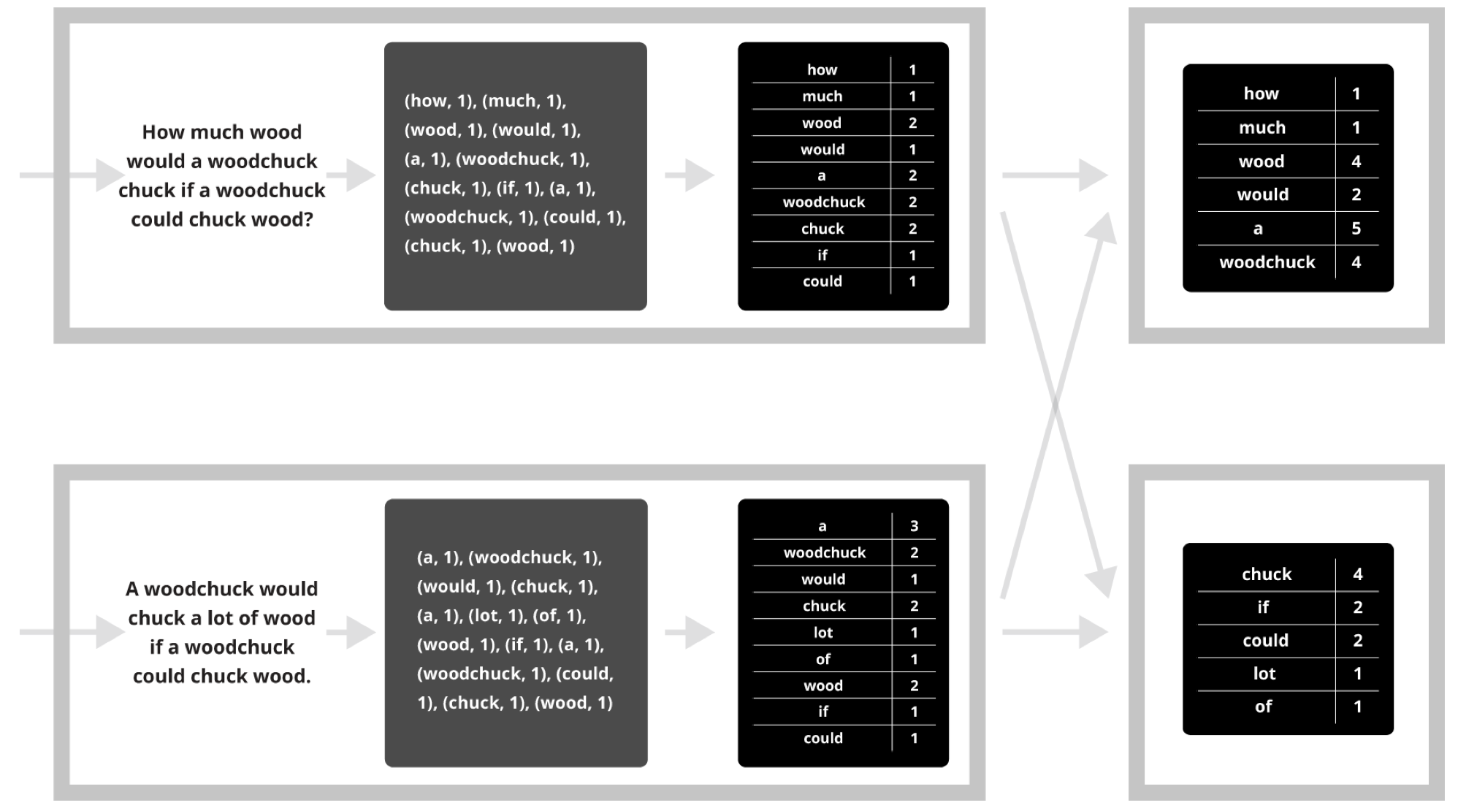
Putting it together…
map
combine
partition
(“shuffle”)
reduce

Slide 5
Synchronization Barrier

Slide 6
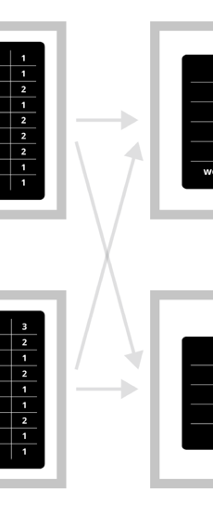
Fault Tolerance in MapReduce
Map worker writes intermediate output to local disk, separated by partitioning. Once completed, tells master node
Reduce worker told of location of map task outputs, pulls their partition’s data from each mapper, execute function across data
Note:
“All-to-all” shuffle b/w mappers and reducers
Written to disk (“materialized”) b/w each stage

Slide 7
Generality vs Specialization

Slide 8
General Systems
Can be used for many different applications
Jack of all trades, master of none
Pay a generality penalty
Once a specific application, or class of applications becomes sufficiently important, time to build specialized systems

Slide 9
MapReduce is a General System
Can express large computations on large data; enables fault tolerant, parallel computation
Fault tolerance is an inefficient fit for many applications
Parallel programming model (map, reduce) within synchronous rounds is an inefficient fit for many applications

Slide 10
MapReduce for Google’s Index
Flagship application in original MapReduce paper
Q: What is inefficient about MapReduce for computing web indexes?
“MapReduce and other batch-processing systems cannot process small updates individually as they rely on creating large batches for efficiency.”
Index moved to Percolator in ~2010 [OSDI ‘10]
Incrementally process updates to index
Uses OCC to apply updates
50% reduction in average age of documents

Slide 11
MapReduce for Iterative Computations
Iterative computations: compute on the same data as we update it
e.g., PageRank
e.g., Logistic regression
Q: What is inefficient about MapReduce for these?
Writing data to disk between all iterations is slow
Many systems designed for iterative computations, most notable is Apache Spark
Key idea 1: Keep data in memory once loaded
Key idea 2: Provide fault tolerance via lineage:
Save data to disks occasionally, remember computation that created later version of data. Use lineage to recompute data that is lost due to failure.

Slide 12
MapReduce for Stream Processing
Stream processing: Continuously process an infinite stream of incoming events
e.g., estimating traffic conditions from GPS data
e.g., identify trending hashtags on twitter
e.g., detect fraudulent ad-clicks
Q: What is inefficient about MapReduce for these?

Slide 13
Stream Processing Systems
Many stream processing systems as well, typical structure:
Definite computation ahead of time
Setup machines to run specific parts of computation and pass data around (topology)
Stream data into topology
Repeat forever
Trickiest part: fault tolerance!
Notably systems and their fault tolerance
Apache/Twitter Storm: Record acknowledgment
Spark Streaming: Micro-batches
Google Cloud dataflow: transactional updates
Apache Flink: Distributed snapshot
Specialization is much faster, e.g., click-fraud detection at Microsoft
Batch-processing system: 6 hours
w/ StreamScope[NSDI ‘16]: 20 minute average

Slide 14
In-Memory Data-Parallel Computation

Slide 15
Iterative Algorithms
MR doesn’t efficiently express iterative algorithms:
Iterations
Data
Data
Data
Data
CPU 1
CPU 1
CPU 1
Data
Data
Data
Data
Data
Data
Data
Data
Slow
Processor
CPU 2
CPU 2
CPU 2
Data
Data
Data
Data
Data
Data
Data
Data
CPU 3
CPU 3
CPU 3
Data
Data
Data
Data
Data
Data
Data
Data
Barrier
Barrier
Barrier
Notes:
Many ML algorithms ITERATIVELY REFINE their variables during operation.
MR doesn’t provide a mechanism to directly encode iterative computation, so you are forced to do something like this: put barriers in where all the computation waits for the barrier before proceeding.
If one processor is slow (common case) then whole system runs slowly.

Slide 16
MapAbuse: Iterative MapReduce
System is not optimized for iteration:
Iterations
Data
Data
Data
Data
CPU 1
CPU 1
CPU 1
Data
Data
Data
Data
Data
Data
Data
Data
CPU 2
CPU 2
CPU 2
Startup Penalty
Disk Penalty
Startup Penalty
Disk Penalty
Startup Penalty
Data
Data
Disk Penalty
Data
Data
Data
Data
Data
Data
CPU 3
CPU 3
CPU 3
Data
Data
Data
Data
Data
Data
Data
Data
Notes:
Finally there is a startup penalty associated with the storage and network delays of reading and writing to disk to make this barrier between stages. So the system isn’t optimized for iteration from a performance standpoint.

Slide 17
Spark: Resilient Distributed Datasets
Let’s think of just having a big block of RAM, partitioned across machines…
And a series of operators that can be executed in parallel across the different partitions
That’s basically Spark
A distributed memory abstraction that is both fault-tolerant and efficient

Slide 18
Spark: Resilient Distributed Datasets
Restricted form of distributed shared memory
Immutable, partitioned collections of records
Can only be built through coarse-grained deterministic transformations (map, filter, join, …)
They are called Resilient Distributed Datasets (RDDs)
Efficient fault recovery using lineage
Log one operation to apply to many elements
Recompute lost partitions on failure
No cost if nothing fails

Slide 19
Spark Programming Interface
Language-integrated API in Scala (+ Python)
Usable interactively via Spark shell
Provides:
Resilient distributed datasets (RDDs)
Operations on RDDs: deterministic transformations (build new RDDs), actions (compute and output results)
Control of each RDD’s partitioning (layout across nodes) and persistence (storage in RAM, on disk, etc)

Slide 20
Example: Log Mining
Load error messages from a log into memory, then interactively search for various patterns
Base RDD
Msgs. 1
lines = spark.textFile(“hdfs://...”)
errors = lines.filter(_.startsWith(“ERROR”))
messages = errors.map(_.split(‘\t’)(2))
messages.persist()
Transformed RDD
Worker
results
tasks
Block 1
Master
Action
messages.filter(_.contains(“foo”)).count
messages.filter(_.contains(“bar”)).count
Msgs. 2
Worker
Msgs. 3
Worker
Block 2
Block 3

Slide 21
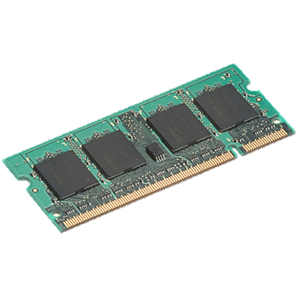
In-Memory Data Sharing
iter. 1
iter. 2
. . .
Input
query 1
one-time processing
query 2
query 3
Input
. . .

Slide 22
Efficient Fault Recovery via Lineage
Maintain a reliable log of applied operations
iter. 1
iter. 2
. . .
Input
Recompute lost partitions on failure
query 1
one-time processing
query 2
query 3
Input
. . .

Slide 23
Generality of RDDs
Despite their restrictions, RDDs can express many parallel algorithms
These naturally apply the same operation to many items
Unify many programming models
Data flow models: MapReduce, Dryad, SQL, …
Specialized models for iterative apps: BSP (Pregel), iterative MapReduce (Haloop), bulk incremental, …
Support new apps that these models don’t
Enables apps to efficiently intermix these models
Notes:
Similarity to GFS/HDFS: large blocks, append only.

Slide 24
Spark Operations
Transformations (define a new RDD) | map filter sample groupByKey reduceByKey sortByKey | flatMap union join cogroup cross mapValues
Actions (return a result to driver program) | collect reduce count save lookupKey take

Slide 25
Task Scheduler
Wide dependencies
DAG of stages to execute
Pipelines functions within a stage
Locality & data reuse aware
Partitioning-aware to avoid shuffles
A:
B:
G:
Stage 1
groupBy
C:
D:
F:
map
E:
join
Stage 2
union
Stage 3
Narrow dependencies
= cached data partition
Notes:
NOT a modified version of Hadoop

Slide 26
Spark Summary
Global aggregate computations that produce program state
compute the count() of an RDD, compute the max diff, etc.
Loops!
Spark makes it much easier to do multi-stage MapReduce
Built-in abstractions for some other common operations like joins
See also Apache Flink for a flexible big data platform

