Slide 1
Concurrency in Go
CS 240 – Fall 2019
Rec. 2

Slide 2
Housekeeping
Name’s Arnaud Dethise, PhD student. Nice to meet you.
Second TA for this course
Will also have office hours (TBA)

Slide 3
Housekeeping
Assignment 1 deadline is coming soon.
Should have read and started the assignment.
If progressing correctly, should have working mapF()

Slide 4
Concurrency in Go
Part 1 - MapReduce
CS 240 – Fall 2019
Rec. 2

Slide 5
Map Reduce
Wikipedia:
“MapReduce is a programming model and an associated implementation for processing and generating big data sets with a parallel, distributed algorithm on a cluster.”
In other words, a general and scalable solution to deal with big data computation on multiple machines.

Slide 6
Abstract Map Reduce
map(key, value) -> list(<k’, v’>)
Apply function to (key, value) pair
Outputs set of intermediate pairs
reduce(key, list<value>) -> <k’, v’>
Applies aggregation function to values
Outputs result
Split and distribute data
Aggregate and compute results

Slide 7
Word Count – The Hello World of Map Reduce
Bus 2
Bus 1
Bus 1
Car 1
Train 1
Bus 3
Bus Car Train
Car 1
Car 1
Bus 3
Car 2
Train 2
Plane 2
Bus Car Train
Train Plane Car
Bus Bus Plane
Car 2
Train 1
Plane 1
Car 1
Train Plane Car
Train 1
Train 1
Train 2
Bus Bus Plane
Bus 2
Plane 1
Plane 1
Plane 1
Plane 2
Splitting
Mapping
Intermediate
Splitting
Reducing
Combining
doMap()
doReduce()

Slide 8
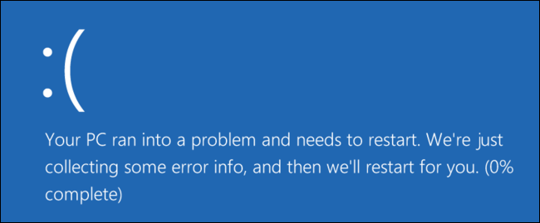
A Motivating Problem for Map Reduce
“Find me the closest Starbucks to KAUST.
Actually, I’ll give you a place and something to look for,
and you find me the closest one.
Here’s a 1 TB text file … good luck”
GPS Coordinates Site Name
[22.3, 39.1] Tim Hortons
[22.2, 39.1] KAUST Library
[35.7, 139.7] Starbucks
... ...
In KAUST
In Tokyo, Japan

Slide 9
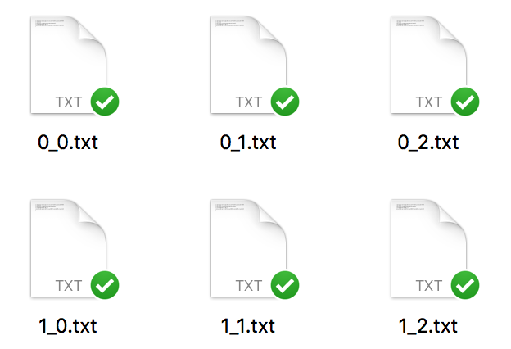

A Motivating Problem for Map Reduce
GPS Coordinates Site Name
[22.3, 39.1] Tim Hortons
[22.2, 39.1] KAUST Library
[35.7, 139.7] Starbucks
... ...
0
1
2
3
4
0
(0,0) | (0,1) | (0,2) | (0,3) | (0,4)
(1,0) | (1,1) | (1,2) | (1,3) | (1,4)
(2,0) | (2,1) | (2,2) | (2,3) | (2,4)
(3,0) | (3,1) | (3,2) | (3,3) | (3,4)
Map to grids
1
Reduce to single files
2
3

Slide 10
Split the File and Map Each Chunk Independently (1/2)
Mapping Nodes
Mapper
GPS Coordinates Site Name
[22.3, 39.1] Tim Hortons
[22.2, 39.1] KAUST Library
[35.7, 139.7] Starbucks
... ...
[42.0, 69.0] Chanak Train Stop
[22.2, 39.2] Burger King
... ...
... ...
... ...
... ...
Mapper

Slide 11
Split the File and Map Each Chunk Independently (2/2)
KEY <grid>: VALUE <locations and name>
...
Mapping Nodes
(1,2): [22.3, 39.1] Tim Hortons
(1,2): [22.2, 39.1] KAUST Library
(1,2): ...
(2,4): [35.7, 139.7] Starbucks
(2,4): ...
Mapper
GPS Coordinates Site Name
[22.3, 39.1] Tim Hortons
[22.2, 39.1] KAUST Library
[35.7, 139.7] Starbucks
... ...
[42.0, 69.0] Chanak Train
[22.2, 39.2] Burger King
... ...
... ...
... ...
... ...
Mapper
(1,3): [42.0, 69.0] Chanak Train
(1,3): ...
(1,2): [22.2, 39.2] Burger King
(1,2): ...
(KEY) can appear in multiple mappers

Slide 12
Collect the Mapper Results and Reduce to Single Files (1/2)
Reducing Nodes
(1,2): [22.3, 39.1] Tim Hortons
(1,2): [22.2, 39.1] KAUST Library
(1,2): ...
(2,4): [35.7, 139.7] Starbucks
(2,4): ...
Reducer
(1,2)
(1,3): [42.0, 69.0] Chanak Train
(1,3): ...
(1,2): [22.2, 39.2] Burger King
(1,2): ...
Reducer
(1,3), (2,4)

Slide 13
Collect the Mapper Results and Reduce to Single Files (2/2)
KEY <grid>: [
VALUES <locations and names>,
...]
Reducing Nodes
(1,2): [
[22.3, 39.1] Tim Hortons,
[22.2, 39.1] KAUST Library,
[22.2, 39.2] Burger King
...]
]
(1,2): [22.3, 39.1] Tim Hortons
(1,2): [22.2, 39.1] KAUST Library
(1,2): ...
(2,4): [35.7, 139.7] Starbucks
(2,4): ...
Reducer
(1,2)
(2,4): [
[35.7, 139.7] Starbucks,
...]
(1,3): [42.0, 69.0] Chanak Train
(1,3): ...
(1,2): [22.2, 39.2] Burger King
(1,2): ...
Reducer
(1,3), (2,4)
(1,3): [
[42.0, 69.0] Chanak Train Stop,
...],

Slide 14
Word Count – The Hello World of Map Reduce
Reducer nodes
Mapper nodes
Bus 2
Bus 1
Bus 1
Car 1
Train 1
Bus 3
Bus Car Train
Car 1
Car 1
Bus 3
Car 2
Train 2
Plane 2
Bus Car Train
Train Plane Car
Bus Bus Plane
Car 2
Train 1
Plane 1
Car 1
Train Plane Car
Train 1
Train 1
Train 2
Bus Bus Plane
Bus 2
Plane 1
Plane 1
Plane 1
Plane 2
Task is automatically distributed across five different nodes
Splitting
Mapping
Intermediate
Splitting
Reducing
Combining

Slide 15

Hadoop: An open-source implementation
Apache Hadoop is the most popular open-source implementation of MapReduce
Runs on top of a distributed filesystem (HDFS)
Try their MapReduce tutorial:
https://hadoop.apache.org/docs/r1.2.1/mapred_tutorial.html

Slide 16




How Hadoop Does it
Mapping Nodes
Reducing Nodes
Mapper
Reducer
Mapper
Reducer

Slide 17
Concurrency in Go
Part 2 - Concurrency
CS 240 – Fall 2019
Rec. 2

Slide 18
What is Concurrency?
It’s like parallel that’s not in parallel

Slide 19
What is Parallelism?
Time
Sequential
f(X)
f(X) = A
f(Y)
f(Y) = B
Parallel
f(X)
f(X) = A
f(Y)
f(Y) = B

Slide 20
What is Concurrency?
Time
Sequential
f(X)
f(X) = A
f(Y)
f(Y) = B
Concurrent
f(X)
f(X) = A
f(Y)
f(Y) = B

Slide 21
Concurrency Could be Parallel but not Always
Concurrent but not Parallel
Time
f(X)
f(X) = A
f(Y)
f(Y) = B
Concurrent and Parallel
f(X)
f(X) = A
f(Y)
f(Y) = B
f(Z)
f(Z) = A
f(W)
f(W) = B

Slide 22
Parallel is Always Concurrent
Parallel but not Concurrent?
Time
f(X)
f(X) = A
f(Y)
f(Y) = B
Nope … still concurrent
Parallel → Concurrent
Concurrent ↛ Parallel

Slide 23
Why Care about Concurrency
If something concurrent but not parallel takes as much time as something sequential, why make it concurrent?
Time
Sequential
f(X)
f(X) = A
f(Y)
f(Y) = B
Concurrent
f(X)
f(X) = A
f(Y)
f(Y) = B

Slide 24
Concurrency is a Design Pattern
“Concurrency is about dealing with lots of things at once.
Parallelism is about doing lots of things at once.”
- Rob Pike
”Concurrency is not Parallelism” by Rob Pike : https://talks.golang.org/2012/waza.slide#1

Slide 25
Distributed Systems are Unpredictable
Servers need to react to:
Others servers
Crashes
Users
…

Slide 26
Making Bank Deposits Concurrent (1/5)
Add($10)
Server
Database
0
Add($10)
Time

Slide 27
Making Bank Deposits Concurrent (2/5)
Add($10)
Server
Read
x = 0
Database
0
Add($10)
read
$0
Time

Slide 28
Making Bank Deposits Concurrent (3/5)
Add($10)
Server
Read
x = 0
x += 10
Write x
Database
10
Add($10)
read
$0
$10
Time

Slide 29
Making Bank Deposits Concurrent (4/5)
Add($10)
Server
Read
x = 0
x += 10
Write x
Read
x = 10
Database
10
Add($10)
read
$0
$10
read
$10
Time

Slide 30
Making Bank Deposits Concurrent (5/5)
Add($10)
Server
Read
x = 0
x += 10
Write x
Read
x = 10
x += 10
Write x
Database
20
Add($10)
read
$0
$10
read
$10
Time
$20

Slide 31
Concurrent Bank Deposits! Yay? (1/5)
Add($10)
Server
Database
0
Add($10)
Time

Slide 32
Concurrent Bank Deposits! Yay? (2/5)
Add($10)
Server
Read
x = 0
Database
0
Add($10)
read
$0
Time

Slide 33
Concurrent Bank Deposits! Yay? (3/5)
Add($10)
Server
Read
x = 0
Read
x = 0
Database
0
Add($10)
read
$0
read
$0
Time

Slide 34
Concurrent Bank Deposits! Yay? (4/5)
Add($10)
Server
Read
x = 0
Read
x = 0
x += 10
Write x
Database
10
Add($10)
read
$0
read
$0
$10
Time

Slide 35
Concurrent Bank Deposits! Yay? (5/5)
Add($10)
Server
Read
x = 0
Read
x = 0
x += 10
Write x
x += 10
Write x
Database
10
Add($10)
read
$0
read
$0
$10
$10
Time

Slide 36
Concurrency Needs to be Synchronized
Locks – limit access using shared memory
Channels – pass information using a queue

Slide 37
Visualize Everything We’ve Learned
And also see many different methods of
achieving synchronization:
http://divan.github.io/posts/go_concurrency_visualize/

