Slide 1
Intro and Course Overview
CS 290E: Systems and Machine Learning
Marco Canini

Slide 2
Course information
Course website
  http://web.kaust.edu.sa/Faculty/MarcoCanini/classes/CS290E/F19/
Meetings
  1PM – 2:30 PM (Mon/Thu for lectures and discussions)
Please subscribe to Piazza
  https://piazza.com/kaust.edu.sa/fall2019/cs290e
Schedule and reading list are subject to change

Slide 3
What do you expect from this class?

Slide 4
What this class is NOT
Not an introductory class to AI/ML
  Students taking the class should already be familiar with AI/ML concepts
Not an established syllabus in the subject’s area
  No knowledge is cast in stone; fast-paced progress is continuously happening
  Corollary: there’s no textbook!

Slide 5
Should you take this class?
Good programming skills
One systems-related course (e.g., CS240, CS244, CS245)
  Taking CS240 same semester is OK
One AI/ML-related course (e.g., CS229, CS390DD, Coursera)
Experience with ML frameworks (e.g., TensorFlow, PyTorch, etc.)

Slide 6
Main goal
Identify and solve big/impactful problems at the intersection between AI/ML and Systems

Slide 7
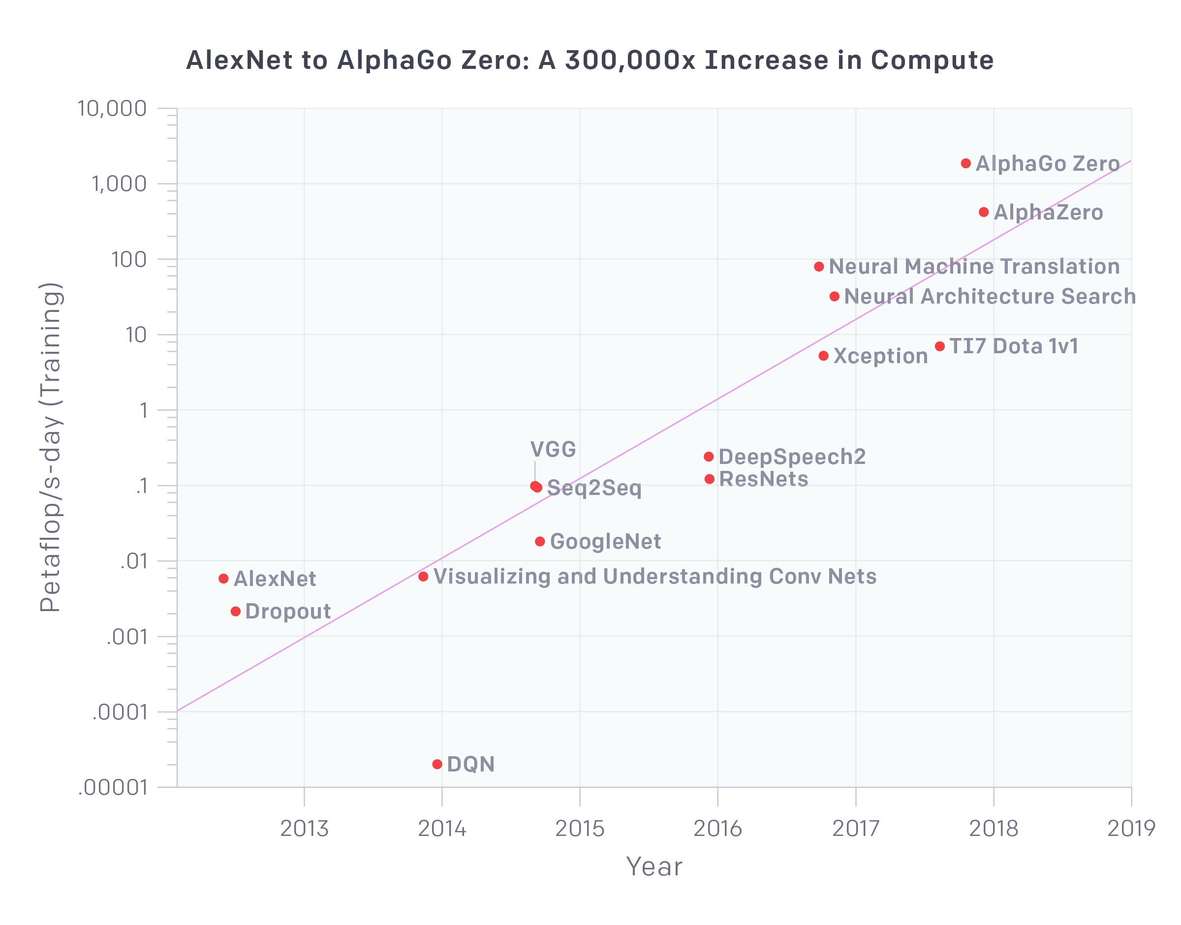
Why?
The need for systems
AI and Compute (https://blog.openai.com/ai-and-compute/)

Slide 8
How?
Study
Major AI developments through systems’ lens
System-related problems that might leverage AI techniques
Enable Systems and AI students to collaborate on projects

Slide 9
Topics
ML Platforms
Model Development and Training Frameworks
Prediction Serving
Hyperparameter Tuning and AutoML
Distributed Model Training
Model Compilation
Hardware Acceleration for Machine Learning
Debugging and Interpretability
Testing and Verification
Secure Machine Learning
Machine Learning Applied to Systems
Open to inputs and suggestions!

Slide 10
Course format
Mix of lectures, seminar-style discussions, and student presentations
Much discussions in the format of a pretend PC meeting
You are responsible for paper readings, and completing a hands-on project

Slide 11
Pretend PC
Ever wondered what being on a PC is like?
Peer reviewing can be frustrating…
http://matt.might.net/articles/peer-fortress/
To reach some learning objectives of the course, we will pretend to be in a PC

Slide 12
Reading assignments
All students are required to read all papers
All students are required to submit “reviews” for each paper:
  Regular reviews answer short, core questions to identify key insights, strengths and weaknesses
  Detailed reviews go in depth producing something similar to a real review
Submit reviews via HotCRP at https://hotcrp.kaust.edu.sa/cs290e

Slide 13
Critical reading
What is the problem addressed by the paper? Is the problem real? Why is this problem important?
What is the hypothesis of the work?
What is the proposed solution’s main idea, and what key insight guides their solution?
Why is the solution different from previous work?
  Is problem new?
  Are assumptions different?
  Is workload different?
Does the paper (or do you) identify any fundamental/hard trade-offs?
What is one (or more) drawback or limitation of the proposal, and how will you improve it?
Do you think the work will be influential in 10 years?
  Why or why not?

Slide 14
Reviews
Regular
  Answer to short questions identifying core novel ideas, strengths, and weaknesses
  Format will be shared
Detailed (2 or 3 per student during the course)
  What you would produce in an actual PC
  Format will be shared

Slide 15
Typical week
Monday | Wednesday | Thursday
1:00-2:30PM Overview lecture by Instructor | 1:00PM deadline Submit paper reviews | 1:00-2:30PM Paper discussions Area Chair presents paper summaries and leads the discussions Champions advocate strongly for their papers Detractors raise their concerns loudly
 | Area Chair creates a summary of each paper based on all the reviews
 | ~7:00PM Area Chair and Instructor identify Champions and Detractors
 | 8:00PM deadline Area Chair posts the summaries on Piazza

Slide 16
Grading
15% Class Participation
  Answer questions, join discussion, lead discussion
20% Paper Reviews
50% Project
  15% Proposal
  35% Report
15% Project Presentation

Slide 17
Participation
Attend all lectures
  Can miss at most two with legitimate reasons
Read all the papers and participate
  Ask questions!
We evaluate class participation by observing how prepared students are to discuss the covered paper when they come to class

Slide 18
Paper reviews
You can miss at most 4 regular reviews without any penalty
  Each missing one beyond that will result in 25% decrease in grade for this segment
  Meaning, missing 8 or more will result in 0% for the “Paper Reviews” segment of your grade
At the end of the term, grade will start from average of:
  2 of your reviews will be randomly selected and graded; the higher grade of the two will be used for grading
  1 of your detailed reviews chosen at random and graded
Grading by peers can increase this segment when your regular review is marked in top 3: by 2 peers → 1%, … by 10 or more → 5%

Slide 19
Project
The biggest component of this course:
  Pick an interesting open problem. Why is it important?
  What has already been done? Why are they not enough?
  Develop a hypothesis about how you’d improve it
    Intuitively, why will your approach work?
  Build a substantial prototype
    Experiment, measure, and compare against the state-of-the-art
Aim at producing a conference/workshop-quality research paper
  Can be related to your research topic

Slide 20
Projects
This is a research-oriented course!
  The final project accounts for 50%+15% of total grade
  Done in groups of 2-3 students. Find your peers!
What can and cannot be a project?
  Just surveys are not allowed. In fact, each project must include a survey of related work and background
  An ideal project should answer the questions you asked during paper reviews and points you cared about for presentations
  Measurements of new environments or of existing solutions on new environments are acceptable upon discussion

Slide 21
Original research: How to approach it?
Find a problem and motivate why this is worth solving
Survey background and related work to get a sense of your (friendly!) competition
  Might require you to go back to the first step
Form/update your hypothesis
Test your hypothesis
  Go back to 3 until you are happy
Present your findings in a presentation and in writing
  Discuss known limitations

Slide 22
Milestones
* Week of
Date | Milestone | Details
Sep 9 | Form Group | Find like-minded students
Sep 19 | Draft Proposal | Send your 2-page proposal by email
Sep 30 | Finalize Proposal Checkpoint (15%) | After a back-and-forth discussions with the instructor
Oct 24 | Midterm Presentations (7.5%) | Define and motivate a problem, survey related work, describe initial idea and early results, outline time plan
Dec 2* | Final Presentation (7.5%) | Present your findings in a presentation
Dec 5 | Final Report (35%) | 8-page final report similar to the papers you read

Slide 23
Draft proposal
Read: The Heilmeier’s Catechism
2 pages including references that ideally includes
  The overall goal of your original project
    What is the problem? | Why is it important to solve?
    What you will do in some detail?| How would you evaluate your solution?
  A brief outline of incremental steps to do to finish the project as well as a timeline
    The goal is to convince both us and yourself that your project is neither too small nor too big
  Use the SysML’20 Latex style files
Include team members
  Meaning, form a group ASAP
Schedule via email a 15-minute meeting to discuss

Slide 24
Finalized proposal
4 pages including references that must include
  Have the structure of the final report
  Complete introduction written
  Status of the project
  Plan for the remaining time
Approved by the instructor and agreed upon by you
  Forms the basis of expectation

Slide 25
Midterm presentation
In-class short presentation over one day (or two days if necessary)
  This is to make sure you are making progress
Must include
  What is the problem?
  Why is it important?
  What are the most related work?
  What’s your idea and progress so far?
  How are/will you evaluate it?

Slide 26
Final presentation and report
Presentation
  Around 15-20 min, similar to a conference presentation
Research paper
  The key part should be written similar to the papers you’ve read
  Your goal is to do publishable quality ML systems research
  Up to five “best projects” will be earmarked for expedited submission to a renowned conference, with the help of the instructor
Also, submit self-contained code as a zip file
Read: How to Write a Great Research Paper by Simon Peyton Jones

Slide 27
Rough outline
Abstract
Introduction (Highlight the importance and give intuition of solution)
Motivation (Use data and simple examples)
Overview (Summarize your overall solution so that readers can follow later)
Core Idea (Main contribution w/ challenges and how you address them)
Implementation (Discuss non-obvious parts of your implementation)
Evaluation (Convince readers that it works and when it fails)
Related Work (Let readers know that you know your competition!)
Discussion (Know your limitations and possible workarounds)
Conclusion (Summarize and point out future work)

Slide 28
Regular check-ins and meetings
Mandatory meeting around the time each milestone is due
  By appointment
Also, send an update (via Piazza) each week to the instructor
  what you did this week
  which papers you read this week
  what you need to do next week to stay on track
These updates will not be graded; the idea is to make sure you are making incremental progress

Slide 29
Before we move on…
Late work policy: no extensions
  Any exceptional circumstances, talk to us early
Zero tolerance for academic misconduct
  Cheating, plagiarism, any form of dishonesty will be handled with maximum severity
Slides will be posted after the class
Everyone must read all the assigned papers before class

Slide 30
Plan for next meetings
Thu 29 – What makes great ML Systems Research?
  Readings to be done before class
  One trial (not graded) review: A Berkeley View of Systems Challenges for AI
Next week – Background Review
  A review of the latest breakthrough in AI/ML
Also, have a look at the schedule and look through the linked resources and optional readings

