Slide 1
CS 345 Introduction
Marco Canini

Slide 2
This Class
Learn about research in Distributed and Networked Systems
  This year a main focus will be on AI/ML in connection to Systems
Be exposed to the state-of-the art solutions to active areas
Work on an exciting project
Hopefully start next generation of impactful projects

Slide 3
About the Instructor
Marco Canini
  Assistant Professor at KAUST since Aug ’16
  https://mcanini.github.io
Research interests span
  Distributed and Networked systems in the context of cloud computing, large-scale data analytics, and machine learning
Head of SANDS Lab
  Software-defined Advanced Networked and Distributed Systems Laboratory

Slide 4
My research
Distributed Systems
Security
Formal Methods
Networking
Machine Learning
Optimization Theory
Software Engineering
Programming Languages
I design, build, measure and analyze large-scale networked systems that span multiple autonomous, potentially untrusted entities
Goal: Discover and apply fundamental principles and valuable knowledge on how to build scalable, dependable and future-proof systems, worthy of society’s trust

Slide 5
Challenges
#1 Challenge: Complexity
Hard to reason about behavior as systems scale to large numbers of components and users
  Poorly understood connections
  Need predictability to ensure scalable performance, reliable operation, etc.
Notes:
Networked systems researchers tackle specific challenges of the design and implementation of a particular systems solution to a given problem.
However, if I were to identify a challenge that stands out and presents itself recurrently, it is complexity

Slide 6
Systems Approach
Formulate problem
Get idea
Build prototype
Measure & analyze
Adjust prototype … repeat previous step
Principles of system construction
  modularity, hierarchy, layering, abstraction, end to end
Notes:
Big problem is that there is really no theory of building systems. It appears these artifacts are way too complex to have a rigorous, constructive approach to dealing with them
In some sense it is like dealing with a biological organisms. They are some of the most complex systems that exist.
We understand how tiny disconnected pieces operate on their own but we know little about how they interact.
In the absence of a constructive theory the typical systems person will formulate a problem, get an idea, build a prototype, measure and analyze it, tweak it, go back to building, measure again and repeat these steps over time. This is the approach that many systems people have used in the past and has lead to highly treasured principles of building systems, which is for now the closest we can get to a rigorous, constructive approach.
These include concepts such as modularity, layering, abstraction.

Slide 7
SANDS Lab
We develop techniques and abstractions for building scalable, dependable and future-proof systems, worthy of society’s trust
Our core interest is in the fundamental questions regarding the distributed network and software infrastructure necessary to support rich communication and compute systems for real-world applications such as cloud computing, large-scale data analytics, and machine learning
We focus on interdisciplinary systems problems found in modern networked systems like large-scale datacenters, multi-Tbps Internet eXchange Points (IXPs), and the Internet of Things (IoT)
We aim to determine the foundations of Software-Defined Infrastructure (SDI): fluid, planetary-scale software systems that are highly interconnected, deeply programmable, and virtualized within end-to-end slices across many administrative domains
We build prototypes that directly improve the lives of real users and evaluate them on real-world workloads.

Slide 8
Example 1: Programmable Networks and Distributed Applications in Data Centers
How can we co-design distributed systems with their network layer, and in doing so achieve substantial (performance) benefits?
Consensus protocols are a crucial building block used by essential services. Their performance is tied to assumptions about network behavior. Networks have recently changed: they are programmable!
We showed that there are significant performance benefits to be gained by offering consensus as a network service.
Proposer
Proposer
Facilitate
software
API
Alleviate
bottlenecks
Coordinator
Coordinator Backup
Acceptor
Acceptor
Acceptor
Learner
Learner
Consensus at 9 M msgs / s and
low latency
μs | P4FPGA | SDNet | Netronome
Forwarding | 0.37 | 0.73 | -
Coordinator | 0.72 | 1.21 | 0.33±0.01
Acceptor | 0.79 | 1.44 | 0.81±0.01

Slide 9

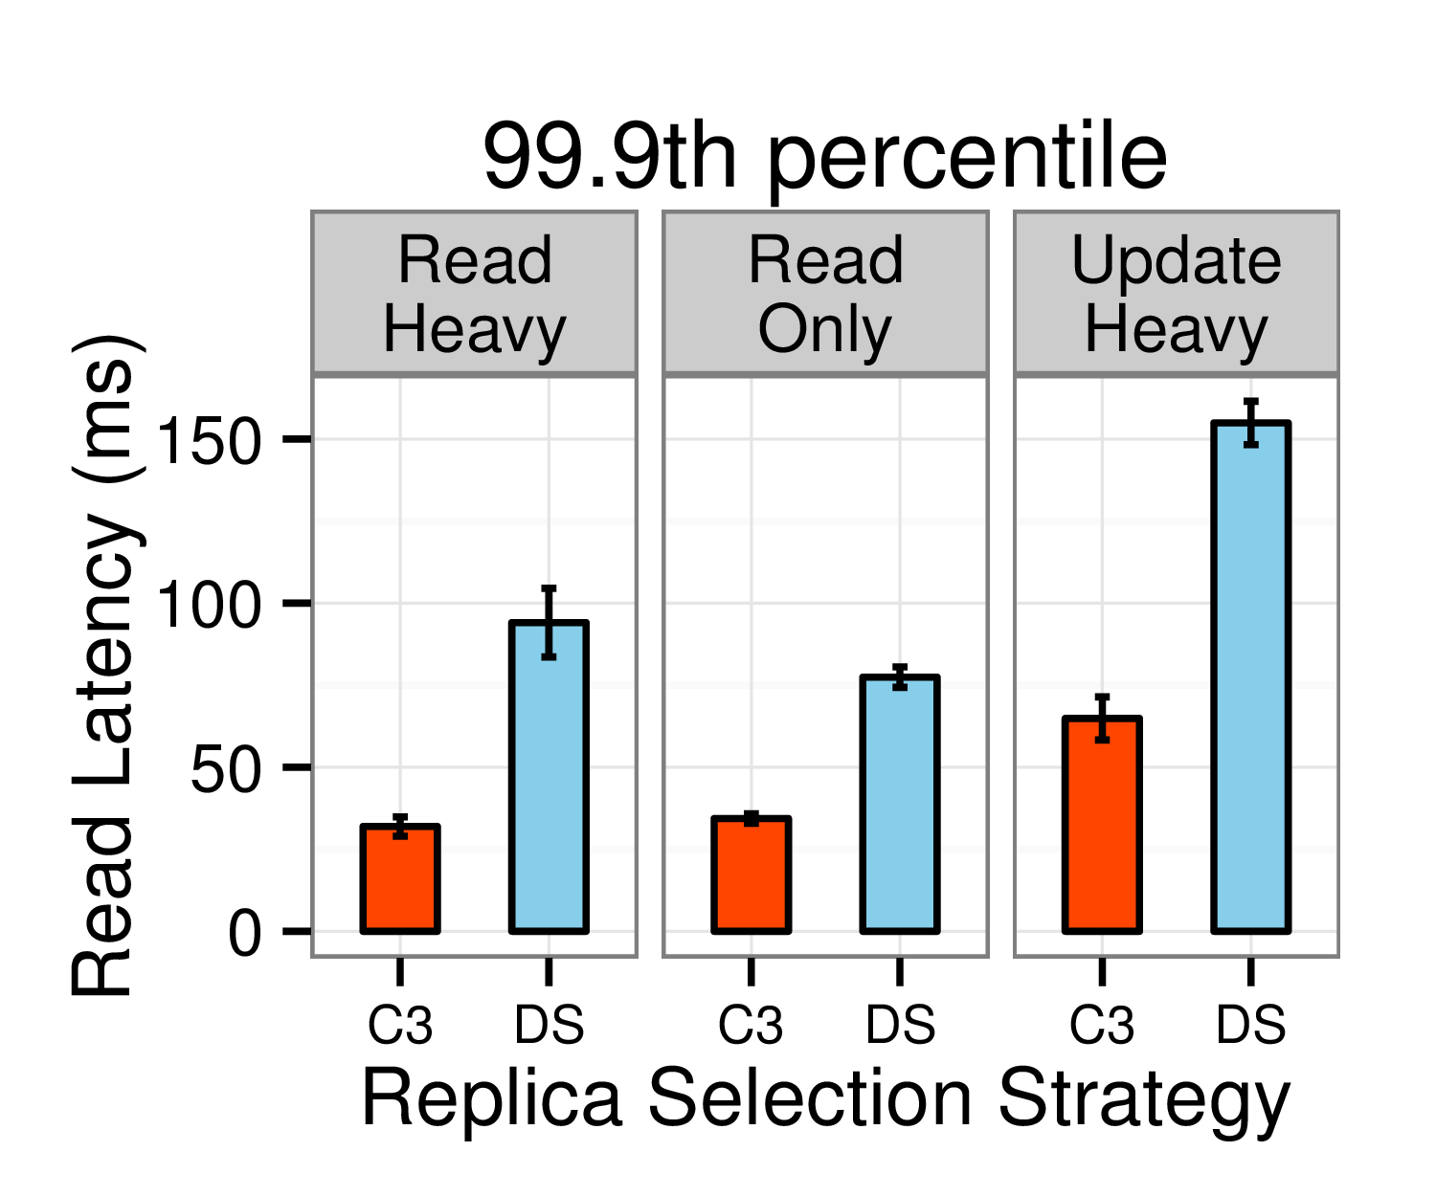
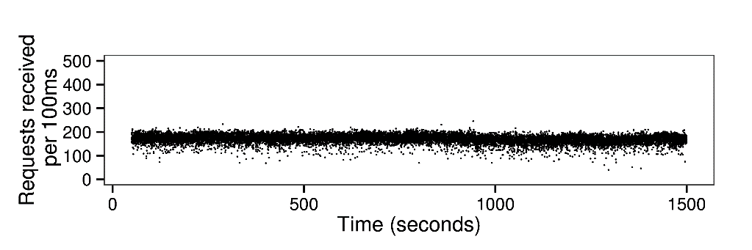
Example 2: Predictable Performance of Distributed Systems
How can we ensure that distributed systems offer predictable response times,
especially at the tail of latency distribution?
KV-store are a common building block to many data center applications. They provide reliable storage via replication and performance via scale-out to clusters.
But selecting the right replica is crucial in the presence of many sources of performance variability!
C3 improves Cassandra’s latency profile at the mean and the tail by up to 3X at the 99.9th percentile, while improving read throughput by up to 50%.
?
Server
Client
Server
Server
C3
Replica Ranking
+
Dist. Rate Control

Slide 10
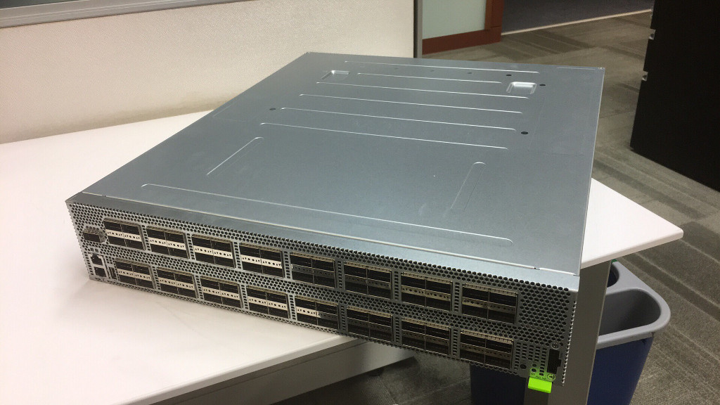
Example 3: DAIET: Data Aggregation In nETwork
The volume of distributed ML communication can be substantially reduced via in-network aggregation
DAIET performs data aggregation along network paths using programmable network devices
The aggregation function is +: it is commutative and associative
  Order independent
C
G
H
D
E
https://sands.kaust.edu.sa/daiet/
A
B

Slide 11
What About You?
Please introduce yourself!

Slide 12
About this class

Slide 13
Course Schedule
Webpage: http://web.kaust.edu.sa/Faculty/MarcoCanini/classes/CS345/S19/
  Piazza: http://piazza.com/kaust.edu.sa/spring2019/cs345
Meetings
  4PM – 5:30 PM (Sun/Wed for lectures and discussions)
Pay attention to the online announcements and schedule
  On average, two meetings per week
  Makeups will be added on a need-to-add basis

Slide 14
Prerequisites
CS 240 (Computing Systems and Concurrency)
  Basics of OS organization, threads, memory management, file systems, scheduling, networking, etc.
  Equivalent course of CS 240 is acceptable as well
Basic knowledge of networking: e.g., CS 244 (Computer Networks)
  Basics of packet switching, Internet architecture and protocols, etc.
Good programming skills
  Build substantial systems for course project
Questions
  Have you taken a grad-level systems (e.g., OS, networking) course before?
  Have you worked on large systems-building project?

Slide 15
Course Requirements
Paper Reviews | 15%
Paper Presentation | 20%
Participation | 15%
Project | 50%
Checkpoint #1: initial proposal | 10%
Checkpoint #2: midterm progress report | 15%
Final report | 25%

Slide 16
Paper Reviews
This is a paper-reading course
  Paper reviews account for 20% of the total grade
20-25 summaries to write
What goes in a good summary?
  Highlight strengths
  Highlight weaknesses
  Describe the entire paper in few sentences
  See detailed guidelines on course website (or next slide)

Slide 17
Critical Reading
What is the problem addressed by the paper? Is the problem real? Why is this problem important?
What is the hypothesis of the work?
What is the proposed solution’s main idea, and what key insight guides their solution?
Why is the solution different from previous work?
  Are system assumptions different?
  Is workload different?
  Is problem new?
Does the paper (or do you) identify any fundamental/hard trade-offs?
What is one (or more) drawback or limitation of the proposal, and how will you improve it?
Do you think the work will be influential in 10 years?
  Why or why not?

Slide 18
What are Hard/Fundamental Tradeoffs?
Brewer’s CAP conjecture: “Consistency, Availability, Partition-tolerance”, you can have only two in a distributed system
In a in-order, reliable communication protocol cannot minimize overhead and latency simultaneously
Hard to simultaneously maximize evolvability and performance

Slide 19
How to Review
You will see a section for describing a paper summary, its strengths, its weaknesses, and detailed comments
In the summary section, please directly address:
  What problem the paper is addressing (1-2 sentences or bullets)
  The core novel ideas or technical contributions of the work (1-2 sentences or bullets). Put another way, what's the 30 second elevator pitch, or, five years from now, what should one remember about this paper?
  A longer description (3-5 sentences) that summarizes the paper's approach, mechanisms, and findings
For the other sections, please include 2-4 bullet points for the strengths and weaknesses, while a much longer exposition in the detailed comments (according to template on slide 16)
Remember to be constructive: don't only focus on the paper's shortcomings, but also on what it could have done differently or as the next steps. Imagine that you are having a conversation with the authors: What would you tell them?

Slide 20
Reviewing Tips
Read (if you haven’t already!)
How to Read a Paper by S. Keshav
How to read a research paper by Michael Mitzenmacher
Writing Reviews for Systems Conferences by Timothy Roscoe

Slide 21
Paper Reviews
Reviews must be submitted electronically 24 hours before the class
  Submission site: https://hotcrp.kaust.edu.sa/cs345
You can miss at most 4 without any penalty
  Each missing one beyond that will result in 25% decrease in grade for this segment
  Meaning, missing 8 or more will result in 0% for the “Paper Reviews” segment of your grade
At the end of the term, 2 of your reviews will be randomly selected and graded
  The higher grade of the two will be used for grading

Slide 22
Paper Presentation
This is a seminar-style course
  Each student must present at least one papers
  Paper presentation account for 20% of the total grade
Presenter to read mandatory and companion paper
Presentation should last 45 minute without interruptions
  Though expect interruptions and questions
  Followed by discussion anchored by the presenters
What should go in a useful presentation?
  See next slide
Lead the discussion
  Go through the strengths and weaknesses from the paper review

Slide 23
Presentation Guidelines
Motivate the paper and provide background
Present the high level idea, approach, and/or insight (using examples, whenever appropriate)
Discuss technical details so that one can understand the key details without carefully reading it
Explain the difference between this paper and related work
Raise questions throughout the presentation to generate discussion

Slide 24
Presentation Structure
Your oral description of the paper should follow a much similar format:
System name (e.g., "VL2") | Institution and/or authors (e.g., "Microsoft Research") | Conference (e.g., "SIGCOMM 2009")
Problem
Core ideas
Descriptive summary, technical details and main results
Related work
Strengths
Weaknesses/limitations
Further discussion, including proposals for follow-up work

Slide 25
Paper Presentation
Email your slides to the instructor 24 hours before the class
Prepare early
Practice a lot
Also, read
  How to Give a Bad Talk by David A. Patterson
  Pointers for Leading Paper Discussions by Randy H. Katz
Also, see
  How to Give a Great Research Talk by Simon Peyton Jones

Slide 26
Paper Review Website
We will use the HotCRP conference software
  http://www.read.seas.harvard.edu/~kohler/hotcrp/
It is a system used by many real-word conferences, including USENIX conferences and many ACM SIGCOMM and SIGPLAN conferences
Submission site: https://hotcrp.kaust.edu.sa/cs345

Slide 27
Participation
Attend all lectures
  Can miss at most two with legitimate reasons
Read all the papers and participate
  Ask questions!
We evaluate class participation by observing how prepared students are to discuss the covered paper when they come to class

Slide 28
Project
The biggest component of this course
  Original research
    Pick an interesting open problem. Why is it important?
    What has already been done? Why are they not enough?
    Develop a hypothesis about how you’d improve it
      Intuitively, why will your approach work?
    Build a substantial prototype
      Experiment, measure, and compare against the state-of-the-art
  Reproduce a result from a systems paper
Aim at producing a conference/workshop-quality research paper
  Can be related to your research topic but it is expected to be distinct!

Slide 29
Projects
This is a research-oriented course!
  The final project accounts for 50% of total grades
  Done in groups of 2 students. Find your peers!
What can and cannot be a project?
  Just surveys are not allowed. In fact, each project must include a survey of related work and background
  An ideal project should answer the questions you asked during paper reviews and points you cared about for presentations
  Measurements of new environments or of existing solutions on new environments are acceptable upon discussion

Slide 30
Original Research: How to Approach It?
Find a problem and motivate why this is worth solving
Survey background and related work to get a sense of your (friendly!) competition
  Might require you to go back to the first step
Form/update your hypothesis
Test your hypothesis
  Go back to 3 until you are happy
Present your findings in a presentation and in writing
  Discuss known limitations

Slide 31
Reproduction: How to Approach It?
Pick an interesting paper
Ask what kind of “reproduction” is appropriate?
Does the primary result of the paper hold up?
What happens if you vary a parameter the original experimenter didn’t consider?
Having reproduced the primary result, can you now extend or improve the work?
What was difficult to reproduce?

Slide 32
Milestones
* Week of
Date | Milestone | Details
6/2/19 | Form Group | Find like-minded students
17/2/19 | Draft Proposal | Send your 2-page proposal by email
28/2/19 | Finalize Proposal Checkpoint #1 (10%) | After a back-and-forth discussions with the instructor
6/4/19 | Midterm Progress Report Checkpoint #2 (15%) | 4-page report should read like parts of a research paper
7/4/19* | Midterm Presentations | Define and motivate a problem, survey related work, and form initial hypothesis and idea
15/5/16 | Final Presentation | Present your findings in a presentation
18/5/16 | Final Report (25%) | 8-page final report similar to the papers you read

Slide 33
Draft Proposal
Read: The Heilmeier’s Catechism
2 pages including references that ideally includes
  The particular results you would like to replicate, or the overall goal of your original project
    What is the problem? | Why is it important to solve?
    What you will do in some detail?| How would you evaluate your solution?
  A brief outline of incremental steps to do to finish the project as well as a timeline
    The goal is to convince both us and yourself that your project is neither too small nor too big
Include team members
  Meaning, form a group ASAP
Schedule via email a 15-minute meeting to discuss

Slide 34
Finalized Proposal
4 pages including references that must include
  Have the structure of the final report
  Complete introduction written
  Status of the project
  Plan for the remaining time
Approved by the instructor and agreed upon by you
  Forms the basis of expectation

Slide 35
Midterm Presentation
In-class short presentation over one day (or two days if necessary)
  This is to make sure you are making progress
Must include
  What is the problem?
  Why is it important?
  What are the most related work?
  What’s your hypothesis so far?
  How are/will you evaluate it?

Slide 36
Final Presentation and Report
Presentation
  It will follow a format similar to other presentations given in the class (20 min)
Research paper
  The key part
  Should be written similar to the papers you’ve read
  Your goal is to do publishable quality systems research
  Up to five “best projects” will be earmarked for expedited submission to a renowned conference, with the help of the instructor
Also, submit self-contained code as a zip file
Read: How to Write a Great Research Paper by Simon Peyton Jones

Slide 37
Rough Outline
Abstract
Introduction (Highlight the importance and give intuition of solution)
Motivation (Use data and simple examples)
Overview (Summarize your overall solution so that readers can follow later)
Core Idea (Main contribution w/ challenges and how you address them)
Implementation (Discuss non-obvious parts of your implementation)
Evaluation (Convince readers that it works and when it fails)
Related Work (Let readers know that you know your competition!)
Discussion (Know your limitations and possible workarounds)
Conclusion (Summarize and point out future work)

Slide 38
Regular Check-ins and Meetings
Mandatory meeting around the time each milestone is due
  By appointment
Also, send an update (via Piazza) each week to the instructor
  what you did this week
  which papers you read this week
  what you need to do next week to stay on track
These updates will not be graded; the idea is to make sure you are making incremental progress

Slide 39
Before We Move On…
Late work policy: no extensions
  Any exceptional circumstances, talk to us early
Zero tolerance for academic misconduct
  Cheating, plagiarism, any form of dishonesty will be handled with maximum severity
Slides will be posted after the class
  Everyone must come after reading all the assigned papers
Class meeting format
  Quick summary by the instructor
  Presentation of typically two papers
  Followed by a short break
  Presenter leads discussions on the papers and related topics

Slide 40
Systems Research

Slide 41
What is systems research?
Core areas:
  Operating systems
  Storage systems
  Networked systems
  Distributed systems
And also their interactions with:
  Computer architecture
  Programming languages / compilers
  Theory and semantics (formal methods)
  Human-Computer Interaction
  Social science
  …

Slide 42
Systems-research methodology
Pursue hypotheses
  This protocol change will improve performance under packet loss
  This filesystem change will improve performance on flash devices
Analyze, extend, or build artefacts
  Real systems (e.g., an OS kernel or storage system)
  Simulations (e.g., of a network topology or processor)
  Analytic models (e.g., of a scheduling algorithm or protocol)
Evaluate behavior of the artefacts
  Compare to baselines / other hypotheses
  Measure quantitatively and qualitatively
  Performance, scalability, complexity, robustness, energy, security, …

Slide 43
Experimentation for exploration vs. evaluation
Similar methodologies, very different activities
Exploration
  Understand and explain the behavior of a system
  Develop hypotheses about causal effects, potential changes
  Consider performing a limit study early in the project
Evaluation
Measure/explain [non-]conformance to hypotheses
Clearly compare with competing approaches and control
Explain why the approach worked (or didn’t)

Slide 44
Thinking about evaluation
Avoid existence proofs (“We built it. The end.”)
Compare with other approaches
  Related work is not just a list of citations!
  Intellectual comparisons with approaches
  Compare experimentally
Argue about benefits and costs of your approach
  Present tradeoffs – very little is unconditionally better!
  Bad: “We only looked at workload A and always win there”
  Good: “Approach X improves important workload A, but not B”
Realism
  How realistic must experiments be to convince the reader?

Slide 45
The experimental method (Bacon, ...)
Make observations
Form hypotheses about causality
Make predictions
Perform an experiment:
  Manipulate independent variables
  Hold other variables constant
  Measure dependent variables
  Compensate for random error (e.g., variance such as timer ticks)
  Control for confounding variables (e.g., in-production experiments)
  Focus on reproducibility
Analyze results of experiment
Draw a conclusion
Report results
Read (if you haven’t):
Repeatability in computer systems research
by C. Collberg and T. A. Proebsting

Slide 46
Some easier things you can measure
Performance
  Throughput and/or latency?
  Scalability as cores/disks/nodes/links/packets... increase?
  Energy use?
Resilience / robustness
  Packet loss? Network partition?
  Node failures? Disk failures?
Compatibility / deployment realism
  Source-code / binary impact on affected applications?
  Protocol / format deployment scenarios?

Slide 47
Some harder things to measure
Security
  Effect on past vulnerabilities?
  Trusted Computing Base (TCB) size?
  Automated reasoning / proofs?
  Services enabled by new security features?
Maintenance burden / debuggability
  Potential costs of adoption / deployment?
  New kinds of bugs – and mitigations for them?
User experience
  User studies – but they are hard!
  Identify proxies through real-system traces – e.g., latency?

Slide 48
Bias, error, fidelity, and generality
Analyze, minimize, and document error:
  Experimenter bias
  Random error / sampling effects
  Confounding variables / controls
  Probe and measurement effects
  Simulation fidelity / configuration realism
  Workload / benchmark realism
  Generality and scope of results
Real-system measurements are samples in distributions
  Use statistics to interpret significance of results

Slide 49
Q&A
That was a short introduction to systems research
Read How to be a computer systems graduate student
by Richard Martin

Slide 50
Credits
In designing and running this course, I acknowledge inspirations from
UIUC CS 525 by Indranil Gupta (Indy)
Michigan EECS 582 by Mosharaf Chowdhury
UCB CS 294 by Ion Stoica and Ali Ghodsi
Cambridge Adv. Topics in Comp. Systems by Richard Mortier
Lecture on “Practical experiments in systems performance research” by Robert N. M. Watson

