Slide 1
Nakamoto Consensus
Marco Canini
Slides reproduced with permission from Bitcoin and Cryptocurrency Technologies by Arvind Narayanan, Joseph Bonneau, Edward Felten, Andrew Miller and Steven Goldfeder

Slide 2
Recap digital currency

Slide 3
GoofyCoin

Slide 4
Goofy can create new coins
New coins belong to me.
signed by pk_{Goofy}
CreateCoin [uniqueCoinID]

Slide 5
A coin’s owner can spend it.
Alice owns it now.
signed by pk_{Goofy}
Pay to pk_{Alice} : H( )
signed by pk_{Goofy}
CreateCoin [uniqueCoinID]

Slide 6
The recipient can pass on the coin again.
signed by pk_{Alice}
Bob owns it now.
Pay to pk_{Bob} : H( )
signed by pk_{Goofy}
Pay to pk_{Alice} : H( )
signed by pk_{Goofy}
CreateCoin [uniqueCoinID]

Slide 7
double-spending attack
signed by pk_{Alice}
signed by pk_{Alice}
Pay to pk_{Bob} : H( )
Pay to pk_{Chuck} : H( )
signed by pk_{Goofy}
Pay to pk_{Alice} : H( )
signed by pk_{Goofy}
CreateCoin [uniqueCoinID]

Slide 8
double-spending attack
the main design challenge in digital currency

Slide 9
ScroogeCoin

Slide 10
Scrooge publishes a history of all transactions
(a block chain, signed by Scrooge)
H( )
prev: H( )
prev: H( )
prev: H( )
transID: 71
transID: 72
transID: 73
trans
trans
trans
optimization: put multiple transactions in the same block

Slide 11
CreateCoins transaction creates new coins
Valid, because I said so.
transID: 73 type:CreateCoins
coins created
num | value | recipient
0 | 3.2 | 0x...
1 | 1.4 | 0x...
2 | 7.1 | 0x...
coinID 73(0)
coinID 73(1)
coinID 73(2)

Slide 12
PayCoins transaction consumes (and destroys) some coins,
and creates new coins of the same total value
transID: 73 type:PayCoins
consumed coinIDs:
68(1), 42(0), 72(3)
Valid if:
-- consumed coins valid,
-- not already consumed,
-- total value out = total value in, and
-- signed by owners of all consumed coins
coins created
num | value | recipient
0 | 3.2 | 0x...
1 | 1.4 | 0x...
2 | 7.1 | 0x...
signatures

Slide 13
Immutable coins
Coins can’t be transferred, subdivided, or combined.
But: you can get the same effect by using transactions
to subdivide: create new trans
consume your coin
pay out two new coins to yourself

Slide 14
Don’t worry, I’m honest.
Crucial question:
Can we descroogify the currency, and operate without any central, trusted party?

Slide 15
Nakamoto consensus

Slide 16
Aspects of decentralization in Bitcoin
Who maintains the ledger?
Who has authority over which transactions are valid?
Who creates new bitcoins?
Who determines how the rules of the system change?
How do bitcoins acquire exchange value?
Beyond the protocol:
exchanges, wallet software, service providers...

Slide 17
Aspects of decentralization in Bitcoin
Peer-to-peer network:
open to anyone, low barrier to entry
Mining:
open to anyone, but inevitable concentration of power
often seen as undesirable
Updates to software:
core developers trusted by community, have great power

Slide 18
Some things Bitcoin does differently
Introduces incentives
Possible only because it’s a currency!
Embraces randomness
Does away with the notion of a specific end-point
Consensus happens over long time scales — about 1 hour

Slide 19
Key idea: implicit consensus
In each round, random node is picked
This node proposes the next block in the chain
Other nodes implicitly accept/reject this block
by either extending it
or ignoring it and extending chain from earlier block
Every block contains hash of the block it extends

Slide 20
Consensus algorithm (simplified)
New transactions are broadcast to all nodes
Each node collects new transactions into a block
In each round a random node gets to broadcast its block
Other nodes accept the block only if all transactions in it are valid (unspent, valid signatures)
Nodes express their acceptance of the block by including its hash in the next block they create

Slide 21
What can a malicious node do?
Double-spending attack
signed by A
C_{A} → B
Pay to pk_{B} : H( )
signed by A
C_{A} → A’
Pay to pk_{A’} : H( )
Honest nodes will extend the longest valid branch
Notes:
Can’t create new transactions from someone else’s address, or modify them.
Suppressing tx’s is only a minor annoyance.

Slide 22
From Bob the merchant’s point of view
1 confirmation
3 confirmations
C_{A} → B
Double-spend probability decreases exponentially with # of confirmations
Most common heuristic: 6 confirmations
C_{A} → A’
double-spend attempt
Hear about C_{A} → B transaction
0 confirmations

Slide 23
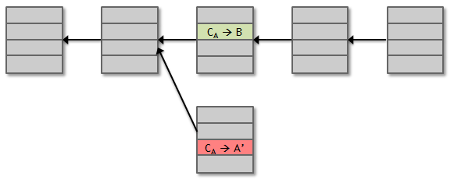
Assumption of honesty is problematic
Can we give nodes incentives for behaving honestly?
Everything so far is just a distributed consensus protocol
But now we utilize the fact that the currency has value
Can we reward nodes that created these blocks?
Can we penalize the node that created this block?

Slide 24
Incentive 1: block reward
Creator of block gets to
include special coin-creation transaction in the block
choose recipient address of this transaction
Value is fixed: currently 25 BTC, halves every 4 years
Block creator gets to “collect” the reward only if the block ends up on long-term consensus branch!

Slide 25
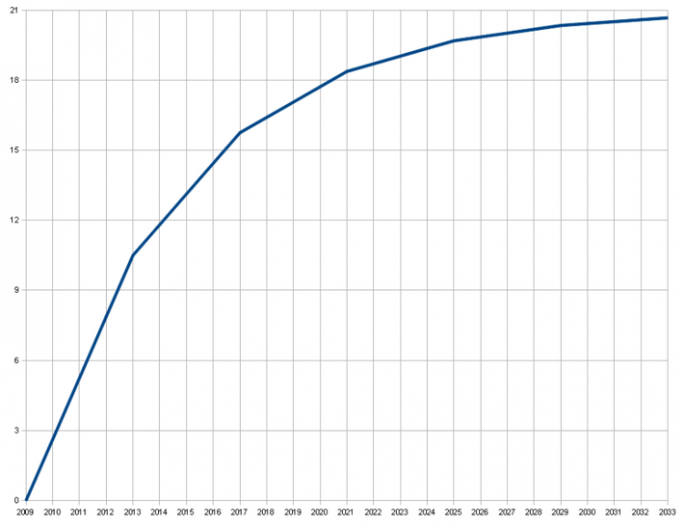
There’s a finite supply of bitcoins
Total supply: 21 million
Block reward is how new bitcoins are created
Runs out in 2040. No new bitcoins unless rules change
Total bitcoins in circulation
First inflection point: reward halved from 50BTC to 25BTC
Year

Slide 26
Incentive 2: transaction fees
Creator of transaction can choose to make
output value less than input value
Remainder is a transaction fee and goes to block creator
Purely voluntary, like a tip

Slide 27
Remaining problems
How to pick a random node?
How to avoid a free-for-all due to rewards?
How to prevent Sybil attacks?

Slide 28
Proof of work
To approximate selecting a random node:
select nodes in proportion to a resource that no one can monopolize (we hope)
In proportion to computing power: proof-of-work
In proportion to ownership: proof-of-stake

Slide 29
Equivalent views of proof of work
Select nodes in proportion to computing power
Let nodes compete for right to create block
Make it moderately hard to create new identities

Slide 30
Hash puzzles
nonce
To create block, find nonce s.t.
H(nonce ‖ prev_hash ‖ tx ‖ … ‖ tx) is very small
prev_h
Tx
Tx
Output space of hash
Target
space
If hash function is secure:
only way to succeed is to try enough nonces until you get lucky
Notes:
If Alice has 100x more computing power than Bob it doesn’t mean she always wins the race. It means she has about a 99% chance of wining. In the long run Bob will create 1% of the blocks

Slide 31
PoW property 1: difficult to compute
As of Aug 2014: about 10²⁰ hashes/block
Only some nodes bother to compete — miners

Slide 32
PoW property 2: parameterizable cost
Nodes automatically re-calculate the target every two weeks
Goal: average time between blocks = 10 minutes
Prob (Alice wins next block) =
fraction of global hash power she controls
Notes:
what happens if time b/w blocks is too low or too high

Slide 33
Key security assumption
Attacks infeasible if majority of miners weighted by hash power follow the protocol

Slide 34
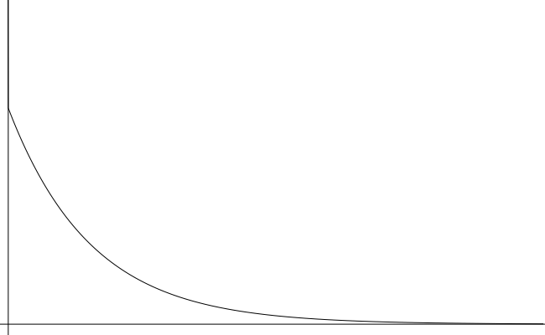
Solving hash puzzles is probabilistic
10
minutes
Probability density
Time to next block (entire network)

Slide 35
PoW property 3: trivial to verify
Nonce must be published as part of block
Other miners simply verify that
H(nonce ‖ prev_hash ‖ tx ‖ … ‖ tx) < target

Slide 36
Mining economics
Complications:
fixed vs. variable costs
reward depends on global hash rate
If mining reward (block reward + Tx fees) | > | hardware + electricity cost | → | Profit

Slide 37
Bitcoin is bootstrapped
security of block chain
health of mining ecosystem
value of currency

Slide 38
What can a “51% attacker” do?
Steal coins from existing address?
Suppress some transactions?
From the block chain
From the P2P network
Change the block reward?
Destroy confidence in Bitcoin?
✗
✓
✗
✗
✓✓

