Slide 1
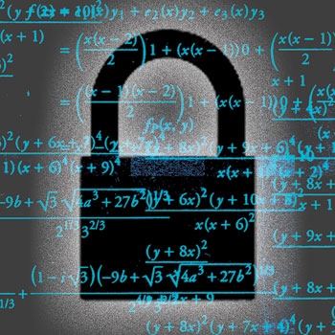
Cryptography
CS230: COMPUTER SYSTEMS SECURITY (Summer 2020)
Marco Canini
Lecture slides adapted from UCL INGI2347 by Gildas Avoine, Upenn CSE331 by Steve Zdancewic, and
Dan Boneh, Stanford Cryptography I@Coursera. Reproduced with permission
Notes:
Image source: http://spectrum.ieee.org/image/62374

Slide 2
Cryptography overview
What’s crypto?
Symmetric-key encryption
Crypto hash functions
Integrity
Trusted 3rd parties
Public-key encryption

Slide 3
Cryptography
Greek for “secret writing”
Confidentiality
  Obscure a message from eaves-droppers
Integrity
  Assure recipient that the message was not altered
Authentication
  Verify the identity of the source of a message
Non-repudation
  Convince a 3rd party that what was said is accurate

Slide 4
Terminology
Alice
Bob
plaintext
ciphertext
ciphertext
plaintext
Encryption
Decryption
Encryption algorithm
  Transforms a plaintext into a ciphertext that is unintelligible for
  non-authorized parties
  Usually parametrized with a cryptographic key
Asymmetric (Public) key cryptography
  Crypto system: encryption + decryption algorithms + key generation
Symmetric (Shared) key cryptography
  Cipher/decipher: symmetric-key encryption/decryption algorithms

Slide 5
Cryptography is everywhere
Secure communication:
  web traffic: HTTPS
  wireless traffic: 802.11i WPA2 (and WEP), GSM, Bluetooth
Encrypting files on disk: EFS, TrueCrypt
Content protection (e.g. DVD, Blu-ray): CSS, AACS
User authentication
… and much much more

Slide 6
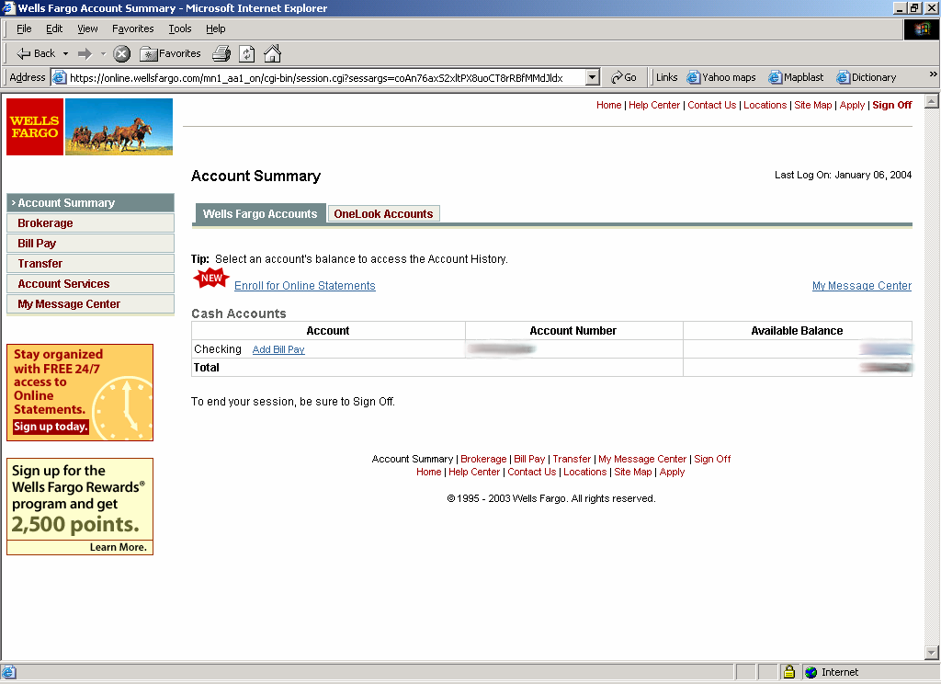
Secure communication
Bob
HTTPS
SSL / TLS
no eavesdropping
no tampering
Alice

Slide 7
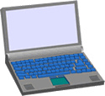
Secure Sockets Layer / TLS
Bob
Alice
Two main parts
  1. Handshake Protocol: Establish shared secret key
  using public-key cryptography
  2. Record Layer: Transmit data using shared secret key
    Ensure confidentiality and integrity

Slide 8
Protected files on disk
Disk
File 1
Alice
Alice
No eavesdropping
No tampering
File 2
Analogous to secure communication:
Alice today sends a message to Alice tomorrow

Slide 9
Things To Remember
Cryptography is:
  A tremendous tool for protecting information in computer systems
  The basis for many security mechanisms
Cryptography is NOT:
  The solution to all security problems
    software bugs, privacy, social engineering attacks
  Reliable unless implemented and used properly
  Something you should try to invent yourself
    many many examples of broken ad-hoc designs

Slide 10
Symmetric-key cryptography
Assumes parties already share a secret key

Slide 11
Build block: sym.-key encryption
nonce
Alice
Bob
m, n
E(k,m,n)=c
c, n
D(k,c,n)=m
E
D
k
k
E, D: cipher k: secret key (e.g., 128 bits)
m, c: plaintext, cipher text n: nonce (aka IV)
Same secret key for both encryption and decryption
Encryption algorithm is publicly known
  Never use a proprietary algorithm

Slide 12
Use Cases
Single use key: (one time key)
  Key is only used to encrypt one message
    encrypted email: new key generated for every email
Multi use key: (many time key)
  Key used to encrypt multiple messages
    encrypted files: same key used to encrypt many files
    SSL: same key used to encrypt many packets
  Need more machinery than for one-time key

Slide 13
Symmetric Ciphers: definition
Def: a cipher defined over ( K, M, C )
space of keys (K ), messages (M), ciphertexts (C )
is a pair of “efficient” algs ( E, D ) where
E is often randomized | D is always deterministic

Slide 14
Stream vs. Block Ciphers
Stream ciphers
  Act on the plaintext one symbol at a time
  Examples: RC4, GSM A5-1, Bluetooth E0, CSS, …
  High speed rate, hardware implementations very cheap
Block ciphers
  Act on the plaintext in blocks of symbols
  Examples: DES, 3DES, AES, IDEA, Blowfish, RC5, Kasumi, Safer, …
  Suited to software implementations on various systems
    (e.g., 8-bit, 32-bit, 64-bit processors)

Slide 15
Stream Ciphers: The One Time Pad (Vernam 1917)
First example of a “secure” cipher
key = (random bit string, long as the message)
msg: 0 1 1 0 1 1 1
key: 1 0 1 1 0 1 0
CT:
⊕
1 1 0 1 1 0 1
Indeed:

Slide 16
Stream ciphers (single key use)
Problem: OTP key is long as the message
Solution: Pseudo random key – stream ciphers
key
c ← PRG(k) ⊕ m
PRG
⊕
message
ciphertext

Slide 17
Dangers in using stream ciphers
One time key !! “Two time pad” is insecure:
C₁ ← m₁ ⊕ PRG(k)
  C₂ ← m₂ ⊕ PRG(k)
  Eavesdropper does:
  C₁ ⊕ C₂ → m₁ ⊕ m₂
  Enough redundancy in English and ASCII encoding that:
  m₁ ⊕ m₂ → m₁ , m₂

Slide 18
What is a secure cipher?
Attacker’s abilities: obtains one ciphertext (for now)
Possible security requirements:
attempt #1: attacker cannot recover secret key
attempt #2: attacker cannot recover all of plaintext
Shannon’s information-theoretic perfect secrecy:
  ciphertext should reveal no “info” about plaintext
Insecure: leaks m
Insecure: leaks m₀

Slide 19
Model of the attacker (also for PK)
Chosen-plaintext attack (CPA)
  The adversary has access to an encryption oracle: he can choose plaintexts and get their corresponding ciphertexts
Chosen-ciphertext attack (CCA)
  The attacker has access to a decryption oracle: he can choose ciphertexts (other than the ciphertext he is challenged with) and get their corresponding plaintext
  More powerful than CPA

Slide 20
Block Ciphers
n bits
n bits
E, D
Plaintext Block
Ciphertext Block
Key
k bits
Canonical examples:
3DES: n= 64 bits, k = 168 bits
AES: n=128 bits, k = 128, 192, 256 bits
IV handled as part of PT block

Slide 21
Building a block cipher
Input: (m, k)
Repeat simple “mixing” operation several times
• DES: Repeat 16 times:
• AES-128: Mixing step repeated 10 times
Difficult to design: must resist subtle attacks
m_{L} ← m_{R}
m_{R} ← m_{L}⊕F(k,m_{R})

Slide 22
Block Ciphers Built by Iteration
key k
key expansion
⋯
k₁
k₂
k₃
k_{n}
m
R(k₁, ⋅)
R(k₂, ⋅)
R(k₃, ⋅)
R(k_{n}, ⋅)
c
R(k,m) is called a round function
for 3DES (n=48), for AES-128 (n=10)

Slide 23
DES challenge
msg = “The unknown messages is: XXXX … ”
CT = c₁ c₂ c₃ c₄ …
Goal: find k ∈ {0,1}⁵⁶ s.t. DES(k, m_{i}) = c_{i} for i=1,2,3
1997: Internet search -- 3 months
1998: EFF machine (deep crack) -- 3 days (250K $)
1999: combined search -- 22 hours
2006: COPACOBANA (120 FPGAs) -- 7 days (10K $)
⇒ 56-bit ciphers should not be used !! (128-bit key ⇒ 2⁷² days)

Slide 24
Triple-DES
Strengthening DES against exhaustive search
Let E : K × M ⟶ M be a block cipher
Define 3E: K³ × M ⟶ M as
For 3DES: key-size = 3×56 = 168 bits. 3×slower than DES.
3E( (k₁,k₂,k₃), m) = E(k₁, D(k₂, E(k₃, m)))
k₁ = k₂ = k₃
=> single DES

Slide 25
Advanced Encryption Standard (AES)
National Institute of Standards & Technology NIST
  Computer Security Research Center (CSRC)
  http://csrc.nist.gov/
Uses the Rijndael algorithm (by Dr. Joan Daemen & Dr. Vincent Rijmen)
  http://jda.noekeon.org/JDA_VRI_Rijndael_V2_1999.pdf
  Adopted May 26, 2002
  Key length: 128, 192, or 256 bits
  Block size: 128 bits
    If DES could be broken in 1 second, then AES would require
    149 trillion years to be broken

Slide 26
Incorrect use of block ciphers
Electronic Code Book (ECB):
Problem:
  if m₁=m₂ then c₁=c₂
PT:
m₁
m₂
CT:
c₁
c₂

Slide 27
In pictures
Original image
Encrypted using ECB mode
Notes:
https://en.wikipedia.org/wiki/Block_cipher_mode_of_operation#Cipher_block_chaining_(CBC)

Slide 28
Correct use of block ciphers I: CBC mode
Cipher Block Chaining with random IV:
IV
m[0]
m[1]
m[2]
m[3]
⊕
⊕
⊕
⊕
E(k,⋅)
E(k,⋅)
E(k,⋅)
E(k,⋅)
IV
c[0]
c[1]
c[2]
c[3]
ciphertext
Q: how to do decryption?

Slide 29
Use cases: how to choose an IV
Single use key: no IV needed (IV=0)
Multi use key: (CPA Security)
  Best: use a fresh random IV for every message

Slide 30
In pictures
Original image
CBC (or other secure modes) result in pseudo-randomness
Notes:
https://en.wikipedia.org/wiki/Block_cipher_mode_of_operation#Cipher_block_chaining_(CBC)

Slide 31
Correct use of block ciphers II: CTR mode
Counter mode with a random IV: (parallel encryption)
IV
m[0]
m[1]
…
m[L]
⊕
E(k,IV)
E(k,IV+1)
…
E(k,IV+L)
IV
c[0]
c[1]
…
c[L]
ciphertext

Slide 32
Performance
Crypto++ 5.6.0 [ Wei Dai ]
AMD Opteron, 2.2 GHz ( Linux)
Cipher Block/key size Speed (MB/sec)
RC4 126
Salsa20/12 643
Sosemanuk 727
3DES 64/168 13
AES-128 128/128 109
stream
block

Slide 33
Crypto hash functions

Slide 34
Hash Algorithms
Take a variable length string
Produce a fixed length digest
(Non-cryptographic) Examples:
  Parity (or byte-wise XOR)
  CRC
Realistic Example:
  The NIST Secure Hash Algorithm (SHA) takes a message of less than 2⁶⁴ bits
  and produces a digest of 160 bits
hash

Slide 35
Cryptographic Hashes
Create a hard-to-invert summary of input data
Like a check-sum or error detection code
  Uses a cryptographic algorithm internally
  More expensive to compute
Sometimes called a Message Digest
Examples:
  Secure Hash Algorithm (SHA)
  Message Digest (MD4, MD5)

Slide 36
Desired Properties
One way hash function
  Given a hash value y, it should be infeasible to find m s.t. h(m)=y
Collision resistance
  It should be infeasible to find two different messages m₁ and m₂ s.t. h(m₁)=h(m₂)
Random oracle property
  h(m) is indistinguishable from a random n-bit value
  Attacker must spend a lot of effort to be able to modify the message without altering the hash value

Slide 37
Collision resistance
Generic birthday attack

Slide 38
Birthday Paradox
Put n people in a room.
What is the probability that 2 of them have the same birthday?
P_{n}
P₂
P₁
P₄
P₃
PR[P_{i} = P_{j}] > 50% with 23 people.
(Think: n² different pairs)
Notes:
One way to think of this is in a room with n people, there are n^2 different pairings. The prob that any pair has the same birthday is the question we are asking.

Slide 39
Birthday Paradox Rule of Thumb
Given B possibilities, and random samples x₁, ..., x_{n} ∈ {1,…,B},
PR[x_{i} = x_{j}] ≈ 50% when n = B^{1/2}

Slide 40
Generic attack on C.R. functions
Let H: M → {0,1}^{n} be a hash function ( |M| >> 2^{n} )
Generic alg. to find a collision in time O(2^{n/2}) hashes
Algorithm:
Choose 2^{n/2} random messages in M: m₁, …, m₂n/2 (distinct with high prob. )
For i = 1, …, 2^{n/2} compute t_{i} = H(m_{i}) ∈{0,1}^{n}
Look for a collision (t_{i} = t_{j}).
If not found, got back to step 1.
How well will this work?

Slide 41
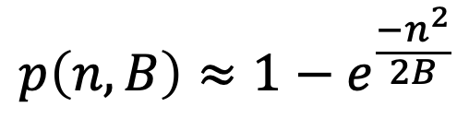
The birthday paradox
Let r₁, …, r_{n} ∈ {1,…,B} be indep. identically distributed integers.
Thm: we get at least two occurrences of the same number with probability:
when n= 1.2 × B^{1/2} then Pr[ ∃i≠j: r_{i} = r_{j} ] ≥ ½
$$p\left(n,B\right)≈1−e^{\frac{−n^{2}}{2B}}$$

Slide 42
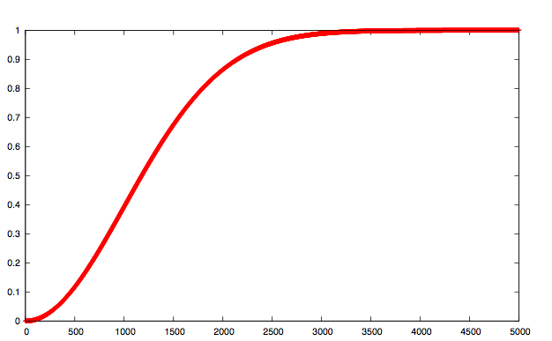
B=10⁶
collision probability
# samples n

Slide 43
Generic attack
H: M → {0,1}^{n} . Collision finding algorithm:
Choose 2^{n/2} random elements in M: m₁, …, m₂n/2
For i = 1, …, 2^{n/2} compute t_{i} = H(m_{i}) ∈{0,1}^{n}
Look for a collision (t_{i} = t_{j}).
If not found, got back to step 1.
Expected number of iteration: ≈ 2
Running time: O(2^{n/2}) (space O(2^{n/2}) )
If H: M-> {0,1}^{n}, then
Pr[collision] ~ ½
with 2^{n/2} hashes

Slide 44
Sample C.R. hash functions: Crypto++ 5.6.0 [ Wei Dai ]
AMD Opteron, 2.2 GHz ( Linux)
digest generic
function size (bits) Speed (MB/sec) attack time
SHA-1 160 153 2⁸⁰
SHA-256 256 111 2¹²⁸
SHA-512 512 99 2²⁵⁶
Whirlpool 512 57 2²⁵⁶
NIST standards
* best known collision finder for SHA-1 requires 2⁵¹ hash evaluations

Slide 45
Integrity
Message Authentication Codes (MAC)

Slide 46
Message Integrity
Goal: integrity, no confidentiality
Examples:
Protecting public binaries on disk
Protecting banner ads on web pages

Slide 47
Message Integrity: MACs
k
k
message m
tag
Alice
Bob
Generate tag:
tag ← S(k, m)
Verify tag:
V(k, m, tag) = ‘yes’
?
Def: MAC I=(S,V) defined over (K,M,T) is a pair of algs
S(k,m) outputs t in T
V(k,m,t) outputs ‘yes’ or ‘no’
Consistency:
∀k∈K, ∀m∈M: V(k, m, S(k, m) ) = ‘yes’

Slide 48
Integrity requires a secret key
message m
tag
Alice
Bob
Generate tag:
tag ← CRC(m)
Verify tag:
V(m, tag) = ‘yes’
?
Attacker can easily modify m and re-compute CRC
CRC designed to detect random, not malicious errors

Slide 49
Secure MACs
Attacker’s power: chosen message attack
  for m₁,m₂,…,m_{q} attacker is given t_{i} ← S(k,m_{i})
Attacker’s goal: existential forgery
  produce some new valid message/tag pair (m,t)
  (m,t) ∉ { (m₁,t₁) , … , (m_{q},t_{q}) }
⇒ attacker cannot produce a valid tag for a new message
⇒ given (m,t) attacker cannot even produce (m,t’) for t’≠t

Slide 50
Secure PRF ⇒ Secure MAC
For a Pseudo Random Function F: K × X → Y
define a MAC I_{F} = (S,V) as:
  S(k,m) := F(k,m)
  V(k,m,t): output `yes’ if t = F(k,m) and `no’ otherwise.
⇒ I_{F} is secure as long as |Y| is large, say |Y| = 2⁸⁰
message m
tag
Alice
Bob
tag ← F(k,m)
accept msg if
tag = F(k,m)

Slide 51
Construction 1: ECBC
(Encrypt-last-block CBC-MAC)
m[0]
m[1]
m[2]
m[3]
⊕
⊕
⊕
E(k,⋅)
E(k,⋅)
E(k,⋅)
E(k,⋅)
Raw CBC
E(k1,⋅)
tag
key = (k, k₁)
The use of k₁ in ECBC is to securely extend CBC-MAC to variable-length messages, without needing to know the length of the message until the end of the computation
Notes:
CBC (aka Raw-CBC) is not a secure MAC: Given tag on a message m, attacker can deduce tag for some other message m’

Slide 52
Construction 2: HMAC
(Hash-MAC)
Standardized method & most widely used MAC on the Internet
  Proposed by Bellare, Canetti, Krawczyk in 1996
  Provably secure
  Standards: FIPS 198-1, RFC 2104, ISO 9797-2
Builds a MAC out of a hash function
  Maintains performance of the original hash function
  Examples:
    HMAC-SHA256: H = SHA256 ; output is 256 bits
    HMAC-SHA1-96: H = SHA1 ; output truncated to 96 bits
HMAC: S(k, m) = H( k ⊕ opad || H( k ⊕ ipad || m ) )

Slide 53
SHA-256: Merkle-Damgard
m[0]
m[1]
m[2]
m[3]
IV
h
h
h
h
H(m)
h(t, m[i]): compression function
Thm 1: if h is collision resistant then so is H
“Thm 2”: if h is a PRF then HMAC is a PRF

Slide 54
Construction 3: PMAC – parallel MAC
ECBC and HMAC are sequential. PMAC:
m[0]
m[1]
m[2]
m[3]
P(k,0)
⊕
P(k,1)
⊕
P(k,2)
⊕
P(k,3)
⊕
F(k,⋅)
F(k,⋅)
F(k,⋅)
F(k,⋅)
⊕
F(k1,⋅)
tag

Slide 55
Authenticated encryption
Encryption + MAC

Slide 56
Combining MAC and ENC
(CCA)
Encryption key K_{E} MAC key = K_{I}
Option 1: MAC-then-Encrypt (SSL)
Option 2: Encrypt-then-MAC (IPsec)
Option 3: Encrypt-and-MAC (SSH)
MAC(M,K_{I})
Enc K_{E}
Msg M
Msg M
MAC
Enc K_{E}
MAC(C, K_{I})
Secure on general grounds
Msg M
MAC
Enc K_{E}
MAC(M, K_{I})
Msg M
MAC

Slide 57
Trusted 3rd Parties
Basic key exchange

Slide 58
Problems with Shared Key Crypto
Compromised key means interceptors can decrypt any ciphertext they’ve acquired
  Change keys frequently to limit damage
Distribution of keys is problematic
  Keys must be transmitted securely
  Use couriers?
  Distribute in pieces over separate channels?

Slide 59
Key Management
Problem: n users
Storing mutual secret keys is difficult
Total: O(n) keys per user ; O(n²) keys in the system
k_{1,3}
u₁
u₃
k_{1,4}
k_{2,3}
k_{1,2}
k_{3,4}
u₂
u₄
k_{2,4}

Slide 60
A better solution
Online Trusted 3rd Party (TTP)
Every user only remembers one key
Alice
k_{A}
k₁
u₁
TTP
k_{AB}
Bob
u₂
k_{B}
k₂

Slide 61
Generating keys: a toy protocol
Alice wants a shared key with Bob
Eavesdropping security only
Bob (k_{B}) Alice (k_{A}) TTP
“Alice wants key with Bob”
choose
random k_{AB}
E(k_{A}, “A,B” || K_{AB})
ticket
ticket⟵E(k_{B}, “A,B” || K_{AB})
k_{AB}
k_{AB}
(E,D) a CPA-secure cipher:
attacker cannot distinguish between
an encrypted value and a random one
Notes:
CPA=Chosen Plaintext Attack

Slide 62
Generating keys: a toy protocol
Alice wants a shared key with Bob
Eavesdropping security only
Eavesdropper sees:
E(k_{A}, “A, B” || k_{AB} ) ; E(k_{B}, “A, B” || k_{AB} )
(E,D) is CPA-secure ⇒
eavesdropper learns nothing about k_{AB}
  TTP needed for every key exchange, knows all session keys
  In a corporate environment might make sense
    Example: Kerberos system

Slide 63
Toy protocol: insecure against active attacks
Example: insecure against replay attacks
Attacker records session between Alice and Bob
  For example a book order
Attacker replays session to Bob
  Bob thinks Alice is ordering another copy of book

Slide 64
Key question
Can we generate shared keys without an online TTP?
Answer: yes!
Starting point of public-key cryptography:
Merkle (1974), Diffie-Hellman (1976), RSA (1977)
Further references:
  More recently: ID-based enc. (BF 2001), Functional enc. (BSW 2011)

Slide 65
Diffie-Hellman Key Exchange

Slide 66
Key exchange without an online TTP?
Goal: Alice and Bob want shared secret, unknown to eavesdropper
  Communication link is public
  They don’t already share any secrets
For now: security against eavesdropping only (no tampering)
Alice
Bob
eavesdropper ??

Slide 67
Diffie-Hellman Key Exchange
Whitfield Diffie and Martin Hellman
  Proposed in 1976 in a seminal paper “New Directions in Cryptography”
  They won the 2015 Turing award for this work

Slide 68
The Diffie-Hellman protocol
Fix a large prime p (e.g. 600 digits ~ 2000 bits)
Fix an integer g in {1, …, p}
Alice
Bob
“Let’s use (p, g)”
choose secret random a in {1,…,p-1}
“OK”
choose secret random b in {1,…,p-1}
A ← gª (mod p)
B ← g^{b} (mod p)
Bª (mod p) = (g^{b})ª =
k_{AB} = g^{ab} (mod p)
= (gª)^{b} = A^{b} (mod p)
Notes:
“Alice”, A = ga (mod p) ; “Bob”, B = gb (mod p)

Slide 69
Security
Eavesdropper sees: p, g, A=gª (mod p), and B=g^{b} (mod p)
Can they compute g^{ab} (mod p) ?
  They can easily calculate g^{a+b} (mod p) but that doesn’t help
  The problem of computing discrete logarithms (to recover a from gª (mod p)) is hard

Slide 70
Diffie-Hellman Example
Alice and Bob agree that p=71 and g=7
Alice selects a private key A=5 and calculates a public key
gª ≡ 7⁵ ≡ 51 (mod 71) ; Alice sends this to Bob
Bob selects a private key B=12 and calculates a public key
g^{b} ≡ 7¹² ≡ 4 (mod 71) ; Bob sends this to Alice
Alice calculates the shared secret:
S ≡ (g^{b})ª ≡ 4⁵ ≡ 30 (mod 71)
Bob calculates the shared secret:
S ≡ (gª)^{b} ≡ 51¹² ≡ 30 (mod 71)
a ≡ b (mod n)
is equivalent to
a mod n = b mod n

Slide 71
Public key cryptography

Slide 72
Public Key Encryption
Alice
Bob
m
E(PK_{Bob},m)=c
c
D(SK_{Bob},c)=m
E
D
PK_{Bob}
key pair
SK_{Bob}
G
PK: public key , SK: secret key (e.g., 1024 bits)
Example: Bob generates (PK_{Bob}, SK_{Bob}) and gives PK_{Bob} to Alice

Slide 73
Applications
Session setup (for now, only eavesdropping security)
Non-interactive applications: (e.g., Email)
Bob sends email to Alice encrypted using PK_{Alice}
Note: Bob needs PK_{Alice} (public key management)
Alice
PK_{Alice}
Bob
generate (PK, SK)
choose random x
(e.g. 48 bytes)
E(PK_{Alice}, x)
x

Slide 74


Applications
Encryption in non-interactive settings:
Encrypted File Systems
sk_{A}
write
read
Alice
E(pk_{A}, K_{F})
Bob
File
E(k_{F}, File)
E(pk_{B}, K_{F})

Slide 75
Applications
Encryption in non-interactive settings:
Key escrow: data recovery without Bob’s key
Escrow
Service
write
sk_{escrow}
E(pk_{escrow}, K_{F})
Bob
E(k_{F}, File)
E(pk_{B}, K_{F})
Notes:
Describe this in corporate settings. Bob’s key is no longer available, but need access to his files.
Escrow service is offline until needed.

Slide 76
Trapdoor functions (TDF)
Def: a trapdoor func. X⟶Y is a triple of efficient algs. (G, F, F⁻¹)
G(): randomized alg. outputs key pair (pk, sk)
F(pk,⋅): deter. alg. that defines a func. X ⟶ Y
F⁻¹(sk,⋅): defines a func. Y ⟶ X that inverts F(pk,⋅)
Security: F(pk, ⋅) is one-way without sk

Slide 77
Public-key encryption from TDFs
(G, F, F⁻¹): secure TDF X ⟶ Y
(E_{s}, D_{s}) : symm. auth. encryption with keys in K
H: X ⟶ K a hash function
We construct a pub-key enc. system (G, E, D):
Key generation G: same as G for TDF
Notes:
authenticated encryption means that encryption is combined with ciphertext integrity (e.g., via a MAC)

Slide 78
Public-key encryption from TDFs
(G, F, F⁻¹): secure TDF X ⟶ Y
(E_{s}, D_{s}) : symm. auth. encryption with keys in K
H: X ⟶ K a hash function
E( pk, m) :
x ⟵ X, y ⟵ F(pk, x)
k ⟵ H(x), c ⟵ E_{s}(k, m)
output (y, c)
D( sk, (y,c) ) :
x ⟵ F⁻¹(sk, y),
k ⟵ H(x), m ⟵ D_{s}(k, c)
output m
Rnd
Notes:
authenticated encryption means that encryption is combined with ciphertext integrity (e.g., via a MAC)

Slide 79
In pictures:
Security Theorem:
If (G, F, F⁻¹) is a secure TDF,
(E_{s}, D_{s}) provides auth. enc.
and H: X ⟶ K is a “random oracle”
then (G,E,D) is CCA secure.
F(pk, x)
E_{s}( H(x), m )
header
body
Notes:
Random oracle means that H is a random function from the set X to the set K. This is an idealization of what a hash function should be. In practice when in comes to implementation, you would use something like SHA-256.
NEVER encrypt m directly with RSA.

Slide 80
Trade-offs for Public Key Crypto
More computationally expensive than symmetric (shared) key crypto
  Algorithms are harder to implement
  Require more complex machinery
More formal justification of difficulty
  Hardness based on complexity-theoretic results
A principal needs 1 private key and 1 public key
  Number of keys for pair-wise communication is O(n)

Slide 81
Public-Key Infrastructure (PKI)
Anyone can send Bob a secret message
  Provided they know Bob’s public key
How do we know a key belongs to Bob?
  If imposter substitutes another key, can read Bob’s mail
One solution: PKI
  Trusted root Certificate Authority (e.g. Symantec)
    Everyone must know the verification key of root CA
  Root authority signs intermediate CA; results in a certificate chain
  More on this later

Slide 82
Digital signatures

Slide 83
Digital Signatures
Public-key encryption
  Alice publishes encryption key
  Anyone can send encrypted message
  Only Alice can decrypt messages with this key
Digital signature scheme
  Alice publishes key for verifying signatures
  Anyone can check a message signed by Alice
  Only Alice can send signed messages

Slide 84
Digital Signatures from TDFs
(G, F, F⁻¹): secure TDF X ⟶ X
H: M ⟶ X a hash function
Security: existential unforgeability under a chosen message attack in the random oracle model
Sign( sk, m∈X) :
output
sig = F⁻¹(sk, H(m) )
Verify( pk, m, sig) :
output
1 if H(m) = F(pk, sig)
0 otherwise

Slide 85
Man-in-the-middle
Active attacker and defense

Slide 86
Insecure against man in the middle
The protocol is insecure against active attacks
Alice
MiTM
Bob
(pk, sk) ⟵ G()
(pk’, sk’) ⟵ G()
“Alice”, pk
“Alice”, pk’
||
choose random
x ∈ {0,1}¹²⁸
“Bob”, E(pk’, x)
||
x ⟵ D(sk’, E(pk’, x))
“Bob”, E(pk, x)
||

Slide 87
Authenticated channel
You should always expect a man-in-the-middle
  e.g. on the internet, your messages go through many intermediaries
Solution: Use an authenticated channel (i.e., use a MAC)
  For instance, Alice and Bob have certificates that contain a public key, and exchange them prior to the session setup
  They use them to authenticate the values in the session setup

Slide 88
RSA

Slide 89
RSA Algorithm
Ron Rivest, Adi Shamir, Leonard Adleman
  Proposed in 1977
  They won the 2002 Turing award for this work
Has withstood years of cryptanalysis
  Not a guarantee of security!
  But a strong vote of confidence
    Further reading: Twenty years of attacks on the RSA cryptosystem,
    D. Boneh, Notices of the AMS, 1999
Hardware implementations:
  1000 x slower than DES
Very widely used:
  SSL/TLS: certificates and key exchange
  Secure email and file systems

Slide 90
RSA at a High Level
Public and private key are derived from secret prime numbers
  Today at least 2048 bits to ensure security (4096 bits is better)
Plaintext message (a sequence of bits)
  Treated as a (large!) binary number
Encryption is modular exponentiation
To break the encryption, conjectured that
one must be able to factor large numbers
  Not known to be in P (polynomial time algorithms)

Slide 91
Modular arithmetic facts
Let n = p⋅q where p and q are prime numbers
Euler’s totient function φ counts the pos. integers < n that are relatively prime to n
  a and b are relatively prime iff their greatest common divisor = 1; GDC(a, b) = 1
Euler’s theorem:
x^{φ(n)} ≡ 1 (mod n) (= 1),
for any x relatively prime with n
a ≡ b (mod n)
is equivalent to
a mod n = b mod n

Slide 92
RSA Details: Key Generation
Choose two distinct random prime numbers p and q
Compute the modulus: n = p⋅q
Choose e such that 1 < e < φ(n) with e and φ(n) relatively prime
  e is the public key exponent (public key = (e, n))
  Typically small: e.g. e = 2¹⁶ + 1 = 65537
Determine d ≡ e⁻¹ (mod φ(n)), that is the modular multiplicative inverse of e (modulo φ(n))
  That is, solve for d given d⋅e ≡ 1 (mod φ(n))
  d is the private key exponent (private key = (d, n))

Slide 93
RSA Details: Key Generation
Publish (e, n) as the public key
Keep (d, n) as the private key
p, q, and φ(n) must also be kept secret or even thrown away altogether!
  Anyone who knows the value of φ(n) can compute d ≡ e⁻¹⋅mod φ(n) !
Notes:
Anyone who knows the value of p and q immediately knows the value of φ(n). Anyone who knows the value of φ(n) can compute d ≡ e⁻¹⋅mod φ(n).

Slide 94
RSA Details: Encryption
Message M is turned to an integer m s.t. 0 ≤ m < n
We use the recipient’s public key (e, n) to compute ciphertext:
c ≡ m^{e} (mod n)
We use modular exponentiation by squaring to compute this efficiently:
m^{e} ≡ (m² mod n)^{(e/2)} (mod n) , if e is even
m^{e} ≡ m (m² mod n)^{((e-1)/2)} (mod n) , else

Slide 95
RSA Details: Decryption
The recipient uses its private key (d, n) to compute:
m ≡ c^{d} (mod n)
This works. Why?
c^{d} mod n ≡ (m^{e} mod n)^{d} (mod n)
≡ m^{(e⋅d)} (mod n )
≡ m^{(k⋅φ(n) + 1)} (mod n )
≡ m⋅(m^{φ(n)})^{k} (mod n )
≡ m¹ (mod n )
e⋅d = 1 (mod φ(n))
⇒ there is integer k s.t.
e⋅d = k φ(n) + 1
m^{φ(n)} = 1 (Euler’s thm)
Notes:
ed = 1 (mod φ(n))
ed = k φ(n) + 1
m^{φ(n)} = 1

Slide 96
RSA as described is NOT secure
Proper use as TDF
(G, F, F⁻¹): secure TDF X ⟶ Y
(E_{s}, D_{s}) : symm. auth. encryption with keys in K
H: X ⟶ K a hash function
E( pk, m) :
x ⟵ X, y ⟵ F(pk, x)
k ⟵ H(x), c ⟵ E_{s}(k, m)
output (y, c)
D( sk, (y,c) ) :
x ⟵ F⁻¹(sk, y),
k ⟵ H(x), m ⟵ D_{s}(k, c)
output m
Rnd
Notes:
authenticated encryption means that encryption is combined with ciphertext integrity (e.g., via a MAC)

Slide 97
Key lengths
Security of public key system should be comparable to security of symmetric cipher:
RSA
Cipher key-size Modulus size
80 bits 1024 bits
128 bits 3072 bits
256 bits (AES) 15360 bits

Slide 98
RSA Details: Encryption Example
Choose two distinct prime numbers, such as p = 61 and q = 53
Compute n = p⋅q giving n = 61×53 = 3233
Compute the totient of the product as φ(n) = (p − 1)(q − 1) giving
φ(3233) = (61 - 1)(53 - 1) = 3120
Choose any number 1 < e < 3120 that is relative prime to 3120; let e = 17
  Choosing a prime number for e leaves us only to check that e is not a divisor of 3120
Compute d, the modular multiplicative inverse of e (mod φ(n)) yielding
d⋅e mod φ(n) = 1 ⇒ d = 2753
The public key is (n = 3233, e = 17)
The private key is (n = 3233, d = 2753)

Slide 99
RSA Details: Encryption Example
To encrypt m = 65, we calculate
c = 65¹⁷ (mod 3233) = 2790
Via modular exponentiation by squaring:
  Note: each congruence is (mod 3233), omitted below
65¹⁷ ≡ 65 (65² mod 3233)⁸ ≡ 65 ⋅ 992⁸
≡ 65 (992² mod 3233)⁴ ≡ 65 ⋅ 1232⁴
≡ 65 (1232² mod 3233)² ≡ 65 ⋅ 1547²
≡ 65 (1547² mod 3233) ≡ 65 ⋅ 789
≡ 2790

