Slide 1
Security
CS 240: Computing Systems and Concurrency
Lecture 19
Marco Canini
Selected content adapted from D. Boneh.

Slide 2
Today
Introdution to Computer Security
What do we mean by security?
Introduction to Cryptography
Symmetric-key crypto
Public-key crypto
Crypto hash functions

Slide 3
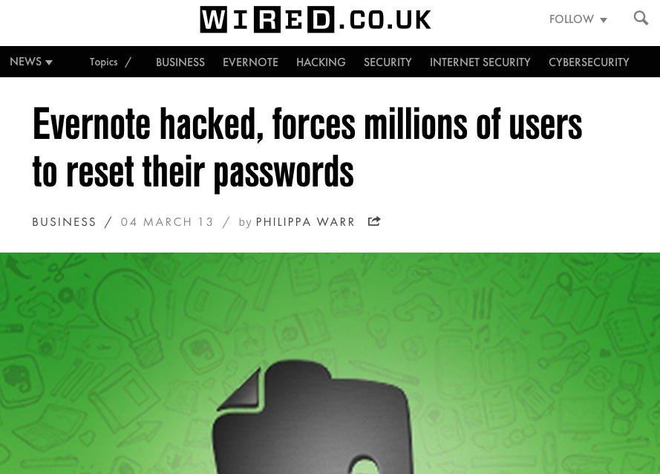
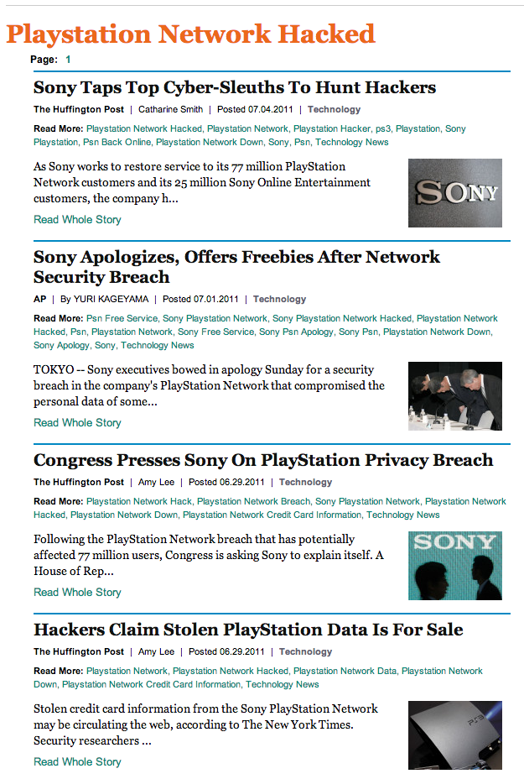
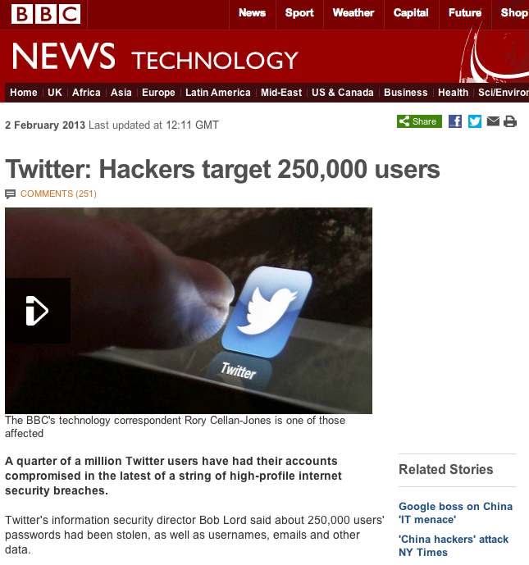
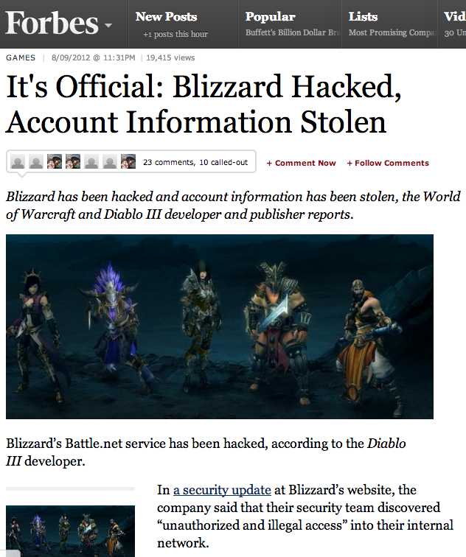
Let’s start
Every day news about new attacks and vulnerabilities
Check out www.cert.org for plenty of examples

Slide 4
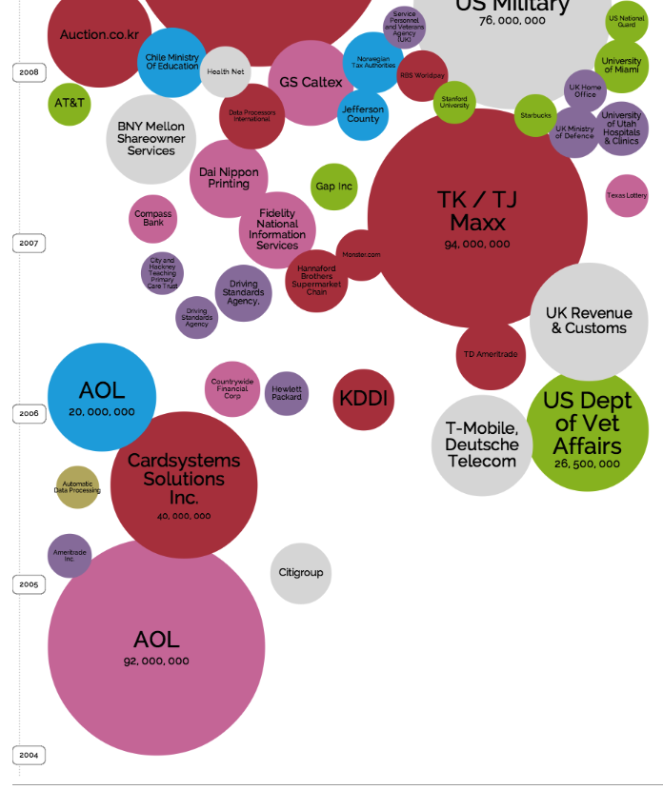

Exponential growth of security incidents over the past 25+ years
http://www.informationisbeautiful.net/visualizations/worlds-biggest-data-breaches-hacks/

Slide 5
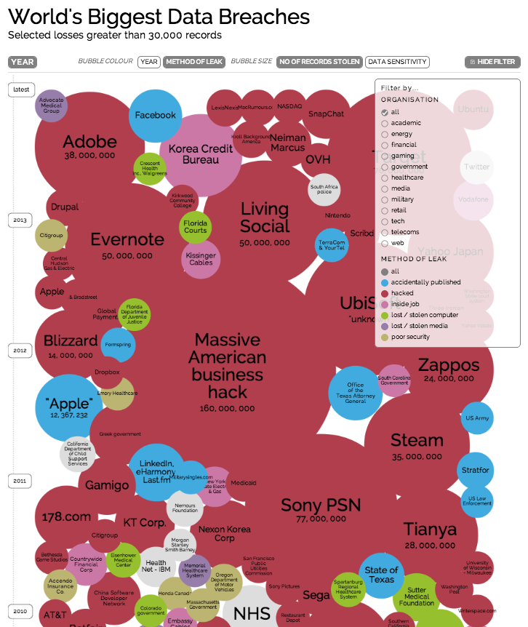
Exponential growth of security incidents over the past 25+ years
Networked systems are more and more complex
Difficult to protect them from ever more sophisticated attacks
http://www.informationisbeautiful.net/visualizations/worlds-biggest-data-breaches-hacks/

Slide 6
The computer security problem
Two factors:
Lots of buggy software (and gullible users)
Money can be made from finding and exploiting vulnerabilities
Marketplace for vulnerabilities
Marketplace for owned machines (PPI)
Many methods to profit from owned client machines
current state of computer security

Slide 7
Why own machines: 1. IP address and bandwidth stealing
Attacker’s goal: look like a random Internet user
Use the IP address of infected machine or phone for:
Spam (e.g. the storm botnet)
Spamalytics: 1:12M pharma spams leads to purchase 1:260K greeting card spams leads to infection
Denial of Service: Services: 1h (20$), 24h (100$)
Click fraud (e.g. Clickbot.a)
Notes:
DDoS service from hack-shop.org.ru
Source: http://www.defcon.org/images/defcon-15/dc15-presentations/dc-15-holt.pdf
Mobile bot-nets: more reliable because phones are always on

Slide 8

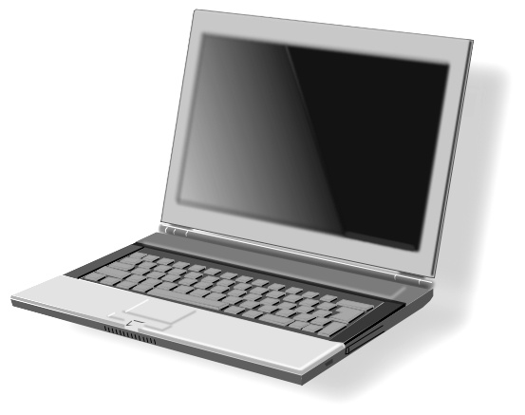

Why own machines: 2. Steal user credentials
keylog for banking passwords, web pwds., gaming pwds.
Example: SilentBanker (and many like it)
User requests login page
Malware injects Javascript
Bank sends login page needed to log in
Bank
When user submits information, also sent to attacker
Similar mechanism used by Zeus botnet

Slide 9
Why own machines: 3. Spread to isolated systems
Example: Stuxtnet
Windows infection ⇒
Siemens PCS 7 SCADA control software on Windows ⇒
Siemens device controller on isolated network

Slide 10
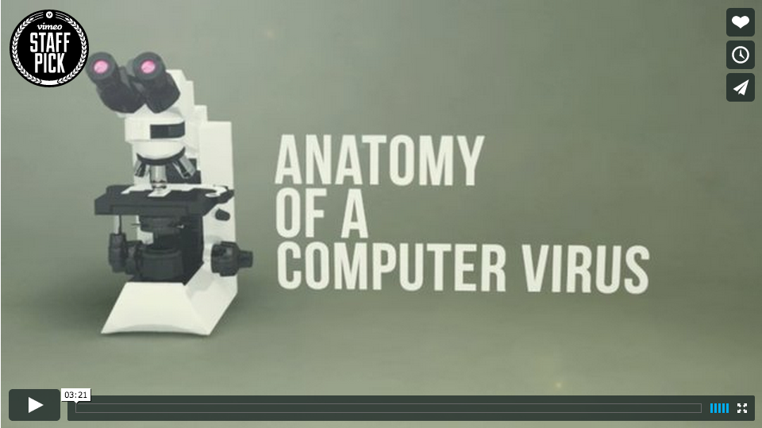
Stuxnet
Stuxnet: Anatomy of a Computer Virus (watch at https://vimeo.com/25118844)
Direction and Motion Graphics: Patrick Clair http://patrickclair.com
Written by: Scott Mitchell
Production Company: Zapruder's Other Films.

Slide 11
What do we mean by security?

Slide 12
What do we mean by security?
Information security is larger than computer security
Defending information from unauthorized access, use, disclosure, disruption, modification, perusal, inspection, recording or destruction
What does it mean for a computer system to be secure?
Notes:
Information security source: Wikipedia

Slide 13
What do we mean by security?
What does it mean for a computer system to be secure?
Achieving some goal in the presence of an adversary
The system only does what it is expected to
Should prevent unauthorized use
What is “unauthorized”?
What about spam?

Slide 14
When is a computer system secure?
When it does exactly what it should
Not more
Not less
But how to know what a system is supposed to do?
Somebody tells us?
But do we trust them?
We write the specification ourselves?
How do we verify that the software meets the specification?
We write the code ourselves?
But what fraction of the software you use have you written?
Can you trust the hardware it runs on?

Slide 15
When is a computer system secure?
A program is secure when it doesn’t do something it shouldn’t
Easier to specify a list of “bad” things:
Delete or corrupt important files
Crash my system
Send my password or credit card details over the Internet
But... what if most of the time the program doesn’t do bad things, but occasionally it does? Is it secure?
Difficult to verify that a system does what it is expected to, impossible to verify that it does not what it is not expected to

Slide 16
“Security is mostly a superstition” – Helen Keller (1880-1968), American writer and activist
Security is all about trade-offs
Performance
Cost
Usability
Functionality
The right question is: how do you know when something is secure enough?
Manage security risks vs benefits
Requires understanding of the trade-offs involved

Slide 17
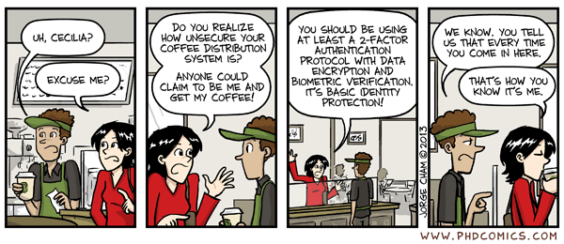
How to think about trade-offs?
What are you trying to protect? How valuable is it?
Nuclear missile launch station vs. … coffee machine
In what way is it valuable?
May be important only to one person (e.g. private e-mail or passwords)
May be important because accurate and reliable (e.g. bank’s accounting logs)
May be important because of a service it provides (e.g. Google’s web servers)

Slide 18
High level plan
Policy: the goal you want to achieve
e.g. only Alice should read file F
Threat model: assumptions about what the attacker could do
e.g. can guess passwords, cannot physically grab file server
Better to err on the side of assuming attacker can do something
Mechanism: knobs that your system provides to help uphold policy
e.g. user accounts, passwords, file permissions, encryption
Resulting goal: no way for adversary within threat model to violate policy
Note that goal has nothing to say about mechanism

Slide 19
Security goals
Prevent common vulnerabilities from occurring (e.g. buffer overflows)
Recover from attacks
Traceability, accountability and auditing of security-relevant actions
Monitoring
Detect attacks
Privacy, confidentiality, anonymity
Protect secrets
Authenticity
Needed for access control, authorization, etc.
Integrity
Prevent unwanted modification or tampering
Availability and reliability
Reduce risk of DoS

Slide 20
Classic CIA triad
Confidentiality
NO unauthorized disclosure of information
E.g. a credit card transaction system attempts to enforce confidentiality by encrypting credit card details over the Internet and in the transaction processing network
Integrity
NO unauthorized information modification
E.g. traditional Unix file permissions can be an important factor in single system measures for protecting data integrity
Availability
Information or system remains available despite attacks
High availability systems aim to remain available at all times, preventing disruptions due to power outages, upgrades, hardware failures, Denial of Service (DoS) attacks, …

Slide 21
Example security mechanisms
Verifying the identity of a prospective user by demanding a password
Authentication
Shielding the computer to prevent interception and subsequent interpretation of electromagnetic radiation
Covert channels
Enciphering information sent communication channels
Cryptography
Locking the room containing the computer
Physical aspects of security
Controlling who is allowed to make changes to a computer system
Social aspects of security

Slide 22
Introduction to cryptography

Slide 23
κρμπτο γραφη (Cryptography)
Greek for “secret writing”
Confidentiality
Obscure a message from eaves-droppers
Integrity
Assure recipient that the message was not altered
Authentication
Verify the identity of the source of a message
Non-repudiation
Convince a 3rd party that what was said is accurate

Slide 24
Things To Remember
Cryptography is:
A tremendous tool
The basis for many security mechanisms
Cryptography is NOT:
The solution to all security problems
Reliable unless implemented and used properly
Something you should try to invent yourself
many many examples of broken ad-hoc designs
Privacy | Steganography | (Encoding|Decoding)

Slide 25
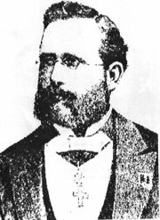
Auguste Kerckhoffs
A cryptosystem should be secure even if everything about the system, except the secret key, is public knowledge.

Slide 26
Cryptography is everywhere
Secure communication:
web traffic: HTTPS
wireless traffic: 802.11i WPA2 (and WEP), GSM, Bluetooth
Encrypting files on disk: EFS, TrueCrypt
Content protection (e.g. DVD, Blu-ray): CSS, AACS
User authentication
… and much much more

Slide 27
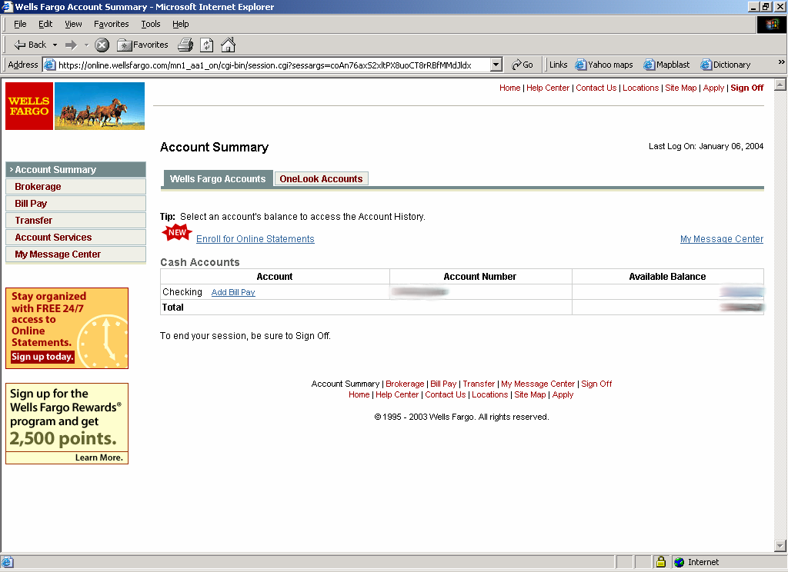
Secure communication
Bob
HTTPS
SSL / TLS
no eavesdropping
no tampering
Alice

Slide 28
Secure Sockets Layer / TLS
Two main parts
1. Handshake Protocol: Establish shared secret key using public-key cryptography
2. Record Layer: Transmit data using shared secret key
Ensure confidentiality and integrity

Slide 29
Protected files on disk
Disk
File 1
Alice
Alice
No eavesdropping
No tampering
File 2
Analogous to secure communication:
Alice today sends a message to Alice tomorrow

Slide 30
Terminology
Alice
Bob
plaintext
ciphertext
ciphertext
plaintext
Encryption
Decryption
Encryption algorithm
Transforms a plaintext into a ciphertext that is unintelligible for non-authorized parties
Usually parametrized with a cryptographic key
Asymmetric (Public) key cryptography
Crypto system: encryption + decryption algorithms + key generation
Symmetric (Shared) key cryptography
Cipher/decipher: symmetric-key encryption/decryption algorithms

Slide 31
Symmetric cryptography
Assumes parties already share a secret key
Same secret key for both encryption and decryption

Slide 32
Building block: sym. encryption
E, D: cipher k: secret key (e.g. 128 bits)
m, c: plaintext, ciphertext n: nonce (aka IV)
Encryption algorithm is publicly known
Never use a proprietary cipher
nonce
Alice
Bob
m, n
E
E(k,m,n)=c
c, n
D
D(k,c,n)=m
k
k

Slide 33
Use Cases
Single use key: (one time key)
Key is only used to encrypt one message
encrypted email: new key generated for every email
No need for nonce (set to 0)
Multi use key: (many time key)
Key used to encrypt multiple messages
SSL: same key used to encrypt many packets
Need either unique nonce or random nonce

Slide 34
First example: One Time Pad (single use key)
Vernam (1917)
Shannon ‘49:
OTP is “secure” against ciphertext-only attacks
Key:
0
1
0
1
1
1
0
0
1
0
⊕
Plaintext:
1
1
0
0
0
1
1
0
0
0
Ciphertext:
1
0
0
1
1
0
1
0
1
0

Slide 35
Stream ciphers (single use key)
Problem: OTP key is as long the message
Solution: Pseudo random key -- stream ciphers
Stream ciphers: RC4 (126 MB/sec) , Salsa20/12 (643 MB/sec)
key
c ← PRG(k) ⊕ m
PRG
⊕
message
ciphertext
Notes:
Pentium 4, 2.1GhZ

Slide 36
Dangers in using stream ciphers
One time key !! “Two time pad” is insecure:
C₁ ← m₁ ⊕ PRG(k)
C₂ ← m₂ ⊕ PRG(k)
Eavesdropper does:
C₁ ⊕ C₂ → m₁ ⊕ m₂
Enough redundancy in English encoding that:
m₁ ⊕ m₂ → m₁ , m₂

Slide 37
Block ciphers: crypto work horse
n Bits
E, D
n Bits
PT Block
CT Block
Key
k Bits
Canonical examples:
3DES: n= 64 bits, k = 168 bits
AES: n=128 bits, k = 128, 192, 256 bits
IV handled as part of PT block

Slide 38
Building a block cipher
Input: (m, k)
Repeat simple “mixing” operation several times
• DES: Repeat 16 times:
• AES-128: Mixing step repeated 10 times
Difficult to design: must resist subtle attacks
• differential attacks, linear attacks, brute-force, …
m_{L} ← m_{R}
m_{R} ← m_{L}⊕F(k,m_{R})

Slide 39
Block ciphers built by iteration
key k
key expansion
k₁
k₂
k₃
k_{n}
m
R(k₁, ⋅)
R(k₂, ⋅)
R(k₃, ⋅)
R(k_{n}, ⋅)
c
R(k,m): round function
for DES (n=16), for AES (n=10)

Slide 40
Incorrect use of block ciphers
Electronic Code Book (ECB):
Problem:
if m₁=m₂ then c₁=c₂
PT:
m₁
m₂
CT:
c₁
c₂

Slide 41
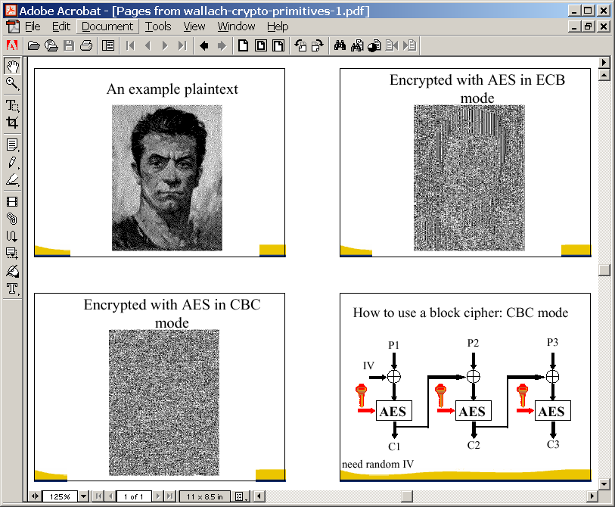
In pictures

Slide 42
Correct use of block ciphers: CBC mode
E a secure PRP. Cipher Block Chaining with random IV:
IV
m[0]
m[1]
m[2]
m[3]
⊕
⊕
⊕
⊕
E(k,⋅)
E(k,⋅)
E(k,⋅)
E(k,⋅)
IV
c[0]
c[1]
c[2]
c[3]
ciphertext
Q: how to do decryption?
Notes:
In cryptography, a pseudorandom permutation (PRP) is a function that cannot be distinguished from a random permutation (that is, a permutation selected at random with uniform probability, from the family of all permutations on the function's domain) with practical effort. [Wikipedia]

Slide 43
Use cases: how to choose an IV
Single use key: no IV needed (IV=0)
Multi use key:
Best: use a fresh random IV for every message
Can use unique IV (e.g counter)
but then first step in CBC must be IV’ ← E(k₁,IV)
benefit: may save transmitting IV with ciphertext

Slide 44
In pictures

Slide 45
Performance
Crypto++ 5.6.0 [ Wei Dai ]
AMD Opteron, 2.2 GHz ( Linux)
Cipher Block/key size Speed (MB/sec)
RC4 126
Salsa20/12 643
Sosemanuk 727
3DES 64/168 13
AES-128 128/128 109
stream
block

Slide 46
Problems with shared key crypto
Compromised key means interceptors can decrypt any ciphertext they’ve acquired
Change keys frequently to limit damage
Distribution of keys is problematic
Keys must be transmitted securely
Use couriers?
Distribute in pieces over separate channels?

Slide 47
Public key cryptography

Slide 48
Public Key Encryption
Gen
key pair
PK_{Bob}
SK_{Bob}
m
E(PK_{Bob},m)=c
c
D(SK_{Bob},c)=m
E
D
Alice
Bob
PK: public key , SK: secret key (e.g., 1024 bits)
Example: Bob generates (PK_{Bob}, SK_{Bob}) and gives PK_{Bob} to Alice

Slide 49
Applications
Session setup (only eavesdropping security)
Non-interactive applications: (e.g. Email)
Bob sends email to Alice encrypted using PK_{Alice}
Note: Bob needs PK_{Alice} (public key management)
Alice
PK_{Alice}
Bob
generate (PK, SK)
choose random x
(e.g. 48 bytes)
E(PK_{Alice}, x)
x

Slide 50
(Simple) RSA Algorithm
Generating a key:
Generate composite n = p * q, where p and q are secret primes
Pick public exponent e
Solve for secret exponent d in d⋅e ≡ 1 (mod (p -1) (q – 1))
Public key = (e, n), private key = d
Encrypting message m: c = m^{e} mod n
Decrypting ciphertext c: m = c^{d} mod n
Security due to cost of factoring large numbers
Finding (p,q) given n takes O(e ^{log n log log n}) operations
n chosen to be 2048 or 4096 bits long

Slide 51
Digital Signatures
Public-key encryption
Alice publishes encryption key
Anyone can send encrypted message
Only Alice can decrypt messages with this key
Digital signature scheme
Alice publishes key for verifying signatures
Anyone can check a message signed by Alice
Only Alice can send signed messages

Slide 52
Public-Key Infrastructure (PKI)
Anyone can send Bob a secret message
Provided they know Bob’s public key
How do we know a key belongs to Bob?
If imposter substitutes another key, can read Bob’s mail
One solution: PKI
Trusted root Certificate Authority (e.g. Symantec)
Everyone must know the verification key of root CA
Check your browser; there are hundreds!!
Root authority signs intermediate CA
Results in a certificate chain

Slide 53
Establishing a shared secret
Alice
Bob
(pk, sk) ⟵ G()
“Alice”, pk
choose random
x ∈ {0,1}¹²⁸
“Bob”, c⟵E(pk,x)
D(sk,c) ⟶ x
x shared secret

Slide 54
Insecure against man in the middle
The protocol is insecure against active attacks
Alice
MiTM
Bob
(pk, sk) ⟵ G()
(pk’, sk’) ⟵ G()
“Alice”, pk
||
“Alice”, pk’
choose random
x ∈ {0,1}¹²⁸
“Bob”, E(pk’, x)
||
x ⟵ D(sk’, E(pk’, x))
“Bob”, E(pk, x)
||

Slide 55
Authenticated channel
You should always expect a man-in-the-middle
e.g. on the internet, your messages go through many intermediaries
Solution: Use an authenticated channel
For instance, Alice and Bob have certificates that contain a public key, and exchange them prior to the msg exchange
They use them to authenticate the values in the session setup phase

Slide 56
Trade-offs for Public Key Crypto
More computationally expensive than symmetric (shared) key crypto
Algorithms are harder to implement
Require more complex machinery
More formal justification of difficulty
Hardness based on complexity-theoretic results
A principal needs 1 private key and 1 public key
Number of keys for pair-wise communication is O(n)

Slide 57
Cryptographic hash functions

Slide 58
Hash Algorithms
Take a variable length string
Produce a fixed length digest
(Non-cryptographic) Examples:
Parity (or byte-wise XOR)
CRC
Realistic Example:
The NIST Secure Hash Algorithm (SHA) takes a message of less than 2⁶⁴ bits and produces a digest of 160 bits
hash

Slide 59
Cryptographic Hashes
Create a hard-to-invert summary of input data
Like a check-sum or error detection code
Uses a cryptographic algorithm internally
More expensive to compute
Sometimes called a Message Digest
Examples:
Secure Hash Algorithm (SHA)
Message Digest (MD4, MD5)

Slide 60
Desired Properties
One way hash function
Given a hash value y, it should be infeasible to find m s.t. h(m)=y
Collision resistance
It should be infeasible to find two different messages m₁ and m₂ s.t. h(m₁)=h(m₂)
Random oracle property
h(m) is indistinguishable from a random n-bit value
Attacker must spend a lot of effort to be able to modify the message without altering the hash value

Slide 61
Data integrity
Message Authentication Codes

Slide 62
Message Integrity: MACs
Goal: message integrity. No confidentiality.
ex: Protecting public binaries on disk.
k
Message m
tag
k
Alice
Bob
Generate tag:
tag ← S(k, m)
Verify tag:
V(k, m, tag) = `yes’
?
note: non-keyed checksum (CRC) is an insecure MAC !!

Slide 63
Secure MACs
Attacker’s power: chosen message attack
for m₁,m₂,…,m_{q} attacker is given t_{i} ← S(k,m_{i})
Attacker’s goal: existential forgery
produce some new valid message/tag pair (m,t)
(m,t) ∉ { (m₁,t₁) , … , (m_{q},t_{q}) }
A secure PRF gives a secure MAC:
S(k,m) = F(k,m)
V(k,m,t): `yes’ if t = F(k,m) and `no’ otherwise.

Slide 64
Standardized method: HMAC (Hash-MAC)
Most widely used MAC on the Internet
H: hash function.
example: SHA-256 ; output is 256 bits
Building a MAC out of a hash function:
HMAC: S( k, m ) = H( k⊕opad || H( k⊕ipad || m ))
Maintains performance of the original hash function

Slide 65
Authenticated Encryption
Encryption + MAC

Slide 66
Combining MAC and ENC
Encryption key K_{E} MAC key = K_{I}
Option 1: MAC-then-Encrypt (SSL)
Option 2: Encrypt-then-MAC (IPsec)
Option 3: Encrypt-and-MAC (SSH)
MAC(M,K_{I})
Enc K_{E}
Msg M
Msg M
MAC
Secure on general grounds
Enc K_{E}
MAC(C, K_{I})
Msg M
MAC
Enc K_{E}
MAC(M, K_{I})
Msg M
MAC

Slide 67
To remember

Slide 68
Limitations of cryptography
Most security problems are not crypto problems
This is good: cryptography works!
This is bad
People make other mistakes; crypto doesn’t solve them
Misuse of cryptography is fatal for security
WEP – ineffective, highly embarrassing for industry
Occasional unexpected attacks on systems subjected to serious review

Slide 69
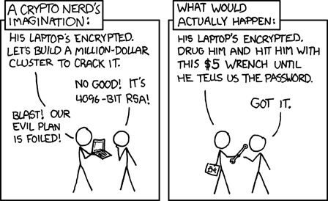
In reality

Slide 70
Wednesday topic:
Bitcoin
and blockchains
and consensus

