Slide 1
Big Data I: Graph Processing, Distributed Machine Learning
CS 240: Computing Systems and Concurrency
Lecture 21
Marco Canini
Credits: Michael Freedman and Kyle Jamieson developed much of the original material.
Selected content adapted from J. Gonzalez.

Slide 2
Patient ate
which contains
purchased
from
Also sold
to
Diagnoses
Patient presents abdominal pain.
Diagnosis?
with
E. Coli
infection
Notes:
Data collection (for better or worse) is on the increase. So there is widespread interest these days in making probabilistic inferences using data from disparate sources.
A nice example is medical diagnosis – suppose some patient presents with a generic symptom.
>>> Might be able to infer a causal chain of events and thus a possible diagnosis of E. Coli infection.

Slide 3
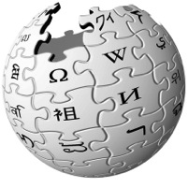



Big Data is Everywhere
6 Billion
Flickr Photos
900 Million
Facebook Users
72 Hours a Minute
YouTube
28 Million
Wikipedia Pages
Machine learning is a reality
How will we design and implement “Big Learning” systems?
Notes:
Huge amounts of data are everywhere, and machine learning algorithms are turning data that once may have been useless into actionable data.
Identify trends, create models, discover patterns. So today we’ll look at how to process this data at these massive scales.
SEGUE: We’ve seen from the smaller problems in the datacenter that processing at these scales DEMANDS PARALLELISM – many processors working on the data at the same time.

Slide 4
Threads, Locks, & Messages
We could use ….
“Low-level parallel primitives”
Notes:
One way of doing this is to use the basic low-level primitives you’ve learned about in your classes on programming languages & architecture to coordinate different machines working on the same problem.

Slide 5
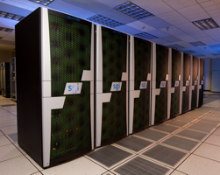
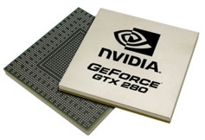
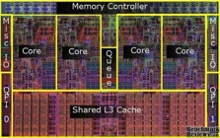
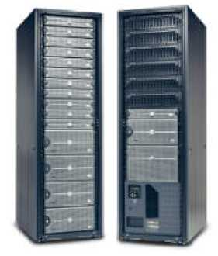

Shift Towards Use Of Parallelism in ML
GPUs
Multicore
Clusters
Clouds
Supercomputers
Programmers repeatedly solve the same parallel design challenges:
Race conditions, distributed state, communication…
Resulting code is very specialized:
Difficult to maintain, extend, debug…
Idea: Avoid these problems by using
high-level abstractions
Notes:
And in fact this is what has been happening over the past decade or so...
>>> So there is a clear need for programming at a higher level of abstraction.

Slide 6
MapReduce / Hadoop
... a better answer:
Build learning algorithms on top of high-level parallel abstractions
Notes:
So one obvious thing to try is to use MapReduce to build these types of learning algorithms.
Hadoop is a Java implementation of MapReduce with a file system.

Slide 7











MapReduce – Map Phase
CPU 1
4
2
.
3
2
1
.
3
2
5
.
8
1
2
.
9
CPU 2
CPU 3
CPU 4
Embarrassingly Parallel independent computation
No Communication needed

Slide 8

MapReduce – Map Phase
CPU 1
8
4
.
3
1
8
.
4
8
4
.
4
2
4
.
1
CPU 2
CPU 3
CPU 4
1
2
.
9
4
2
.
3
2
1
.
3
2
5
.
8
Image Features

Slide 9
MapReduce – Map Phase
CPU 1
6
7
.
5
1
4
.
9
3
4
.
3
1
7
.
5
CPU 2
CPU 3
CPU 4
1
2
.
9
2
4
.
1
4
2
.
3
8
4
.
3
2
1
.
3
1
8
.
4
2
5
.
8
8
4
.
4
Embarrassingly Parallel independent computation

Slide 10
MapReduce – Reduce Phase
Outdoor Picture
Statistics
Indoor
Picture Statistics
22
26
.
26
17
26
.
31
Outdoor
Pictures
CPU 1
CPU 2
Indoor
Pictures
1
2
.
9
2
4
.
1
1
7
.
5
4
2
.
3
8
4
.
3
6
7
.
5
2
1
.
3
1
8
.
4
1
4
.
9
2
5
.
8
8
4
.
4
3
4
.
3
I O O I I I O O I O I I
Image Features

Slide 11
Map-Reduce for Data-Parallel ML
Excellent for large data-parallel tasks!
Data-Parallel Graph-Parallel
Is there more to
Machine Learning
?
Map Reduce
Feature
Extraction
Algorithm
Tuning
Label Propagation
Lasso
Belief
Propagation
Kernel
Methods
Basic Data Processing
Tensor
Factorization
PageRank
Deep Belief
Networks
Neural
Networks
Notes:
So MR is great for these types of tasks, which are called embarrassingly parallel. But the Machine Learning algorithms we’re interested in are significantly more complex.

Slide 12
Exploiting Dependencies
Notes:
A lot of powerful ML methods come from exploiting dependencies between data!

Slide 13
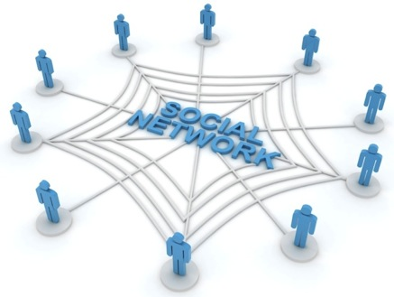
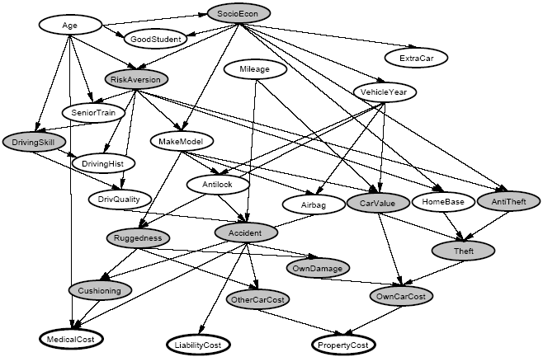
Graphs are Everywhere
Social Network
Collaborative Filtering
Users
Netflix
Movies
Probabilistic Analysis
Text Analysis
Docs
Wiki
Words
Notes:
This idea has lots of applications. Might be infering interests about people in a social network,
>>> Collaborative filtering: trying to predict movie ratings of each user given a sparse matrix of movie ratings from all users. Matrix = BIPARTITE GRAPH where you have users on one side and movies on the other.
>>> Textual analysis: e.g. detecting user sentiment regarding product reviews on a website like Amazon.
>>> relate random variables.

Slide 14
Concrete Example
Label Propagation
Notes:
So for a concrete example, let’s look at label propagation in a social network graph.

Slide 15

Label Propagation Algorithm
Social Arithmetic:
Recurrence Algorithm:
iterate until convergence
Parallelism:
Compute all Likes[i] in parallel
Sue Ann
50% What I list on my profile
40% Sue Ann Likes
10% Carlos Like
80% Cameras
20% Biking
40%
+
I Like:
60% Cameras, 40% Biking
Profile
50%
50% Cameras
50% Biking
Me
Carlos
10%
30% Cameras
70% Biking
Notes:
So to make deeper inferences about for example someone’s hobbies, we might want to do "social arithmetic" on a social networking graph.
>>> Then once we have these interests on the graph we can compute the probability someone likes a hobby as the weighted probabilities that their friends likes that hobby. Some measure of closeness would be the weight. This is just one step that gets applied to the ENTIRE GRAPH – so iterate this applied to ALL NODES.
>>> FURTHERMORE we want to perform this computation on all nodes in the graph IN PARALLEL to speed it up!

Slide 16
Properties of Graph Parallel Algorithms
Dependency
Graph
Factored
Computation
Iterative
Computation
What I Like
What My Friends Like
Notes:
Taking a step back – the big picture here is that this is one example of many GRAPH PARALLEL algorithms that have the following properties.
There is significant information in the dependencies between different pieces of data, and we can represent those dependencies very naturally using a graph.
As a result computation factors into different local vertex neighborhoods in the graph, depends directly only on those neighborhoods.
And because the graph has many chains of connections, we need to ITERATE the local computation, PROPAGATING information around the graph.

Slide 17
Map-Reduce for Data-Parallel ML
Excellent for large data-parallel tasks!
Data-Parallel Graph-Parallel
MapReduce
MapReduce?
Feature
Extraction
Algorithm
Tuning
Label Propagation
Lasso
Belief
Propagation
Kernel
Methods
Basic Data Processing
Tensor
Factorization
PageRank
Deep Belief
Networks
Neural
Networks
Notes:
So that's what these Graph-Parallel algorithms are all about.
So at this point you should be wondering, why not use MapReduce for Graph Parallel Algorithms?

Slide 18
Problem: Data Dependencies
MapReduce doesn’t efficiently express data dependencies
User must code substantial data transformations
Costly data replication
Independent Data Rows
Notes:
Number of reasons. First,
To use MR, on these problems, the user has to code up substantial transformations to the data to make each piece of data independent from the others, this often involves replicating data, which is costly in terms of storage.

Slide 19
Iterative Algorithms
MR doesn’t efficiently express iterative algorithms:
Iterations
Data
Data
Data
Data
CPU 1
CPU 1
CPU 1
Data
Data
Data
Data
Data
Data
Data
Data
Slow
Processor
CPU 2
CPU 2
CPU 2
Data
Data
Data
Data
Data
Data
Data
Data
CPU 3
CPU 3
CPU 3
Data
Data
Data
Data
Data
Data
Data
Data
Barrier
Barrier
Barrier
Notes:
Many ML algorithms (like the social network example before) ITERATIVELY REFINE their variables during operation.
MR doesn’t provide a mechanism to directly encode iterative computation, so you are forced to do something like this: put barriers in where all the computation waits for the barrier before proceeding.
If one processor is slow (common case) then whole system runs slowly.

Slide 20
MapAbuse: Iterative MapReduce
Only a subset of data needs computation:
Iterations
Data
Data
Data
Data
CPU 1
CPU 1
CPU 1
Data
Data
Data
Data
Data
Data
Data
Data
CPU 2
CPU 2
CPU 2
Data
Data
Data
Data
Data
Data
Data
Data
CPU 3
CPU 3
CPU 3
Data
Data
Data
Data
Data
Data
Data
Data
Barrier
Barrier
Barrier
Notes:
Often just a SUBSET of the data needs to be computed on, that subset will change on each iteration of the algorithm. So this setup using MapReduce is doing a lot of UNNECESSARY WORK.

Slide 21
MapAbuse: Iterative MapReduce
System is not optimized for iteration:
Iterations
Data
Data
Data
Data
CPU 1
CPU 1
CPU 1
Data
Data
Data
Data
Data
Data
Data
Data
CPU 2
CPU 2
CPU 2
Startup Penalty
Disk Penalty
Startup Penalty
Disk Penalty
Startup Penalty
Data
Data
Disk Penalty
Data
Data
Data
Data
Data
Data
CPU 3
CPU 3
CPU 3
Data
Data
Data
Data
Data
Data
Data
Data
Notes:
Finally there is a startup penalty associated with the storage and network delays of reading and writing to disk to make this barrier between stages. So the system isn’t optimized for iteration from a performance standpoint.

Slide 22
ML Tasks Beyond Data-Parallelism
Data-Parallel Graph-Parallel
Map Reduce
?
Feature
Extraction
Cross
Validation
Graphical Models
Gibbs Sampling
Belief Propagation
Variational Opt.
Semi-Supervised Learning
Label Propagation
CoEM
Computing Sufficient
Statistics
Collaborative
Filtering
Tensor Factorization
Graph Analysis
PageRank
Triangle Counting
Notes:
There’s a large universe of applications that fit nicely into graph-parallel algorithms
What kind of framework would be a good target for these applications?

Slide 23
ML Tasks Beyond Data-Parallelism
Data-Parallel Graph-Parallel
Map Reduce
Feature
Extraction
Cross
Validation
Pregel
Computing Sufficient
Statistics
Notes:
There are many distributed graph processing frameworks.
We will focus on GraphLab.

Slide 24

Limited CPU Power
Limited Memory
Limited Scalability
Notes:
So the challenge is to scale up computation from a single server with its limited capabilities.

Slide 25

Distributed Cloud
Scale up computational resources!
Challenges:
Distribute state
Keep data consistent
Provide fault tolerance
Notes:
The way we’ve seen to do this previously in this class is to scale OUT.

Slide 26
The GraphLab Framework
Graph Based
Data Representation
Update Functions
User Computation
Consistency Model
Notes:
So the high-level view of GraphLab is that it has three main parts, first a graph based data representation. Second, a way for the user to express computation through update functions, and finally a consistency model. So let’s take the three parts in turn.

Slide 27
Data Graph
Data is associated with both vertices and edges
Graph:
Social Network
Vertex Data:
User profile
Current interests estimates
Edge Data:
Relationship
(friend, classmate, relative)
Notes:
GraphLab stores the program state as a directed graph called the Data Graph.

Slide 28
Distributed Data Graph
Partition the graph across multiple machines:
Notes:
Cut along edges
SEGUE: So we have missing pieces of data from each node’s viewpoint. So this means that a LOCAL data fetch becomes a REMOTE data fetch.

Slide 29
Distributed Data Graph
Ghost vertices maintain adjacency structure and replicate remote data.
“ghost” vertices
Notes:
So the ghost vertices live locally, maintaining adjacency. They replicate data locally so that it can be read quickly.

Slide 30
Distributed Data Graph
Cut efficiently using HPC Graph partitioning tools (ParMetis / Scotch / …)
“ghost” vertices
Notes:
So GraphLab runs a graph partitioning tool to cut the graph into many pieces, each gets distributed to a different machine.

Slide 31
The GraphLab Framework
Graph Based
Data Representation
Update Functions
User Computation
Consistency Model
Notes:
Given the data at each node, what can the user do with it? The update function lets the user express that.

Slide 32
Update Function
A user-defined program, applied to a vertex; transforms data in scope of vertex
Pagerank(scope){
// Update the current vertex data
// Reschedule Neighbors if needed
if vertex.PageRank changes then
reschedule_all_neighbors;
}
Update function applied (asynchronously)
in parallel until convergence
Many schedulers available to prioritize computation
Selectively triggers computation at neighbors
Notes:
An update function is a stateless procedure that modifies the data within the
>>> SCOPE of a vertex (all edges and adjacent nodes). The update function also SCHEDULES the future execution of update functions on OTHER VERTICES.
>>> So for e.g. if we are computing the Google PageRank of a web page, each vertex = a web page, each edge = hyperlink from one web page to another.
>>> PageRank is a weighted sum. When one page's PageRank changes, ONLY its neighbors needs to be recomputed!
>>> SEGUE: GraphLab applies the update functions in parallel until the entire computation converges.

Slide 33
Distributed Scheduling
Each machine maintains a schedule over the vertices it owns
a
f
b
d
a
b
c
h
c
g
e
f
g
h
i
j
k
i
j
Distributed Consensus used to identify completion
Notes:
Each machine maintains a separate SCHEDULE of vertices waiting to be run. Serially pulls tasks from its local scheduler queue and runs the user update functions.
>>> One machine's scheduler may result in added tasks on another's schedule if it processes a vertex adjacent to ghost vertices.

Slide 34
Ensuring Race-Free Code
How much can computation overlap?
Notes:
So we are in an asynchronous, dynamic computation environment.
We mostly want to prevent race conditions, where two updates are writing or reading/writing to the same vertex or edge.

Slide 35
The GraphLab Framework
Graph Based
Data Representation
Update Functions
User Computation
Consistency Model
Notes:
To address this, let’s now move on to the consistency model.

Slide 36
PageRank Revisited
Pagerank(scope) {
…
}
Notes:
So let’s revisit the core piece of computation and see how it behaves if we allow it to race.

Slide 37
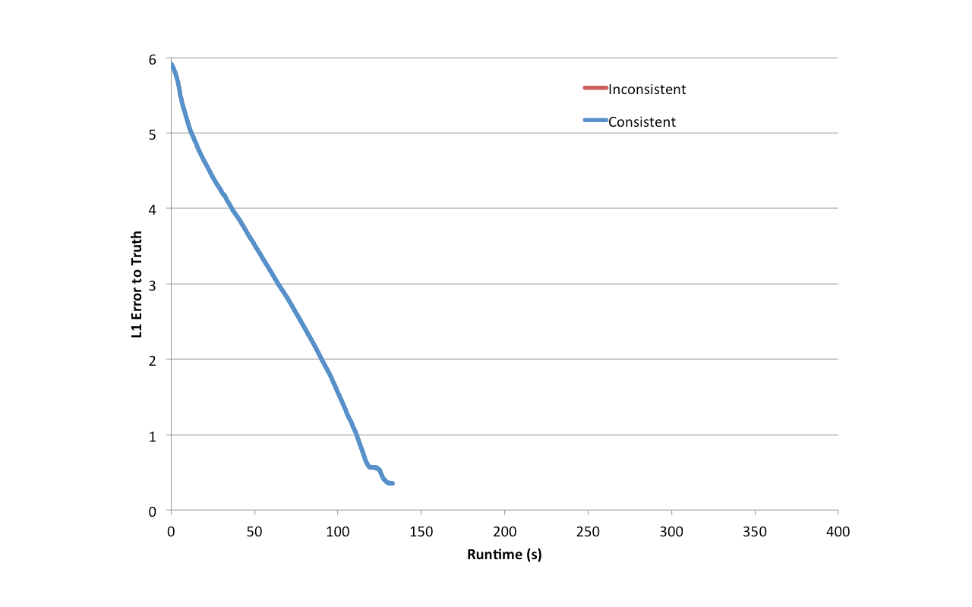
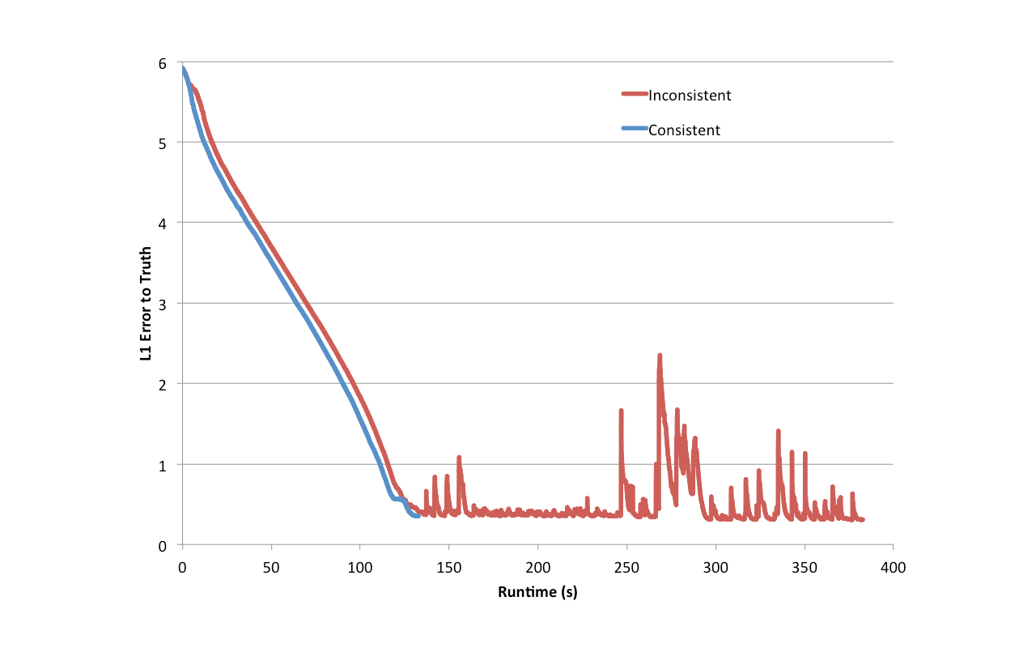
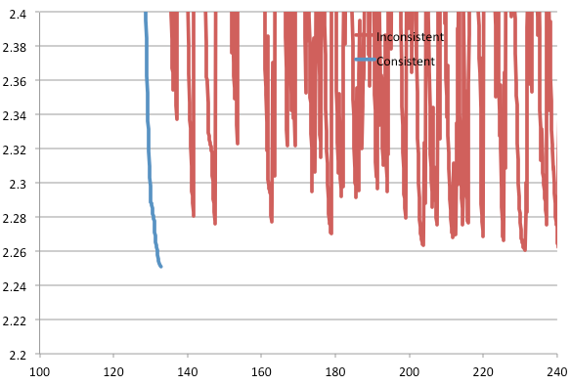
PageRank data races confound convergence
Notes:
This was actually encountered in user code!
Plot error to ground truth over time. If we can run consistently. Converges just fine; but if we don’t:
>>> zoom in. Fluctures near convergence and never quite gets there.
SEGUE: Now, PageRank is provably convergent under inconsistency, yet it does not converge. Why?

Slide 38
Racing PageRank: Bug
Pagerank(scope) {
…
}
Notes:
Take a look at the code again. Can we see the problem?
A vertex’s PageRank fluctuates when its neighbors read it because we are writing directly to the vertex PageRank value. This results in the propagation of bad values.

Slide 39
Racing PageRank: Bug Fix
Pagerank(scope) {
…
}
tmp
tmp
Notes:
Solution is to store in a TEMPORARY variable, and only modify the vertex ONCE at the end.
- First problem: without consistency, the programmer has to be constantly aware of that fact and be careful to code around it.

Slide 40
Throughput != Performance
No Consistency
Higher Throughput
(#updates/sec)
Potentially Slower Convergence of ML
Notes:
Conventional wisdom is that ML algorithms are robust to inconsistency, so ignore this issue (allow computation to race) and it will still work out.
BUT higher throughput does not mean that the algorithm converges faster.

Slide 41
Serializability
For every parallel execution, there exists a sequential execution of update functions which produces the same result.
CPU 1
time
Parallel
CPU 2
Sequential
Single
CPU
Notes:
So as we saw before in this class, we can define race free operation using the notion of SERIALIZABILITY.
>>> Suppose we have a graph with three vertices, and two CPUs are running update functions on these three vertices IN PARALLEL.
>>> The execution is serializable there exists a corresponding serial schedule of update functions that when executed sequentially produces the SAME VALUES in the data-graph.

Slide 42
Serializability Example
Write
Stronger / Weaker
consistency levels available
User-tunable consistency levels
trades off parallelism & consistency
Read
Overlapping regions
are only read.
Update functions one vertex apart can be run in parallel.
Edge Consistency
Notes:
So if we ensure each update function has exclusive read-write access to its vertex and adjacent edges but read only access to adjacent vertices, then
>>> there will be NO conflicts if update functions separate by one vertex apart from each other run at the same time
>>> (both are READING from the overlapping regions).
>>> GraphLab calls this EDGE CONSISTENCY.

Slide 43
Distributed Consistency
Solution 1: Chromatic Engine
Edge Consistency via Graph Coloring
Solution 2: Distributed Locking
Notes:
So to achieve edge consistency GraphLab has TWO algorithms. The first is called the Chromatic Engine.
Vertices of the same color are all at least one vertex apart.
Therefore, all vertices of the same color can be run in parallel!

Slide 44
Chromatic Distributed Engine
Execute tasks
on all vertices of
color 0
Execute tasks
on all vertices of
color 0
Ghost Synchronization Completion + Barrier
Time
Execute tasks
on all vertices of
color 1
Execute tasks
on all vertices of
color 1
Ghost Synchronization Completion + Barrier
Notes:
The chromatic distributed engine takes turns with different colors, executing tasks on all vertices of the same color in parallel.
>>> It puts a synchronization BARRIER after every color, so waits for all the tasks for a certain color to finish before proceeding.
>>> Iterates with successive colors.

Slide 45
Matrix Factorization
Netflix Collaborative Filtering
Alternating Least Squares Matrix Factorization
Model: 0.5 million nodes, 99 million edges
Users
Users
Movies
Netflix
D
D
Movies
Notes:
Let's now look at an application that uses the Chromatic Engine, it's the Netflix collaborative filtering application.
Here the bipartite graph can be represented equivalently as this red sparse matrix relating users to movies they like.
We seek a FACTORIZATION of the RED Netflix matrix into two narrower matrices, each of dimension D on one side.

Slide 46

Netflix Collaborative Filtering
vs 4 machines
Ideal
MPI
Hadoop
D=100
D=20
GraphLab
# machines
# machines
(D = 20)
Notes:
Higher D produces higher accuracy while increasing computational cost. X-AXIS is number of machines. Y-AXIS is the speedup relative to FOUR machines. RED curve shows the ideal speedup relative to four machines, linear with slope 1/4. The gap to ideal is the amount of OVERHEAD GraphLab’s chromatic engine introduces.
>>> Now comparing on the Y-AXIS the absolute RUNTIME of the collaborative filtering task, we see that GraphLab is able to slightly outperform the hand-coded MPI implementation! Surprising! Also two orders of magnitude better than the Hadoop MapReduce framework.

Slide 47
Distributed Consistency
Solution 1: Chromatic Engine
Edge Consistency via Graph Coloring
Requires a graph coloring to be available
Frequent barriers → inefficient when only some vertices active
Solution 2: Distributed Locking
Notes:
For complex and/or very large graphs, the user cannot provide a graph coloring, it's too computationally expensive. And we cannot use the chromatic engine to find a graph coloring.
Frequent Barriers make it extremely inefficient for highly dynamic systems where only a small number of vertices are active in each round.

Slide 48

Distributed Locking
Edge Consistency can be guaranteed through locking.
: RW Lock
Notes:
We associate a rw-lock with each vertex.

Slide 49
Consistency Through Locking
Acquire write-lock on center vertex, read-lock on adjacent.
Performance problem: Acquiring a lock from a neighboring machine incurs a latency penalty
Notes:
- write on center, read on adjacent, taking care to acquire locks in canonical ordering
- read lock acquired more than once
minor variations.
SEGUE: But a problem with this is that the communication required to grab a lock on a piece of data that a neighboring machine owns is significant.

Slide 50
Simple locking
lock scope 1
Process request 1
Time
scope 1 acquired
update_function 1
release scope 1
Process release 1
Notes:
- visualize
- acquire a remote lock, send a message.
- only when locks are acquire then machine can run the update function.

Slide 51
Pipelining hides latency
GraphLab Idea: Hide latency using pipelining
lock scope 1
lock scope 2
Process request 1
Time
lock scope 3
Process request 2
scope 1 acquired
Process request 3
scope 2 acquired
scope 3 acquired
update_function 1
release scope 1
update_function 2
Process release 1
release scope 2
Notes:
- large number (10K) simultaneous.
- update function when locks ready. In flight.
- Hide latency of individual.

Slide 52
Distributed Consistency
Solution 1: Chromatic Engine
Edge Consistency via Graph Coloring
Requires a graph coloring to be available
Frequent barriers → inefficient when only some vertices active
Solution 2: Distributed Locking
Residual BP on 190K-vertex/560K-edge graph, 4 machines
No pipelining: 472 sec; with pipelining: 10 sec
Notes:
47 times speedup.

Slide 53
How to handle machine failure?
What when machines fail? How do we provide fault tolerance?
Strawman scheme: Synchronous snapshot checkpointing
Stop the world
Write each machines’ state to disk

Slide 54
Snapshot Performance
No Snapshot
Snapshot
How can we do better, leveraging GraphLab’s consistency mechanisms?
Snapshot time
One slow machine
Slow machine
Notes:
- evaluate behavior. Plot progress.
- linear progress
- Introduce one slow machine into the system
Because we have to stop the world, one slow machine slows everything down!

Slide 55
Chandy-Lamport checkpointing
Step 1. Atomically one initiator
(a) Turns red, (b) Records its own state (c) sends marker to neighbors
Step 2. On receiving marker non-red node atomically: (a) Turns red,
(b) Records its own state, (c) Sends markers along all outgoing channels
First-in, first-out channels between nodes
Implemented within GraphLab as an Update Function
Notes:
Bank balance example -- describe.

Slide 56
Async. Snapshot Performance
No Snapshot
Snapshot
One slow machine
No system performance penalty incurred from the slow machine!
Notes:
Lets see the behavior of this Asynchronous Snapshot procedure.
Instead of a flat-line, we get a little curve.

Slide 57
Summary
Two different methods of achieving consistency
Graph Coloring
Distributed Locking with pipelining
Efficient implementations
Asynchronous FT w/fine-grained Chandy-Lamport
Performance
Efficiency
Scalability
Useability
Notes:
Extended GraphLab abstraction to distributed systems

Slide 58
Sunday topic:
Streaming Data Processing
and Cluster Coordination

