Slide 1
Byzantine Fault Tolerance
CS 240: Computing Systems and Concurrency
Lecture 15
Marco Canini

Slide 2
So far: Fail-stop failures
Traditional state machine replication tolerates fail-stop failures:
  Node crashes
  Network breaks or partitions
State machine replication with N = 2f+1 replicas can tolerate f simultaneous fail-stop failures
  Two algorithms: Paxos, RAFT
Notes:
So far in this class we’ve discussed consensus protocols for state-machine replication in the setting where a failure means the node just stops working.
>>> You’re now experts in the Paxos and RAFT algorithms...
SEGUE: But in reality it’s often not the case that a node or system component just stops working...

Slide 3
Byzantine faults
Byzantine fault: Node/component fails arbitrarily
  Might perform incorrect computation
  Might give conflicting information to different parts of the system
  Might collude with other failed nodes
Why might nodes or components fail arbitrarily?
  Software bug present in code
  Hardware failure occurs
  Hack attack on system
Notes:
So the type of faults we will focus on today are called Byzantine faults – these are where the node fails arbitrarily.

Slide 4
Today: Byzantine fault tolerance
Can we provide state machine replication for a service in the presence of Byzantine faults?
Such a service is called a Byzantine Fault Tolerant (BFT) service
Why might we care about this level of reliability?
Notes:
And the question we're going to ask today is can we provide a reliable state machine replicated service in the presence of Byzantine faults.
SEGUE: So handling fail-stop failures is hard enough; this is a really difficult requirement to meet why might we care?

Slide 5
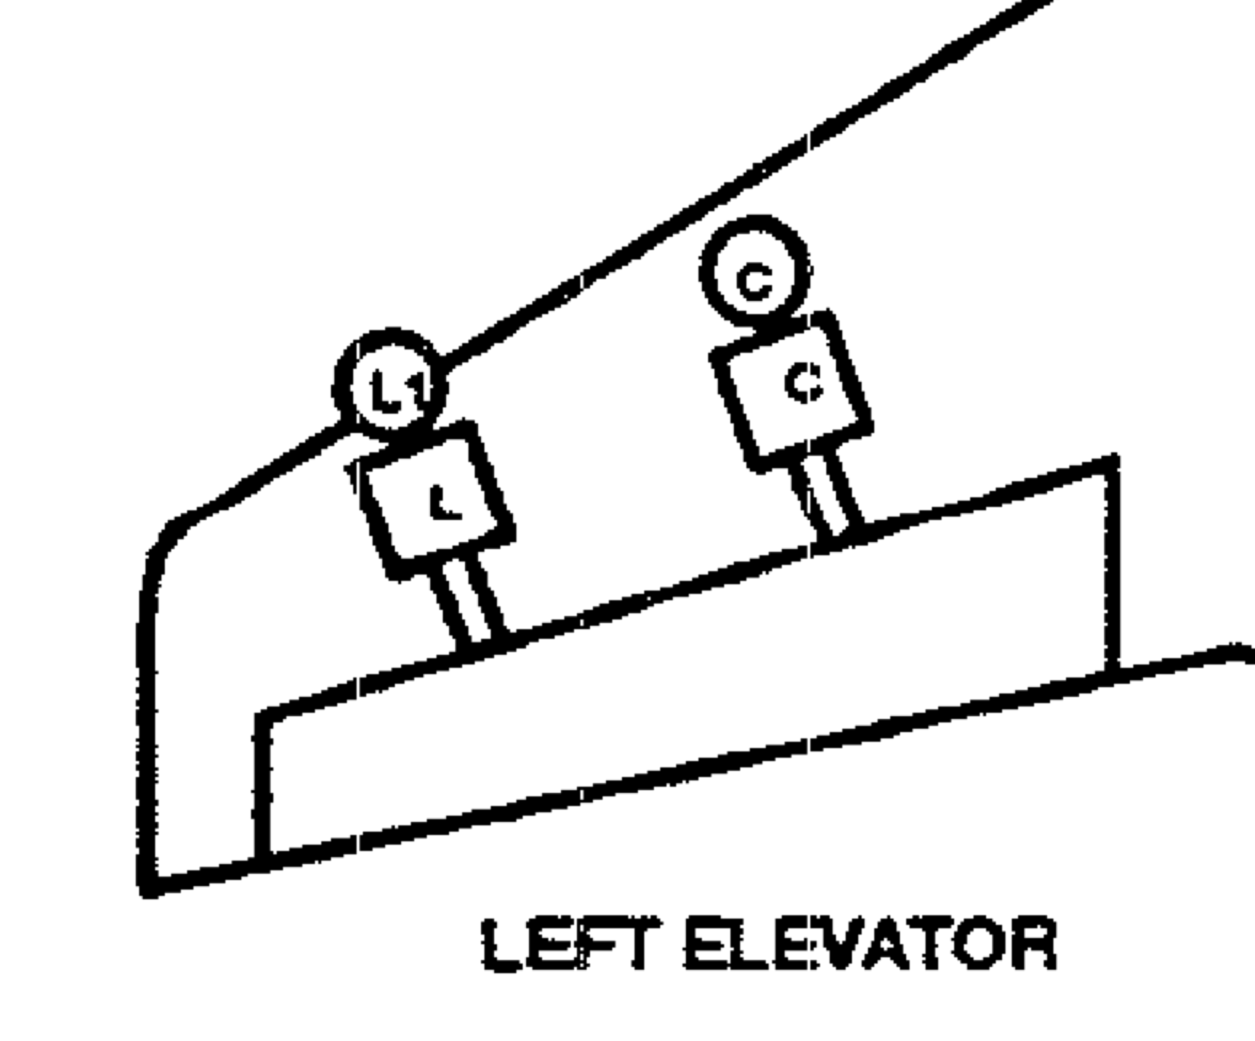
Mini-case-study: Boeing 777 fly-by-wire primary flight control system
Triple-redundant, dissimilar processor hardware:
  Intel 80486
  Motorola
  AMD
Each processor runs code from a different compiler
Key techniques:
Hardware and software diversity
Voting between components
Simplified design:
Pilot inputs → three processors
Processors vote → control surface
Notes:
Here's a thought for next time you're peering out the window of a modern airplane at 35,000 ft. When you make an airplane fly-by-wire: you connect a microprocessor to an airplane's control surface.
>>> I gave you a simplified design here.
SEGUE: Key techniques: hardware/software diversity and voting. We will see these techniques being used.

Slide 6
Today
Traditional state-machine replication for BFT?
Practical BFT replication algorithm
Performance and Discussion
Notes:
So in the rest of today’s lecture, first we'll talk about why traditional state machine replication won't cut it for BFT.
Then I'll describe a Practical BFT replication algorithm, wrap up with performance and discussion.

Slide 7
Review: Tolerating one fail-stop failure
Traditional state machine replication (Paxos) requires, e.g., 2f + 1 = three replicas, if f = 1
Operations are totally ordered → correctness
  A two-phase protocol
Each operation uses ≥ f + 1 = 2 of them
  Overlapping quorums
    So at least one replica “remembers”
Notes:
So let's review traditional state machine replication like Paxos.
>>> These numbers mean that the quorums form overlap from one operation to the next
SEGUE: Okay, so why doesn’t this work for Byzantine Fault Tolerance?

Slide 8
Use Paxos for BFT?
Can’t rely on the primary to assign proposal #
  Could assign same proposal # to different requests
Can’t use Paxos for view change
  Under Byzantine faults, the intersection of two majority (f + 1 node) quorums may be bad node
  Bad node tells different quorums different things!
    e.g. tells N0 accept val1, but N1 accept val2
Notes:
So why can’t we use traditional state machine replication for Byzantine Fault Tolerance? two reasons.
1. First, remember primary told others what seqno & value was, and they trusted this! Same seqno, diff requests breaks state machine replication.
>>> 2. f+1 nodes is a majority and so even if f fail, one node will still keep the state of the correct answer, and we trust that that node is not lying and was not lied to by the nodes that failed.
SEGUE: So let's see this last point in more detail...

Slide 9

Paxos under Byzantine faults (f = 1)
Prepare(1.N0)
Promise(1.N0, Ø)
N2
Prepare(1.N0)
OK
N0
Promise(1.N0, Ø)
N1
n_{h}=1.N0
n_{h}=1.N0
Notes:
So consider this Paxos example. N0 is the leader and broadcasts a prepare message.
>>> N1 & N2 respond OK. n_{h} is highest proposal number seen (N0:1).

Slide 10
Paxos under Byzantine faults (f = 1)
f +1 ✓
Accept(1.N0, xyz)
N2
Promise(1.N0, Ø)
Accept(1.N0, xyz)
OK
N0
Decide
xyz
N1
n_{h}=1.N0
n_{h}=1.N0
Notes:
Then, N0 broadcasts Accept message, and let's suppose the network between N0 and N1 breaks or is slow.
>>> N2, our bad node, then replies OK, so N0 has a majority accept quorum of f+1 nodes to go ahead and decide its proposed value >>> say xyz

Slide 11
Paxos under Byzantine faults (f = 1)
Prepare(1.N2)
N2
Promise(1.N2, Ø)
N0
Decide
xyz
N1
n_{h}=1.N0
n_{h}=1.N2
Notes:
But then, the bad guy N2 turns around and as leader, Prepares another higher sequence number, which N1 will say OK to b/c it's higher than N0's message.

Slide 12
Paxos under Byzantine faults (f = 1)
Accept(1.N2, abc)
N2
Promise(1.N2, Ø)
f +1 ✓
N0
Decide
xyz
Decide abc
N1
n_{h}=1.N0
n_{h}=1.N2
Conflicting decisions!
Notes:
So now N2 tells N1 (ONLY) accept with a different value.
So N1 decides a different value abc and we have conflicting decisions.
SEGUE: So clearly one problem is that the failed node can be in the intersection of two majority accept quorums.

Slide 13
Theoretical fundamentals:
Byzantine Generals
General #2
General #1
Unreliable messenger
General #3
Result: Using messengers, problem solvable iff > ⅔ of the generals are loyal
Notes:
So what to do? Due to Lamport (1982). Problem of agreement in a setting where Byzantine faults happen can be expressed abstractly in terms of a group of generals of the Byzantine army camped with their troops around an enemy city. Communicating only by messengers.
Must agree on common battle plan
They only way to succeed is to attack together or wait together
However, one or more of them may be traitors who will try to confuse the others
SEGUE: Today we’ll see an algorithm that achieves this.

Slide 14
Put burden on client instead?
Clients sign input data before storing it, then verify signatures on data retrieved from service
Example: Store signed file f1=“aaa” with server
  Verify that returned f1 is correctly signed
Notes:
Before I show you the algorithm the other design point we should talk about is using end-to-end crypto outside the system.

Slide 15
<cryptography in 6 slides>

Slide 16
κρυπτό + γραφή (Cryptography)
Greek for “secret writing”
Confidentiality
  Obscure a message from eavesdroppers
Integrity
  Assure recipient that the message was not altered
Authentication
  Verify the identity of the source of a message
Non-repudiation
  Convince a 3rd party that what was said is accurate

Slide 17


Terminology
Alice
Bob
plaintext
ciphertext
ciphertext
plaintext
Encryption
Decryption
Encryption algorithm
  Transforms a plaintext into a ciphertext that is unintelligible for
  non-authorized parties
  Usually parametrized with a cryptographic key
Asymmetric (Public) key cryptography
  Crypto system: encryption + decryption algorithms + key generation
Symmetric (Shared) key cryptography
  Cipher/decipher: symmetric-key encryption/decryption algorithms

Slide 18
Symmetric key encryption
E, D: cipher k: secret key (e.g. 128 bits)
m, c: plaintext, ciphertext n: nonce (aka IV)
Encryption algorithm is publicly known
  Never use a proprietary cipher
nonce
Alice
Bob
m, n
E
E(k,m,n)=c
c, n
D
D(k,c,n)=m
k
k

Slide 19
Public key encryption
Gen
key pair
PK_{Bob}
SK_{Bob}
m
E(PK_{Bob},m)=c
c
D(SK_{Bob},c)=m
E
D
Alice
Bob
PK: public key , SK: secret key (e.g., 1024 bits)
Example: Bob generates (PK_{Bob}, SK_{Bob}) and gives PK_{Bob} to Alice

Slide 20
Applications
Public-key encryption
  Alice public key for encryption
  Anyone can send encrypted message
  Only Alice can decrypt messages (with secret key)
Digital signature scheme
  Alice public key for verifying signatures
  Anyone can check a message signed by Alice
  Only Alice can sign messages (with secret key)

Slide 21
Establishing a shared secret
Alice
Bob
(pk, sk) ⟵ G()
“Alice”, pk
choose random
x
“Bob”, c⟵E(pk,x)
D(sk,c) ⟶ x
x shared secret

Slide 22
</cryptography in 6 slides>

Slide 23
Put burden on client instead?
Clients sign input data before storing it, then verify signatures on data retrieved from service
Example: Store signed file f1=“aaa” with server
  Verify that returned f1 is correctly signed
But a Byzantine node can replay stale, signed data in its response
Inefficient: Clients have to perform computations and sign data
Notes:
Before I show you the algorithm the other design point we should talk about is using end-to-end crypto outside the system.
>>> BUT: client stores (signed) f1=“aaa” and later stores (signed) f1=“bbb”, Byzantine node can always return f1=“aaa”
>>> BUT: clients must do expensive public key crypto EACH TIME they store a key-value pair.

Slide 24
Today
Traditional state-machine replication for BFT?
Practical BFT replication algorithm
[Liskov & Castro, 2001]
Performance and Discussion
Notes:
So here comes the algorithm for BFT replication, due to Barbara Liskov and Miguel Castro at MIT.

Slide 25
Practical BFT: Overview
Uses 3f+1 replicas to survive f failures
  Shown to be minimal (Lamport)
Requires three phases (not two)
Provides state machine replication
  Arbitrary service accessed by operations
    E.g., file system ops read and write files and directories
  Tolerates Byzantine-faulty clients
Notes:
So for example, to survive one failure, you need four replicas, not three.

Slide 26

Correctness argument
Assume operations are deterministic
Assume replicas start in same state
If replicas execute same requests in same order:
  Correct replicas will produce identical results
Client
Replicas
Notes:
We’ll rely on the state machine replication correctness argument that you know well by now.
Protocol has to guarantee that all the non-faulty replicas execute the same operations in the same order.

Slide 27
Non-problem: Client failures
Clients can’t cause replica inconsistencies
Clients can write bogus data to the system
  Sol’n: Authenticate clients and separate their data
    This is a separate problem
Client
Replicas
Notes:
One of the nice things about state machine replication is that it will allow us to provide service in spite of Byzantine-faulty clients. Can make sure that the client doesn’t stop halfway through and leave the system in a bad state so that it can’t proceed.

Slide 28
What clients do
Send requests to the primary replica
Wait for f+1 identical replies
  Note: The replies may be deceptive
    i.e. replica returns “correct” answer, but locally does otherwise!
But ≥ one reply is actually from a non-faulty replica
f+1 matching replies
Client
3f+1 replicas
Notes:
So first I’ll tell you what the clients do, then I’ll tell you what the replicas do (here you see an example with f = 1).
>>> From client’s perspective, f of these replies might be lies (reply saying the right thing, but messes up the state!)
>>> But by the numbers at least 1 of them is coming from a non-faulty replica, and we can rely on that in our protocol.
SEGUE: Haven’t showed you the protocol yet. Protocol needs to ensure that the answer from the non-faulty replica is a correct answer.

Slide 29
What replicas do
Carry out a protocol that ensures that
  Replies from honest replicas are correct
  Enough replicas process each request to ensure that
    The non-faulty replicas process the same requests
    In the same order
Non-faulty replicas obey the protocol
Notes:
Challenge is that we don’t know which replicas are faulty and which aren’t!
SEGUE: So now let’s get into more details of the protocol.

Slide 30
Primary-Backup protocol
Primary-Backup protocol: Group runs in a view
  View number designates the primary replica
Primary is the node whose id (modulo view #) = 1
Client
Primary
Backups
View

Slide 31
Ordering requests
Primary picks the ordering of requests
  But the primary might be a liar!
Backups ensure primary behaves correctly
  Check and certify correct ordering
  Trigger view changes to replace faulty primary
Client
Primary
Backups
View
Notes:
The first problem is how we choose an order of requests. So that’s the role of the primary in any particular view.
>>> So the backups are checking up on what the primary is doing. The way we survive failures is by a VIEW CHANGE to change who the primary is (later).
SEGUE: So now let’s see how correct operation propagates from view to view.

Slide 32
Byzantine quorums (f = 1)
A Byzantine quorum contains ≥ 2f+1 replicas
One op’s quorum overlaps with next op’s quorum
  There are 3f+1 replicas, in total
    So overlap is ≥ f+1 replicas
f+1 replicas must contain ≥ 1 non-faulty replica
Notes:
So just like in Paxos quorums propagate correct operation from view to view, but unlike Paxos, Byzantine quorum has >= 2f+1 replicas. Here f=1 so 3f+1=4 replicas.
Green op executed at these three, orange later/different quorum.
>>> Pick the failure to be in the INTERSECTION of the quorums (worst case!). Truth will be carried through the ONE intersecting replica.

Slide 33
Quorum certificates
A Byzantine quorum contains ≥ 2f+1 replicas
Quorum certificate: a collection of 2f + 1 signed, identical messages from a Byzantine quorum
  All messages agree on the same statement
Notes:
Okay, so now we have a clue about what a CORRECT PRIMARY is going to do in the protocol. It is going to collect a quorum certificate.

Slide 34
Keys
Each client and replica has a private-public keypair
Secret keys: symmetric cryptography
  Key is known only to the two communicating parties
  Bootstrapped using the public keys
Each client, replica has the following secret keys:
  One key per node for sending messages
  One key per node for receiving messages
Notes:
Need to validate that messages in quorum certificates really came from the nodes that they claim to be from. So for that we set up secret keys at each node.
Secret keys for every pair of communicating nodes.
SEGUE: So now let me walk you through the protocol’s operation.

Slide 35
Ordering requests
m=⟨request,op,t⟩_{Signed, Client}
Primary
⟨Let seq(m)=n⟩_{Signed, Primary}
Backup 1
Backup 2
Backup 3
Client requests operation op with timestamp t
Primary chooses the request’s sequence number (n)
  Sequence number determines order of execution
Notes:
First the client submits a request to the primary, and the primary validates and chooses an ordering of requests.
>>> For that we use sequence numbers, and the primary is responsible for choosing the sequence number for the request, which it does when it receives the request.
>>> Let’s suppose Backup 3 fails.
>>> SEGUE: As in Paxos e.g. earlier primary may LIE, so other replicas must check up on it!

Slide 36
Checking the primary’s message
m_{Signed, Client}
Let seq(m)=n_{Signed, Primary}
Primary
I accept seq(m)=n_{Signed, Backup 1}
Backup 1
I accept seq(m)=n_{Signed, Backup 2}
Backup 2
Backup 3
Backups locally verify they’ve seen ≤ one client request for sequence number n
  If local check passes, replica broadcasts accept message
    Each replica makes this decision independently
Notes:
>>> At this point in time, each replica checks the primary’s message.
Check: no two messages propose identical sequence numbers for different client requests. And verify crypto signatures.
>>> If a replica is happy it sends acceptance messages >>> saying that it is happy with that number for this client request.
Primary isn’t bothering to do this b/c it was the one that chose the seqno in the first place.

Slide 37
Collecting a prepared certificate (f = 1)
m_{Signed, Client}
Let seq(m)=n_{Signed, Primary}
Primary
P
I accept seq(m)=n_{Signed, Backup 1}
Backup 1
P
I accept seq(m)=n_{Signed, Backup 2}
Backup 2
P
Backup 3
Each correct node has a prepared certificate locally, but does not know whether the other correct
nodes do too! So, we can’t commit yet!
Backups wait to collect a prepared quorum certificate
Message is prepared (P) at a replica when it has:
  A message from the primary proposing the seqno
  2f messages from itself and others accepting the seqno
Notes:
At this stage, replicas wait for these acceptance messages, try to collect a prepared quorum certificate (2f+1 messages saying the replica accepts the ordering).
>>> When it has that we say that the request is prepared at that replica. Each of the replicas have to create their own prepared quorum certificate.
>>> What does it mean to be prepared?
There’s no global agreement yet on whether we should commit or not. Couldn’t commit at this point because we want everyone to commit or no one to commit.
SEGUE: So we press onward to the next stage of the protocol…

Slide 38
Collecting a committed certificate (f = 1)
m_{Signed, Client}
Let seq(m)=n
Have cert for seq(m)=n_{Signed, Primary}
Primary
P
C
—”—_{Signed, Backup 1}
Backup 1
P
C
accept
—”—_{Signed, Backup 2}
Backup 2
P
C
Backup 3
Once the request is committed, replicas execute the operation and send a reply
directly back to the client.
Prepared replicas announce: they know a quorum accepts
Replicas wait for a committed quorum certificate C: 2f+1 different statements that a replica is prepared
Notes:
So that’s exactly what the next phase of the protocol accomplishes. They announce that THEY KNOW that a quorum accepts.
>>> When receive 2f+1 different statements that a replica is prepared they COMMIT the operation, reply to client. To ensure state machine replication, replica doesn’t execute request until it has executed all earlier requests.
SEGUE: So let's think about what can go wrong here. Primary can't tamper with request b/c of encryption. But, could try to assign two different requests the same sequence number...

Slide 39
Byzantine primary: replaying old requests
The client assigns each request a unique, monotonically increasing timestamp t
Servers track greatest t executed for each client c, T(c), and their corresponding reply
  On receiving request to execute with timestamp t:
    If t < T(c), skip the request execution
    If t = T(c), resend the reply but skip execution
    If t > T(c), execute request, set T(c) ← t, remember reply
Malicious primary can invoke t = T(c) case but cannot compromise safety

Slide 40
Byzantine primary: Splitting replicas (f = 1)
m_{Signed, Client}
Replayed request, signed by client
Primary
Let seq(m’)=n
accept m’
Backup 1
Let seq(m)=n
Backup 2
Let seq(m)=n
Backup 3
accept m
Recall: To prepare, need primary message and 2f accepts
  Backup 1: Won’t prepare m’
  Backups 2, 3: Will prepare m
Notes:
If m’ is a replayed request, backup 1 won’t execute further. But suppose it attempts to prepare…

Slide 41
Splitting replicas
In general, backups won’t prepare two different requests with the same seqno if primary lies
Suppose they did: two distinct requests m and m′ for the same sequence number n
  Then prepared quorum certificates (each of size 2f+1) would intersect at an honest replica
  So that honest replica would have sent an accept message for both m and m′ which can’t happen
    So m = m′

Slide 42
View change
Client
Primary
Backups
View
If a replica suspects the primary is faulty, it requests a view change
  Sends a view change request to all replicas
    Everyone acks the view change request
New primary collects a quorum (2f+1) of responses
  Sends a new-view message with this certificate
Notes:
Okay, so now we know that backups won’t commit if the primary starts lying, so let’s talk about how the replicas can take over and allow the system to proceed so that a Byzantine primary doesn’t bring the system down.
Replicas watch the primary and if they hear conflicting messages they request a view change.
Structure is similar to the normal operation of the system.

Slide 43
Considerations for view change
Need committed operations to survive into next view
  Client may have gotten answer
Need to preserve liveness
  If replicas are too fast to do view change, but really primary is okay – then performance problem
  Or malicious replica tries to subvert the system by proposing a bogus view change
Notes:
So you need to have mechanisms that you don’t do view changes too often so that the system as a whole makes progress and can’t be subverted.

Slide 44
Garbage collection
Storing all messages and certificates into a log
  Can’t let log grow without bound
Protocol to shrink the log when it gets too big
  Discard messages, certificates on commit?
    No! Need them for view change
  Replicas have to agree to shrink the log
Notes:
Each replica is storing all the messages and certificates into a log on disk.
Replicas have to agree to shrink the log, otherwise couldn’t form a new view in certain view change situations.

Slide 45
Proactive recovery
What we’ve done so far: good service provided there are no more than f failures over system lifetime
  But cannot recognize faulty replicas!
Therefore proactive recovery:
  Recover the replica to a known good state whether faulty or not
Correct service provided no more than f failures in a small time window – e.g., 10 minutes
Notes:
Want a system that works with no more than f simultaneous failures.
But …replicas!: a faulty replica might appear okay because it responds to requests, and a non-faulty replica might appear faulty because of broken network or server overload.
>>>
So you select a replication level that gives you confidence that there won’t be more than f failures in that many minutes.

Slide 46
Recovery protocol sketch
Watchdog timer
Secure co-processor
  Stores node’s private key (of private-public keypair)
Read-only memory
Restart node periodically:
  Saves its state (timed operation)
  Reboot, reload code from read-only memory
  Discard all secret keys (prevent impersonation)
  Establishes new secret keys and state
Notes:
So here's a sketch of the proactive recovery. First, here's the HW involved.
>>> Every 10 minutes the watchdog timer fires and the node reboots
Assumption – can’t get to the secure co-processor by remote exploit over the Internet.
Read-only memory stores the BFT code, so the attacker can’t change that!
Note that we relied on the secret keys to prevent impersonation, and if impersonation happened it could break the assumption of no more than f failures.

Slide 47
Today
Traditional state-machine replication for BFT?
Practical BFT replication algorithm
[Liskov & Castro, 2001]
Performance and Discussion

Slide 48
File system benchmarks
BFS filesystem runs atop BFT
  Four replicas tolerating one Byzantine failure
  Modified Andrew filesystem benchmark
What’s performance relative to NFS?
  Compare BFS versus Linux NFSv2 (unsafe!)
    BFS 15% slower: claim can be used in practice
Notes:
Andrew benchmark emulates a software development workload (compile, link).
Linux NFSv2 servers didn’t sync their data to disk before returning writes to the client.
These figures are without view changes or proactive recovery.

Slide 49
Practical limitations of BFT
Protection is achieved only when at most f nodes fail
  Is one node more or less secure than four?
    Need independent implementations of the service
Needs more messages, rounds than conventional state machine replication
Does not prevent many classes of attacks:
  Turn a machine into a botnet node
  Steal data from servers
Notes:
Expensive in terms of the number times messages have to traverse the network between replicas.
Doesn’t prevent hacking into the OS or other services not part of BFT.
Doesn’t prevent hacking from exposing data perhaps stored in the servers.

Slide 50
Large impact
Inspired much follow-on work to address its limitations
The ideas surrounding Byzantine fault tolerance have found numerous applications:
  Boeing 777 and 787 flight control computer systems
  Digital currency systems
Being picked up again in developments of permissioned blockchain systems
Notes:
But on the up-side..

