Slide 1
Course Overview
CS 240: Computing Systems and Concurrency
Lecture 2
Marco Canini

Slide 2
Philosophy and Recurring Themes
Keep it real! This is the real world:
  Things break. Components fail.
  Latency matters. Can’t beat speed of light.
  Certain things are impossible. Need work arounds.
How do we build systems that work at very large scale and tolerate failures?
Given systems span many nodes, how do we enable different nodes to agree on “things” (e.g., time, order of operations, state of the system)?

Slide 3
Learning Objectives
Reasoning about concurrency
Reasoning about failure
Reasoning about performance
Building systems that correctly handle concurrency and failure
Knowing specific system designs and design components

Slide 4
Course Goals
Gain an understanding of the principles and techniques behind the design of modern, reliable, and high-performance systems
In particular learn about distributed systems
  Learn general systems principles (modularity, layering, naming, security, ...)
  Practice implementing real, larger systems that must run in nasty environment
One consequence: Must pass exams and projects independently as well as in total
  Note, if you fail either you will not pass the class

Slide 5
Keep the Big Picture in Mind
Course: many topics, grouped around key areas
Might feel like lectures are disconnected…
... and first need to cover some background
Big Picture:
  real systems have complex requirements that span the concepts of multiple topics
  E.g., we want fault tolerance, consistency and scalability

Slide 6
Course Organization
http://sands.kaust.edu.sa/classes/CS240/F21/

Slide 7
Learning the material: People
Lecture
  Professor Marco Canini
  Slides available on course website
  Office hours: right after lecture or by appointment
TAs
  Arnaud Dethise: M 10:00-11:30, 1-4409-WS18
Main Q&A forum: www.campuswire.com
  No anonymous (to instructors) posts or questions
  Can send private messages to instructors

Slide 8
Learning the Material: Books
Lecture notes!
No required textbooks
References on website available in the Library:
  Programming reference:
    The Go Programming Language. Alan Donovan and Brian Kernighan
  Topic reference:
    Distributed Systems: Principles and Paradigms. Andrew S. Tanenbaum and Maaten Van Steen
    Guide to Reliable Distributed Systems. Kenneth Birman

Slide 9
Grading
Four programming assignments (50% total)
  10% each for 1 & 2
  15% each for 3 & 4
Two exams (50% total)
  Midterm exam on October 6 (15%)
  Final exam during exam period (35%)

Slide 10
Exams
Test learning objectives mostly using designs covered in lectures
And test knowledge of specific design patterns and designs
Open book (but if you don’t study it will create time pressure)
Recipe for success:
  Attend lecture and actively think through problems
  Ask questions during lecture and afterwards in my office hours
  Actively work through problems
  Complete programming assignments
  Study lecture materials for specific design patterns and designs
  Run the system designs in your mind and see what happens

Slide 11
About Assignments
Systems programming somewhat different from what you might have done before
  Low-level (C / Go)
  Often designed to run indefinitely (error handling must be rock solid)
  Must be secure - horrible environment
  Concurrency
  Interfaces specified by documented protocols
TAs’ Office Hours
Read: Dave Andersen’s “Software Engineering for System Hackers”
  Practical techniques designed to save you time & pain

Slide 12
Why use Go?
Easy concurrency w/ goroutines (lightweight threads)
Garbage collection and memory safety
Libraries provide easy RPC
Channels for communication between goroutines

Slide 13
Where is Go used?
Google, of course!
Docker (container management)
CloudFlare (Content delivery Network)
Digital Ocean (Virtual Machine hosting)
Dropbox (Cloud storage/file sharing)
… and many more!

Slide 14
About Assignments
Reinforce / demonstrate all learning objectives!
1: Sequential Map/Reduce (due September 16)
2: Distributed Map/Reduce (due September 23)
3-1: Raft Leader Election (due November 16)
3-2: Raft Log Consensus (due December 2)
4: Key-Value Storage Service (due December 9)

Slide 15
Programming Assignments
Recipe for disaster
  Start day assignment is due
  Write code first, think later
  Test doesn’t pass => randomly flip some bits
  Assume you know what program is doing

Slide 16
Programming Assignments
Recipe for success
  Start early (weeks early)
  Think through a complete design
  Progressively build out your design (using tests to help)
  Checkpoint progress in git (and to gitlab) frequently
  Debug, debug, debug
    Verify program state is what you expect (print it out!)
    Write your own smaller test cases
    Reconsider your complete design
  Attend office hours

Slide 17
Policies: Collaboration
Working together important
  Discuss course material
  Work on problem debugging
Parts must be your own work
  Midterm, final, programming assignments
What we hate to say: we run cheat checkers… they work surprisingly well
Please *do not* put code on *public* repositories

Slide 18
Policies: Write Your Own Code
Programming is an individual creative process. At first, discussions with friends is fine. When writing code, however, the program must be your own work.
Do not copy another person’s programs, comments, README description, or any part of submitted assignment. This includes character-by-character transliteration but also derivative works. Cannot use another’s code, etc. even while “citing” them.
Writing code for use by another or using another’s code is academic fraud in context of coursework.
Do not publish your code e.g., on Github, during/after course!

Slide 19
Policies: Late Work
72 late hours to use throughout the semester
  (but not beyond December 9)
After that, each additional day late will incur a 10% lateness penalty
  (1 min late counts as 1 day late)
Submissions late by 3 days or more will no longer be accepted
  (Fri and Sat count as days)
In case of illness or extraordinary circumstance (e.g., emergency), talk to us early!

Slide 20
Summary
Attend lecture, attend labs, think actively!
Start programming assignments early, use the right strategy!

Slide 21
And for some technical bits today … Distributed Systems and Correctness

Slide 22
Example
Assume a distributed storage
  Clients can read and write files
Server1
Client
S3
S2

Slide 23
System model
N processes p₁,…,p_{N} in the system (no process failures)
  Every process executes an algorithm
    An automation with set of states, set of inputs, set of outputs and a state transition function S x I → S x O
There are two first-in, first-out, unidirectional channels between every process pair p_{i} and p_{j}
  Call them channel(p_{i}, p_{j}) and channel(p_{j}, p_{i})
  All messages sent on channels arrive intact and in order
  Channel cannot duplicate, create or modify messages

Slide 24
System model
Message passing
No failures (for now)
Two possible timing assumptions
  Synchronous System
  Asynchronous System
    No upper bound on message delivery
    No bound on relative process speeds

Slide 25
Example execution
Assume a distributed storage
  Clients can read and write files
Server1
Client
S3
S2

Slide 26
Execution of the system
Processes execute sequences of events
  events can be of 3 types: local, send or receive
An execution (or run) is a sequence of events that respect the system-wide distributed algorithm
  each process is consistent with the local sequences
  a message is sent by a process only if its (local) algorithm prescribes it to do it given the preceding sequence of its inputs
  every received message was previously sent, and no message is received twice

Slide 27
Space-Time diagrams
A graphic representation of distributed execution
A
B
J
C
E
F
G
Server1
S1
C
S2
S2
C
D
H
I
Time →

Slide 28
Common failure assumption
Generally, a failure occurs when a process deviates from the algorithm assigned to it
A process is correct if it never fails
crash failure: the faulty process prematurely stops taking steps of its algorithm
A typical assumption is that, in every possible execution out of N processes, at most f < N can be faulty
We call such a system f-resilient

Slide 29
Safety and liveness properties
Notes:
QUESTION: how is it different from parallelism?

Slide 30
Reasoning about fault tolerance
This is hard!
  How do we design fault-tolerant systems?
  How do we know if we’re successful?
Often use “properties” that hold true for every possible execution
We focus on safety and liveness properties

Slide 31
Properties
Property: a predicate that is evaluated over a run of the system
  “every message that is received was previously sent”
Not everything you may want to say about a system is a property:
  “the program sends an average of 50 messages in a run”

Slide 32
Safety properties
“Bad things” don’t happen, ever
  No more than k processes are simultaneously in the critical section
  Messages that are delivered are delivered in causal order
A safety property is “prefix closed”:
  if it holds in a run, it holds in every prefix
Notes:
NOTE: can be violated in finite execution

Slide 33
Liveness properties
“Good things” eventually happen
  A process that wishes to enter the critical section eventually does so
  Some message is eventually delivered
  Eventual consistency: if a value doesn’t change, two servers will eventually agree on its value
Every run can be extended to satisfy a liveness property
  If it does not hold in a prefix of a run, it does not mean it may not hold eventually
Notes:
NOTE: might not be violated in finite execution

Slide 34
Often a trade-off
“Good” and “bad” are application-specific
Safety is very important in banking transactions
  May take some time to confirm a transaction
Liveness is very important in social networking sites
  See updates right away

Slide 35
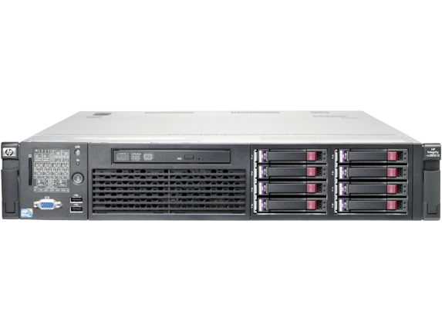
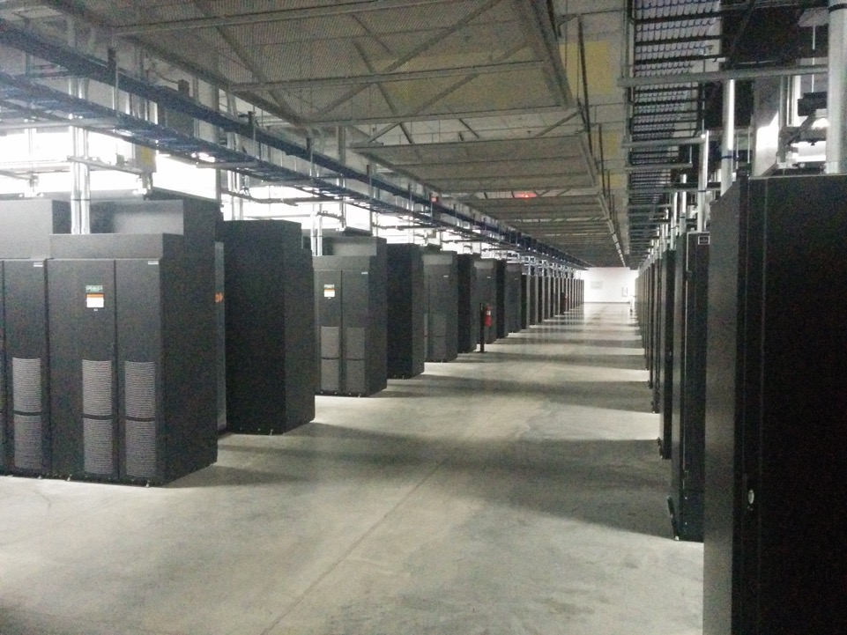
Conclusion
Attend lecture, attend labs, think actively!
Start programming assignments early, use the right strategy!
Super cool distributed systems stuff starts Monday!

