Slide 1
Concurrency
CS 240

Slide 2
What is Concurrency?
It’s like parallel that’s not in parallel

Slide 3
What is Parallelism?
Time
Sequential
f(X)
f(X) = A
f(Y)
f(Y) = B
Parallel
f(X)
f(X) = A
f(Y)
f(Y) = B

Slide 4
What is Concurrency?
Time
Sequential
f(X)
f(X) = A
f(Y)
f(Y) = B
Concurrent
f(X)
f(X) = A
f(Y)
f(Y) = B

Slide 5
Concurrency Could be Parallel but not Always
Concurrent but not Parallel
Time
f(X)
f(X) = A
f(Y)
f(Y) = B
Concurrent and Parallel
f(X)
f(X) = A
f(Y)
f(Y) = B
f(Z)
f(Z) = A
f(W)
f(W) = B

Slide 6
Parallel is Always Concurrent
Parallel but not Concurrent?
Time
f(X)
f(X) = A
f(Y)
f(Y) = B
Nope … still concurrent
Parallel → Concurrent
Concurrent ↛ Parallel

Slide 7
Why Care about Concurrency
If something concurrent but not parallel takes as much time as something sequential, why make it concurrent?
Time
Sequential
f(X)
f(X) = A
f(Y)
f(Y) = B
Concurrent
f(X)
f(X) = A
f(Y)
f(Y) = B

Slide 8
Concurrency is a Design Pattern
“Concurrency is about dealing with lots of things at once.
Parallelism is about doing lots of things at once.”
- Rob Pike
”Concurrency is not Parallelism” by Rob Pike : https://talks.golang.org/2012/waza.slide#1

Slide 9
Distributed Systems are Unpredictable
Servers need to react to:
Others servers
Crashes
Users
…

Slide 10
Making Bank Deposits Concurrent (1/5)
Add($10)
Server
Database
0
Add($10)
Time

Slide 11
Making Bank Deposits Concurrent (2/5)
Add($10)
Server
Read
x = 0
Database
0
Add($10)
read
$0
Time

Slide 12
Making Bank Deposits Concurrent (3/5)
Add($10)
Server
Read
x = 0
x += 10
Write x
Database
10
Add($10)
read
$0
$10
Time

Slide 13
Making Bank Deposits Concurrent (4/5)
Add($10)
Server
Read
x = 0
x += 10
Write x
Read
x = 10
Database
10
Add($10)
read
$0
$10
read
$10
Time

Slide 14
Making Bank Deposits Concurrent (5/5)
Add($10)
Server
Read
x = 0
x += 10
Write x
Read
x = 10
x += 10
Write x
Database
20
Add($10)
read
$0
$10
read
$10
Time
$20

Slide 15
Concurrent Bank Deposits! Yay? (1/5)
Add($10)
Server
Database
0
Add($10)
Time

Slide 16
Concurrent Bank Deposits! Yay? (2/5)
Add($10)
Server
Read
x = 0
Database
0
Add($10)
read
$0
Time

Slide 17
Concurrent Bank Deposits! Yay? (3/5)
Add($10)
Server
Read
x = 0
Read
x = 0
Database
0
Add($10)
read
$0
read
$0
Time

Slide 18
Concurrent Bank Deposits! Yay? (4/5)
Add($10)
Server
Read
x = 0
Read
x = 0
x += 10
Write x
Database
10
Add($10)
read
$0
read
$0
$10
Time

Slide 19
Concurrent Bank Deposits! Yay? (5/5)
Add($10)
Server
Read
x = 0
Read
x = 0
x += 10
Write x
x += 10
Write x
Database
10
Add($10)
read
$0
read
$0
$10
$10
Time

Slide 20
Concurrency Needs to be Synchronized
Locks – limit access using shared memory
Channels – pass information using a queue

Slide 21
Visualize Everything We’ve Learned
And also see many different methods of
achieving synchronization:
http://divan.github.io/posts/go_concurrency_visualize/

Slide 22
RPCs in Go
Networked battleship game
CS 240

Slide 23
What is a RPC (Remote Procedure Call)?
RPC means a client will execute some function on a remote server
Client make a local requests with some parameters
RPC library encodes the request and parameters, send them to server
Server decodes the request and parameters
Procedure is executed on the server
Server sends back the reply to the client

Slide 24
RPC exercise
We will use the net/rpc package to implement a client and server
https://golang.org/pkg/net/rpc/
Server side:
Create the server instance
Define the procedure
Listen for incoming requests
Client side:
Create the client instance and connect to the server
Make the RPC

Slide 25
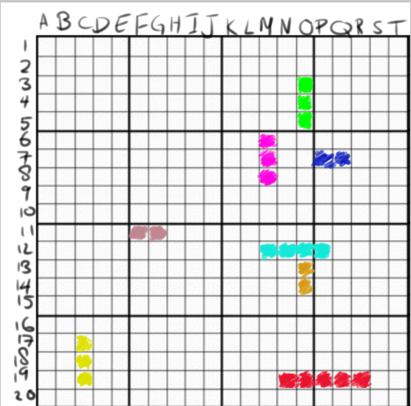
Battleship
A grid map on which you place your ships
“Deploy attack on (N, 19)!”
Goal: Find and sink all enemy ships

Slide 26
Today’s task: Implement a Battleship client
Project files available on the Campuswire
We will run a central server
Implement the client (client.go) and test it against other students

Slide 27
Task 1 and 2
Establish connection to the server
See https://golang.org/pkg/net/rpc/ example “rpc.DialHTTP”
Must return a rpc.Client object
Make the JoinGame request
You want to call the remote BattleshipsService.JoinGame function
Parameters PublicPlayer and JoinGameRequest are defined in common.go
See https://golang.org/pkg/net/rpc/ example “client.Call”

Slide 28
Task 3
Implement the attack server
Tasks 1 and 2 were making requests as a client, now must accept requests
See https://golang.org/pkg/net/rpc/
Examples “rpc.Register” and “rpc.HandleHTTP”
Create a listener to serve requests on a separate goroutine

Slide 29
Task 4
Implement the turn logic
Hint: The turn logic can be achieved with Channels, Locks or WaitGroups
Hint 2: When the other player attacks, you get a “token” to make one attack
After implementation is complete, you can run against other players

