Slide 1
MapReduce case study
CS 240: Computing Systems and Concurrency
Lecture 1.1
Marco Canini

Slide 2
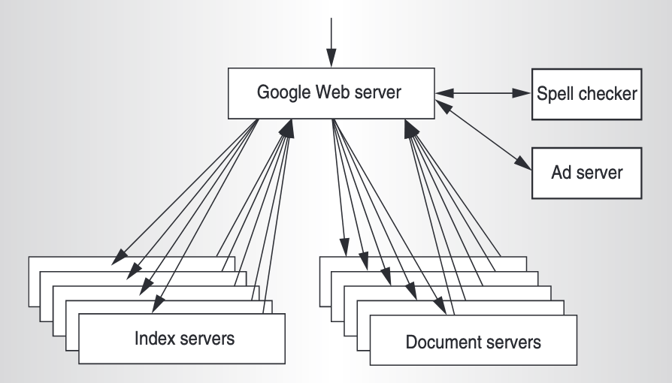
Why scalable analytics?
Google’s index was perhaps one of the first “big data” problems
Crawler fetched 100s of millions of web pages
Needed to create giant indices from keywords
Too much work for any individual machine → needed to be spread across many machines
Soon they also needed to compute various statistics on this data
For instance, how many documents contained a given keyword?
This led to the development of the MapReduce framework
Barrosso et al., “Web Search for a Planet: The Google Cluster Architecture”, IEEE MICRO 23(2)

Slide 3
Key challenges
Data is spread across (many) computers
What do we do if related data is on different computers, but we need all of it to perform some computation?
Communication is expensive
Need to be smart about where data is stored, and when it is moved
Coordination is key
The computation needs to be carefully orchestrated to get the correct result
… especially if there are failures, heterogeneous machines, etc.

Slide 4
Case Study: MapReduce
(Data-parallel programming at scale)

Slide 5
What is MapReduce?
MapReduce is a famous distributed programming model
Invented at Google; paper published in 2004
At that time, it was used for the production indexing system
Closed source, but open-source reimplementations exist
Example: Apache Hadoop
Originally ran on GFS (The Google FileSystem)
GFS is designed for sequential reads and appends
This is the workload that MapReduce would produce!

Slide 6
Application: Word Count
SELECT count(word) FROM data
GROUP BY word
cat data.txt
| tr -s '[[:punct:][:space:]]' '\n'
| sort | uniq -c

Slide 7
Using partial aggregation
Compute word counts from individual files
Then merge intermediate output
Compute word count on merged outputs

Slide 8
Using partial aggregation: data flow
In parallel, send to worker:
Compute word counts from individual files
Collect result, wait until all finished
Then merge intermediate output
Compute word count on merged intermediates

Slide 9
I don’t want to deal with all this!
Wouldn't it be nice if there were some system that took care of all these details for you?
But every task is different!
Or is it? The detailed are different (what to compute, etc.), but the data flow is often same!
Maybe we can have a ‘generic’ solution?
Ideally, just tell the system what needs to be done
This is what frameworks like MapReduce (and Apache Spark and Apache Flink) do!

Slide 10
MapReduce: Programming Interface
map(key, value) -> list(<k’, v’>)
Apply function to (key, value) pair and produces set of intermediate pairs
reduce(key, list<value>) -> <k’, v’>
Applies aggregation function to values collected by key
Outputs result

Slide 11
MapReduce example: Word Count
map(String key, String value):
// key: document name; value: document line
for each word w in value:
EmitIntermediate(w, "1");
reduce(String key, Iterator values):
// key: a word; value: a list of counts
int result = 0;
for each v in values:
result += ParseInt(v);
Emit(key, AsString(result));

Slide 12
MapReduce: Optimizations
combine(list<key, value>) -> list<k,v>
Perform partial aggregation on mapper node:
<the, 1>, <the, 1>, <the, 1> → <the, 3>
combine() should be commutative and associative
partition(key, int) -> int
Need to aggregate intermediate vals with same key
Given n partitions, map key to partition 0 ≤ i < n
Typically via hash(key) mod n

Slide 13
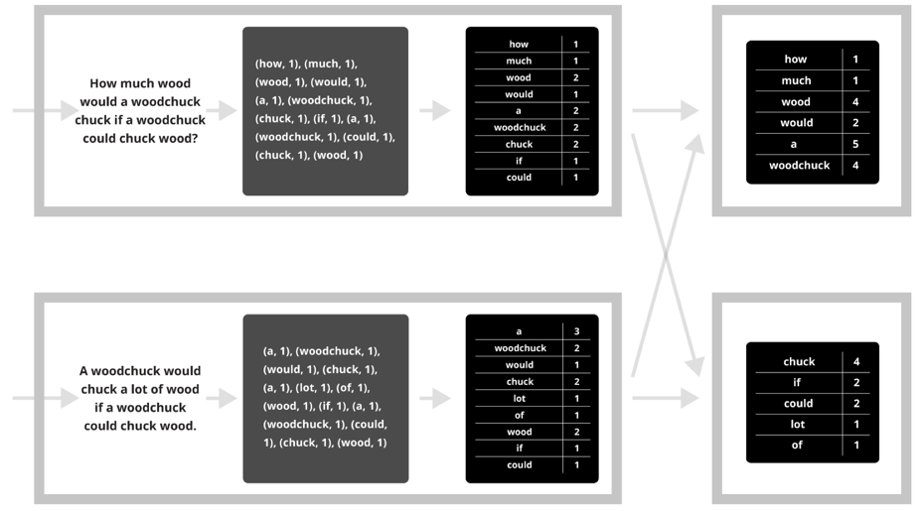
Putting it together…
map
combine
partition
reduce

Slide 14
Synchronization Barrier

Slide 15
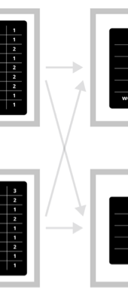
Fault Tolerance in MapReduce
Map worker writes intermediate output to local disk, separated by partitioning. Once completed, tells master node.
Reduce worker told of location of map task outputs, pulls their partition’s data from each mapper, execute function across data
Note:
“All-to-all” shuffle b/w mappers and reducers
Written to disk (“materialized”) b/w each stage

Slide 16
Fault Tolerance in MapReduce
Master node monitors state of system
If master failures, job aborts and client notified
Map worker failure
Both in-progress/completed tasks marked as idle
Reduce workers notified when map task is re-executed on another map worker
Reducer worker failure
In-progress tasks are reset to idle (and re-executed)
Completed tasks had been written to global file system

Slide 17
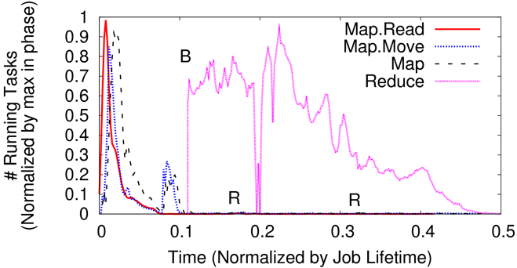
Straggler Mitigation in MapReduce
Tail latency means some workers finish late
For slow map tasks, execute in parallel on second map worker as “backup”, race to complete task

Slide 18
MapReduce: Limitations
MapReduce worked very well for Google’s initial use cases, and lots of others besides
No data dependencies within map/reduce phases → Good scalability
But it does have some important limitations:
Complex operations have to be rewritten into ‘map’ and ‘reduce’ operations (possibly with several rounds of mapping and reducing)
Dataflows always read from and write to disk (why?) → limited speed

Slide 19
You’ll build (simplified) MapReduce!
Assignment 1: Sequential MapReduce
Learn to program in Go!
Due September 13
Assignment 2: Distributed MapReduce
Learn Go’s concurrency, network I/O, and RPCs
Due September 20

