Slide 1
Replication State Machines via Primary-Backup
CS 240: Computing Systems and Concurrency
Lecture 10
Marco Canini

Slide 2
From eventual to strong consistency
Eventual consistency
  Multi-master: Any node can accept operation
  Asynchronously, nodes synchronize state
Eventual consistency inappropriate for many applications
  Imagine bank ledger as eventually consistent
Stronger consistency makes applications easier to write

Slide 3
Plan
Introduction to Primary-Backup replication
Case study: VMWare’s fault-tolerant virtual machine

Slide 4


Primary-Backup Replication
Mechanism: Replicate and separate servers
Goal #1: Reliable despite individual server failures
Goal #2: Semantics of a single server
Client C
Primary P
Backup B
Notes:
SEGUE: Don't want clients to have to resubmit their requests.

Slide 5
Primary-Backup Replication
Nominate one replica primary
Other replicas are backup
  Only one primary at a time
Clients send all operations to current primary
Primary orders clients’ operations
Client C
Primary P
Backup B
Need to keep clients, primary, and backup in sync: who is primary and who is backup (no Split Brain)

Slide 6
State machine replication
Insight: A replica is essentially a state machine
  E.g., set of (key, value) pairs is state
  Operations transition between states
Each operation executed on all replicas, or none at all
  i.e., we need distributed all-or-nothing atomicity
Key assumption: Operations are deterministic
If op is deterministic, replicas will end in same state

Slide 7
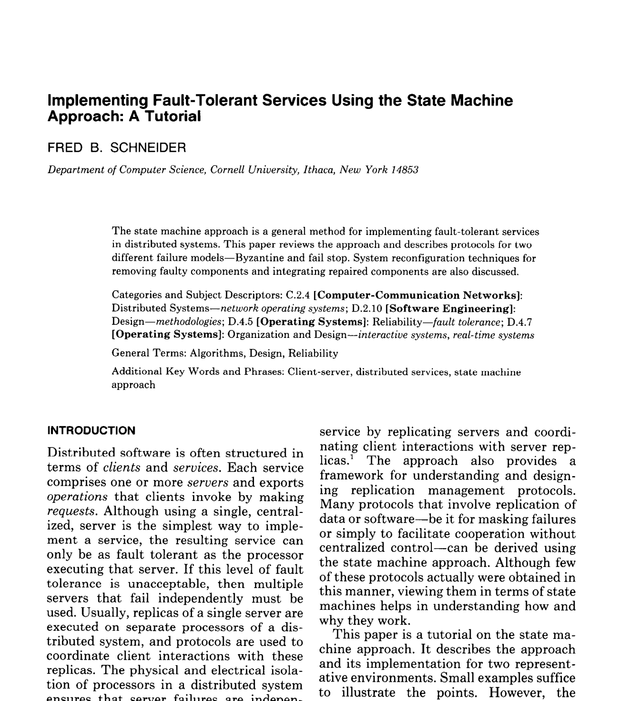
More reading: ACM Computing Surveys, Vol. 22, No. 4, December 1990 (pdf)

Slide 8
Replica coordination
All non-faulty state machines receive all operations in the same order
Agreement: Every non-faulty state machine receives every operation
Order: Every non-faulty state machine processes the operations it receives in the same order

Slide 9
Primary-Backup Replication
Client C
put(x,1)
Primary gets operations
Primary orders ops into log
Replicates log of ops to backup
Backup exec’s ops or writes to log
Primary P
put(x,1)
Backup B
When does the primary execute ops?

Slide 10
Primary-Backup Replication
Asynchronous Replication
Client C
put(x,1)
ack
Primary gets operations
Primary exec’s ops
Primary orders ops into log
Replicates log of ops to backup
Backup exec’s ops or writes to log
Primary P
put(x,1)
Backup B
What can go wrong w/ async replication?
Notes:
What can go wrong w/ async replication?

Slide 11
Primary-Backup Replication
Synchronous Replication
Client C
put(x,1)
ack
Primary gets operations
Primary orders ops into log
Replicates log of ops to backup
Backup exec’s op or writes to log
Primary gets ack, execs ops
Primary P
put(x,1)
ack
Backup B
If the primary fails? A backup is promoted to new primary

Slide 12
Hot vs. Cold backups
“Backup exec’s op or writes to log”
Hot Backups execute operations from the primary as soon as they receive it
Cold Backups log operations received from primary, and execute them only if primary fails

Slide 13

Why does this work?
Synchronous Replication
Clients
shl
Logging
Module
State
Machine
Logging
Module
State
Machine
Servers
Log
Log
add
jmp
mov
shl
add
jmp
mov
shl
Backup
Primary
Replicated log => replicated state machine
  All servers execute same commands in same order

Slide 14
Why does this work?
Synchronous Replication
Clients
shl
Logging
Module
State
Machine
Logging
Module
State
Machine
Logging
Module
State
Machine
Servers
Log
Log
Log
add
jmp
mov
shl
add
jmp
mov
shl
add
jmp
mov
shl
Backup
Backup
Primary
Replicated log => replicated state machine
  All servers execute same commands in same order

Slide 15
Need determinism? Make it so!
Operations are deterministic
  No events with ordering based on local clock
    Convert timer, network, user into logged events
  Nothing using random inputs
Execution order of ops is identical
  e.g. replicated state machines (RSMs) is single threaded

Slide 16
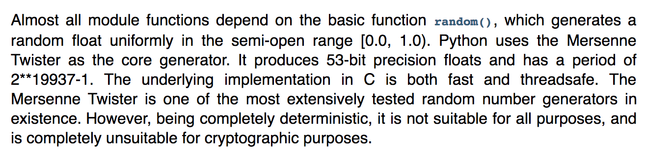
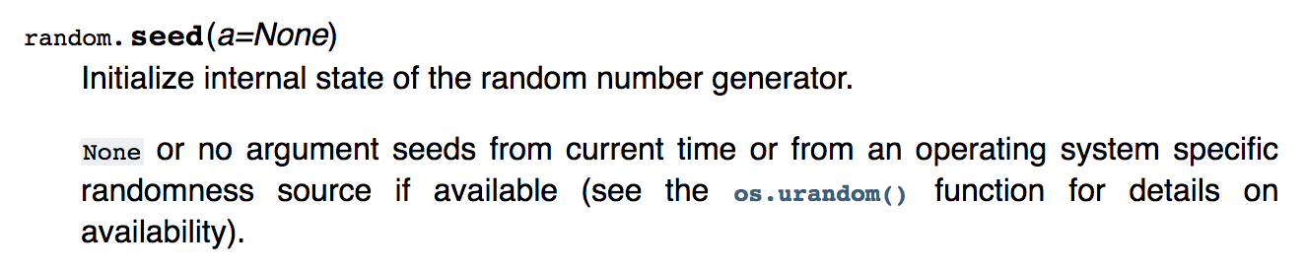
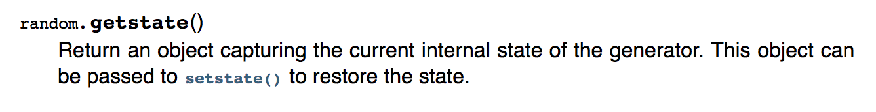
Example: Make random() deterministic

Slide 17
Example: Make random() deterministic
Primary:
  Initiates PRNG with OS-supplied randomness, gets initial seed
  Sends initial seed to to backup
Backup
  Initiates PRNG with seed from primary

Slide 18
Primary-Backup: Summary
First step in our goal of making stateful replicas fault-tolerant
Allows replicas to provide continuous service despite persistent net and machine failures
Finds repeated application in practical systems

Slide 19
Case study
The design of a practical system for
fault-tolerant virtual machines
D. Scales, M. Nelson, G. Venkitachalam, VMWare
SIGOPS Operating Systems Review 44(4), Dec. 2010 (pdf)

Slide 20
Where should RSM be implemented?
In hardware
  Sensitive to architecture changes
At the OS level
  State transition are hard to track and coordinate
At the application level
  Requires sophisticated application programmers

Slide 21
VMware vSphere Fault Tolerance (VM-FT)
Goals:
Replication of the whole virtual machine
Completely transparent to apps and clients
High availability for any existing software
Notes:
Ambitious system from VMware – want to give an entire Virtual Machine the benefits of primary-backup replication.
>>> Actually run a virtual machine on top of primary-backup replication!

Slide 22
Overview
Two virtual machines (primary, backup) on different bare metal
Logging channel runs over network
Shared disk via fiber channel
Notes:
The backup executes identically to the primary, except with a small time lag.
>>> Wrinkle: Disk not replicated, instead shared

Slide 23
Virtual Machine I/O
VM inputs
  Incoming network packets
  Disk reads
  Keyboard and mouse events
  Clock timer interrupt events
VM outputs
  Outgoing network packets
  Disk writes
Notes:
To replicate the VM they need to look at the VM as a black box.
VM inputs: everything that flows into the VM.
VM outputs: everything that flows out of the VM.
>>> Disk writes are considered an output because they go to the shared disk attached to both VMs.

Slide 24
Overview
Primary sends inputs to backup
Backup outputs dropped
Primary-backup heartbeats
  If primary fails, backup takes over
Notes:
The backup executes identically to the primary, except with a small time lag.
>>> Wrinkle: Disk not replicated, instead shared

Slide 25
VM-FT: Challenges
Making the backup an exact replica of primary
Making the system behave like a single server
Avoiding two primaries (Split Brain)
Notes:
(Outline slide) So we have a general idea of how this works from the basic primary-backup design, but here are the subtle points that the VM-FT paper addresses.
(Exact replica:) How to cope with non-determinism

Slide 26
Log-based VM replication
Step 1: Hypervisor at primary logs the causes of non-determinism
  Log results of input events
    Including current program counter value for each
  Log results of non-deterministic instructions
    e.g. log result of timestamp counter read
Notes:
Want to model VM as a deterministic state machine, so to do that we have to convert non-deterministic operations to deterministic operations so that state machine replication holds.
Inputs: packet with arbitrary data may arrive; arbitrary keystroke may arrive.
SEGUE: So once the primary has logged both causes of non-determinism, the backup can use this information.

Slide 27
Log-based VM replication
Step 2: Primary hypervisor sends log entries to backup hypervisor
Backup hypervisor replays the log entries
  Stops backup VM at next input event or non-deterministic instruction
    Delivers same input as primary
    Delivers same non-deterministic instruction result as primary
Notes:
Needs to know when the next input event occurs, so backup lags behind primary by one input event

Slide 28
VM-FT Challenges
Making the backup an exact replica of primary
Making the system behave like a single server
  FT Protocol
Avoiding two primaries (Split Brain)
Notes:
So now we are reasoning about the output events that the system generates, in particular when the primary fails. And their solution to this problem is called the fault tolerant (FT) protocol.

Slide 29
Primary to backup failover
When backup takes over, non-determinism makes it execute differently than primary would have
  This is okay!
Output requirement
  When backup takes over, execution is consistent with outputs the primary has already sent
Notes:
>>> Want to avoid contradictions between the primary and backup when it fails over.
SEGUE: Let’s see how inconsistencies can happen.

Slide 30
The problem of inconsistency
Input
Event?
Output
Primary
Backup
Primary fails
Notes:
Suppose primary fails just after an output event. Of “in flight” events, backup doesn’t know whether they came before/after output event.
Red event may have influenced value of output, backup doesn’t know where in its execution stream to place it: before or after the output.
Primary also doesn’t know what the value of the output event was, so can’t fix it that way.
Subtle: Arbitrarily many events may have happened at primary unbeknownst to backup, can’t speculate!

Slide 31
VM-FT protocol
Primary logs each output operation
Delays sending output until Backup acknowledges it
    But does not need to delay execution
Input
Primary fails
Output
Primary
ack
Backup
Duplicate output
Notes:
There are no other events in the backup’s log so it can reach the same state as the primary was when it made the output.
Might output twice but that is okay – duplicate network packet or duplicate write to disk.
>>> Primary doesn’t need to delay execution, just outputs.

Slide 32
VM-FT protocol
Primary logs each output operation
Delays sending output until Backup acknowledges it
    But does not need to delay execution
Input
Primary fails
Output
Primary
ack
Backup
Duplicate output
Restart execution at an output event
Notes:
There are no other events in the backup’s log so it can reach the same state as the primary was when it made the output.
Might output twice but that is okay – duplicate network packet or duplicate write to disk.
>>> Primary doesn’t need to delay execution, just outputs.

Slide 33
VM-FT: Challenges
Making the backup an exact replica of primary
Making the system behave like a single server
Avoiding two primaries (Split Brain)
  Logging channel may break
Notes:
Finally, avoiding split brain gets difficult when the logging channel breaks.

Slide 34
Detecting and responding to failures
Primary and backup each run UDP heartbeats, monitor logging traffic from their peer
Before “going live” (backup) or finding new backup (primary), execute an atomic test-and-set on a variable in shared storage
If the replica finds variable already set, it aborts
Notes:
This avoids split-brain.

Slide 35
VM-FT: Summary
Primary-backup replication with whole machines!
Design for correctness and consistency of replicated VM outputs despite failures
  Determinism tricky, but doable
  Primary delays output until acked by backup
  Use atomic test-and-set on shared disk to avoid split brain

Slide 36
Primary-Backup: Take-away ideas
All replicas receive and process the same sequence of (deterministic) operations
  Clients send all operations to current primary
  Primary orders clients’ ops into a log
  Primary replicates the log to backup
  Backup executes ops
  Async vs Sync replication: when the primary executes
Need to keep clients, primary, and backup in sync: who is primary and who is backup

