Slide 1
Impossibility Results: CAP, PRAM & FLP
CS 240: Computing Systems and Concurrency
Lecture 16
Marco Canini

Slide 2
Network partitions divide systems

Slide 3
Network partitions divide systems

Slide 4
How can we handle partitions?
Totally-ordered Multicast?
Bayou?
Dynamo?
Chord?
Paxos?
RAFT?

Slide 5
How about this set of partitions?

Slide 6
Fundamental trade-off?
Replicas appear to be a single machine, but lose availability during a network partition
OR
All replicas remain available during a network partition but do not appear to be a single machine

Slide 7
CAP theorem preview
You cannot achieve all three of:
Consistency
Availability
Partition-Tolerance
Partition Tolerance => Partitions Can Happen
Availability => All Sides of Partition Continue
Consistency => Replicas Act Like Single Machine
Specifically, Linearizability

Slide 8
Impossibility Results Useful!!!!
Fundamental tradeoff in design space
Must make a choice
Avoids wasting effort trying to achieve the impossible
Tells us the best-possible systems we can build!

Slide 9
CAP conjecture [Brewer 00]
From keynote lecture by Eric Brewer (2000)
History: Eric started Inktomi, early Internet search site based around “commodity” clusters of computers
Using CAP to justify “BASE” model: Basically Available, Soft-state services with Eventual consistency
Popular interpretation: 2-out-of-3
Consistency (Linearizability)
Availability
Partition Tolerance: Arbitrary crash/network failures

Slide 10
CAP theorem [Gilbert Lynch 02]
Assume to contradict that Algorithm A provides all of CAP
Client 1
Client 1

Slide 11
CAP theorem [Gilbert Lynch 02]
Assume to contradict that Algorithm A provides all of CAP
Client 1
Client 1
Partition Possible (from P)

Slide 12
CAP theorem [Gilbert Lynch 02]
Assume to contradict that Algorithm A provides all of CAP
w(x=1)
Client 1
Client 1
ok
Write eventually returns
(from A)
Partition Possible (from P)

Slide 13
CAP theorem [Gilbert Lynch 02]
Assume to contradict that Algorithm A provides all of CAP
w(x=1)
r(x)
Client 1
Client 1
ok
x=0
Read begins after write completes
Read eventually returns (from A)
Write eventually returns
(from A)
Partition Possible (from P)

Slide 14
CAP theorem [Gilbert Lynch 02]
Assume to contradict that Algorithm A provides all of CAP
Not consistent (C) => contradiction!
w(x=1)
r(x)
Client 1
Client 1
ok
x=0
Read begins after write completes
Read eventually returns (from A)
Write eventually returns
(from A)
Partition Possible (from P)

Slide 15
CAP Interpretation Part 1
Cannot “choose” no partitions
2-out-of-3 interpretation doesn’t make sense
Instead, availability OR consistency?
i.e., fundamental trade-off between availability and consistency
When designing system must choose one or the other, both are not possible

Slide 16
CAP Interpretation Part 2
Cannot “beat” CAP theorem
Can engineer systems to make partitions extremely rare, however, and then just take the rare hit to availability (or consistency)

Slide 17
More trade-offs L vs. C
Low-latency: Speak to fewer than quorum of nodes?
2PC: write N, read 1
RAFT: write ⌊N/2⌋ + 1, read ⌊N/2⌋ + 1
General: |W| + |R| > N
L and C are fundamentally at odds
“C” = linearizability, sequential, serializability (more later)

Slide 18
PACELC
If there is a partition (P):
How does system tradeoff A and C?
Else (no partition)
How does system tradeoff L and C?
Is there a useful system that switches?
Dynamo: PA/EL
“ACID” dbs: PC/EC
http://dbmsmusings.blogspot.com/2010/04/problems-with-cap-and-yahoos-little.html

Slide 19
PRAM [Lipton Sandberg 88] [Attiya Welch 94]
d is the worst-case delay in the network over all pairs of processes [datacenters]
Sequentially consistent system
read time + write time ≥ d

Slide 20
PRAM Theorem:
Impossible for sequentially consistent system to always provide low latency

Slide 21
PRAM [Lipton Sandberg 88] [Attiya Welch 94]
Fundamental tradeoff between consistency and latency!
Proof intuition (see papers for details)
Let P1 and P2 be the 2 furthest away processes; assume 2 objects: x, y
Assume to contradict read time + write time < d
Thus the following executions are possible because P1’s Write can’t be seen at P2 Read:
P1: |--W(x=1)--| |--R(y)=0--|
P2: |--W(y=1)--| |--R(x)=0--|
But there is no total order of these operations, so does not provide sequential consistency

Slide 22
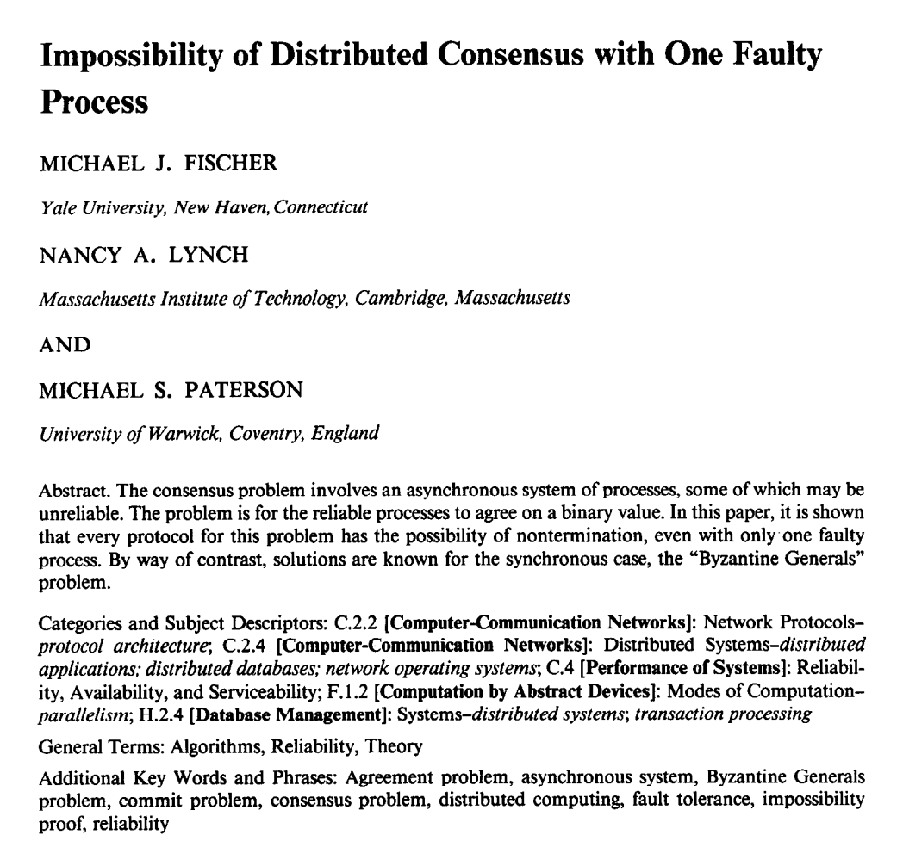
“FLP” result
No deterministic 1-crash-robust consensus algorithm exists with asynchronous communication

Slide 23
FLP is the original impossibility result for distributed systems!
Useful interpretation: no consensus algorithm can always reach consensus with an asynchronous network
Do not believe such claims!
Led to lots and lots of theoretical work
(Consensus is possible when the network is reasonably well-behaved)

Slide 24
FLP’s weak assumptions
Only 1 failure
Also impossible for more failures
For “weak” consensus (only some process needs to decide)
Also impossible for real consensus
For reliable communication
Also impossible for unreliable communication
For only two states: 0 and 1
Also impossible for more failures
For crash failures
Also impossible for Byzantine failures

Slide 25
FLP’s strong assumptions
Deterministic actions at each node
Asynchronous network communication
All “runs” must eventually achieve consensus

Slide 26
Main technical approach
Initial state of system can end in decision “0” or “1”
Consider 5 processes, each in some initial state
[ 1,1,1,1,1 ] → 1
[ 1,1,1,1,0 ] → ?
[ 1,1,1,0,0 ] → ?
[ 1,1,0,0,0 ] → ?
[ 1,0,0,0,0 ] → 0
Must exist two configurations here which differ in decision

Slide 27
Main technical approach
Initial state of system can end in decision “0” or “1”
Consider 5 processes, each in some initial state
[ 1,1,1,1,1 ] → 1
[ 1,1,1,1,0 ] → 1
[ 1,1,1,0,0 ] → 1
[ 1,1,0,0,0 ] → 0
[ 1,0,0,0,0 ] → 0
Assume decision differs between these two processes

Slide 28
Main technical approach
Goal: Consensus holds in face of 1 failure
[ 1,1,0,0,0 ] →
[ 1,1,1,0,0 ] →
One of these configurations must be “bi-valent” (i.e., undecided):
Both futures possible
1 | 0
0

Slide 29
Main technical approach
Goal: Consensus holds in face of 1 failure
[ 1,1,0,0,0 ] →
[ 1,1,1,0,0 ] →
Inherent non-determinism from asynchronous network
Key result: All bi-valent states can remain in bi-valent states after performing some work
One of these configurations must be “bi-valent” (i.e., undecided):
Both futures possible
1
0 | 1

Slide 30
Staying bi-valent forever
System thinks process p failed, adapts to it…
But no, p was merely slow, not failed… (Can’t tell the difference between slow and failed.)
System think process q failed, adapts to it…
But no, q was merely slow, not failed…
Repeat ad infinitum …

Slide 31
Consensus is impossible
But, we achieve consensus all the time…

Slide 32
FLP’s strong assumptions
Deterministic actions at each node
Randomized algorithms can achieve consensus
Asynchronous network communication
Synchronous or even partial synchrony is sufficient
All “runs” must eventually achieve consensus
In practice, many “runs” achieve consensus quickly
In practice, “runs” that never achieve consensus happen vanishingly rarely
Both are true with good system designs

