Slide 1
Time and Logical Clocks 2
CS 240: Computing Systems and Concurrency
Lecture 4
Marco Canini

Slide 2
Lamport Clocks Review
Happens-Before relationship
Event a happens before event b (a → b)
c, d not related by → so concurrent, written as c || d
Lamport clocks is a logical clock construction to capture the order of events in a distributed systems (disregarding the precise clock time)
Tag every event a by C(a)
If a → b, then ?
If C(a) < C(b), then ?
If a || b, then ?

Slide 3
Lamport Clocks Review
Happens-Before relationship
Event a happens before event b (a → b)
c, d not related by → so concurrent, written as c || d
Lamport clocks is a logical clock construction to capture the order of events in a distributed systems (disregarding the precise clock time)
Tag every event a by C(a)
If a → b, then C(a) < C(b)
If C(a) < C(b), then NOT b → a (a → b or a || b)
If a || b, then nothing

Slide 4
Lamport Clocks and causality
Lamport clock timestamps don’t capture causality
Given two timestamps C(a) and C(z), want to know whether there’s a chain of events linking them:
a → b → ... → y → z

Slide 5
Take-away points: Lamport clocks
Can totally-order events in a distributed system: that’s useful!
We saw an application of Lamport clocks for totally-ordered multicast
But: while by construction, a → b implies C(a) < C(b),
The converse is not necessarily true:
C(a) < C(b) does not imply a → b (possibly, a || b)
Can’t use Lamport clock timestamps to infer causal relationships between events
Notes:
Want to tag events with logical timestamps and reason about their causal or happens-before relationships, but can’t use Lamport clock timestamps here
And this is what we will want to do later in the class when we build systems that process updates in a distributed manner.

Slide 6
Today
Logical Time: Vector clocks

Slide 7
Vector clock: Introduction
One integer can’t order events in more than one process
So, a Vector Clock (VC) is a vector of integers, one entry for each process in the entire distributed system
Label event e with VC(e) = [c₁, c₂ …, c_{n}]
Each entry c_{k} is a count of events in process k that causally precede e

Slide 8
Vector clock: Update rules
Initially, all vectors are [0, 0, …, 0]
Two update rules:
For each local event on process i, increment local entry c_{i}
If process j receives message with vector [d₁, d₂, …, d_{n}]:
Set each local entry c_{k} = max{c_{k}, d_{k}}, for k = 1…n
Increment local entry c_{j}

Slide 9
Vector clock: Example
All processes’ VCs start at [0, 0, 0]
Applying local update rule
Applying message rule
Local vector clock piggybacks on inter-process messages
P1
P2
P3
a
[1,0,0]
e
[0,0,1]
[2,0,0]
b
[2,0,0]
[2,1,0]
c
[2,2,0]
d
[2,2,0]
[2,2,2]
f
Physical time ↓

Slide 10
Comparing vector timestamps
Rule for comparing vector timestamps:
V(a) = V(b) when a_{k} = b_{k} for all k
V(a) < V(b) when a_{k} ≤ b_{k} for all k and V(a) ≠ V(b)
Concurrency:
a || b if a_{i} < b_{i} and a_{j} > b_{j}, some i, j

Slide 11
Vector clocks capture causality
V(w) < V(z) then there is a chain of events linked by Happens-Before (→) between w and z
If V(a) || V(w) then there is no such chain of events between a and w
P1
P2
P3
[1,0,0]
w
a
[0,0,1]
[2,0,0]
x
[2,1,0]
y
z
[2,2,0]

Slide 12
Two events a, z
Lamport clocks: C(a) < C(z)
Conclusion: NOT z → a (either a → z or a || z)
Vector clocks: V(a) < V(z)
Conclusion: a → z
Vector clock timestamps precisely capture Happens-Before relationship (potential causality)

Slide 13
Disadvantage of vector timestamps
Compared to Lamport timestamps, vector timestamps O(n) overhead for storage and communication, n = no. of processes

Slide 14
Take-away points
Vector Clocks
Precisely capture happens-before relationship

Slide 15
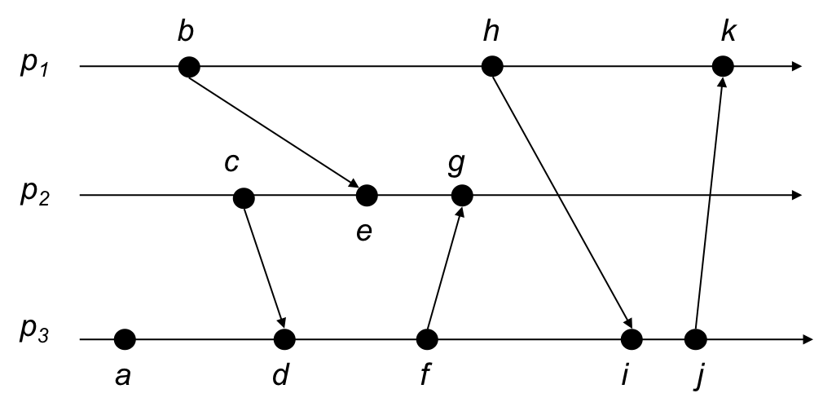
VC Quiz
Suppose these processes maintain vector clocks. Write the vector clock of each event starting from clock time 0.
Notes:
a: [0, 0, 1]
b: [1, 0, 0]
c: [0, 1, 0]
d: [0, 1, 2]
e: [1, 2, 0]
f: [0, 1, 3]
g: [1, 3, 3]
h: [2, 0, 0]
i: [2, 1, 4]
j: [2, 1, 5]
k: [3, 1, 5]

Slide 16
Safety and liveness properties

Slide 17
Reasoning about fault tolerance
This is hard!
How do we design fault-tolerant systems?
How do we know if we’re successful?
Often use “properties” that hold true for every possible execution
We focus on safety and liveness properties

Slide 18
Properties
Property: a predicate that is evaluated over a run of the system
“every message that is received was previously sent”
Not everything you may want to say about a system is a property:
“the program sends an average of 50 messages in a run”

Slide 19
Safety properties
“Bad things” don’t happen, ever
No more than k processes are simultaneously in the critical section
Messages that are delivered are delivered in causal order
A safety property is “prefix closed”:
if it holds in a run, it holds in every prefix
Notes:
NOTE: can be violated in finite execution

Slide 20
Liveness properties
“Good things” eventually happen
A process that wishes to enter the critical section eventually does so
Some message is eventually delivered
Eventual consistency: if a value doesn’t change, two servers will eventually agree on its value
Every run can be extended to satisfy a liveness property
If it does not hold in a prefix of a run, it does not mean it may not hold eventually
Notes:
NOTE: might not be violated in finite execution

Slide 21
Often a trade-off
“Good” and “bad” are application-specific
Safety is very important in banking transactions
May take some time to confirm a transaction
Liveness is very important in social networking sites
See updates right away

