Slide 1
Big Data Processing
CS 240: Computing Systems and Concurrency
Lecture 9
Marco Canini

Slide 2
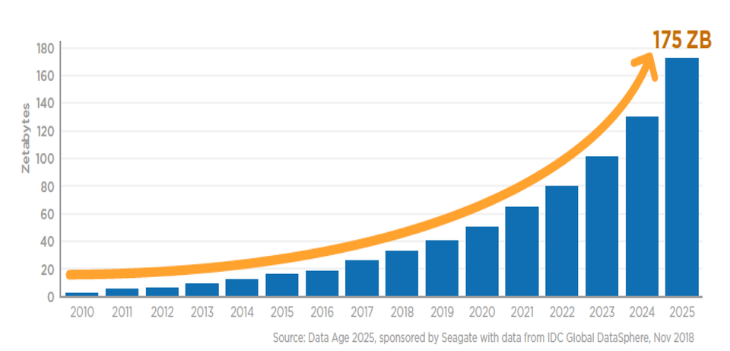
Distributed Systems, Why?
BIG DATA really demands distributed systems!

Slide 3
Distributed Systems, Why?
BIG DATA really demands distributed systems!
Large-scale computing with:
Scalability and parallelism
Fault tolerance
Load management
Consistency (exactly-once processing guarantees)
Transparency (programming abstractions and high-level languages)

Slide 4
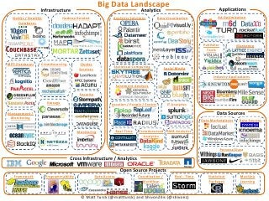
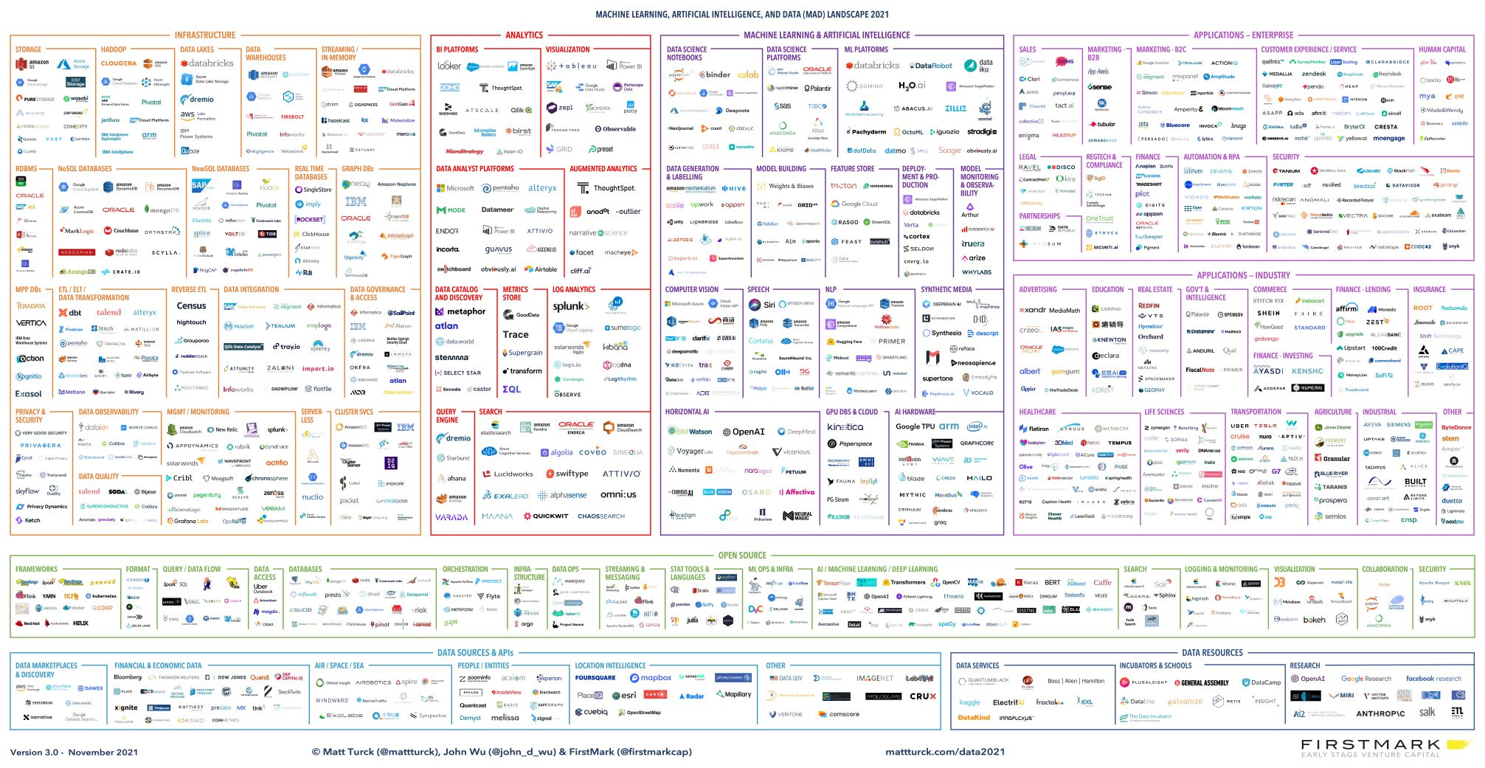
BIG DATA Landscape evo
2021
2012
© Matt Turck (@mattturck), John Wu (@john_d_wu) & FirstMark (@firstmarkcap)

Slide 5
Diff. Problems → Diff. Approaches
Batch vs streaming data
Is data available in full before its processing begins?
Is data produced incrementally over time?
Generality vs specialization
A general system can be used for many different applications, but not ideally suited to any
A specialized system focuses on the needs of a class of application and takes advantage of their characteristics

Slide 6
Diff. Problems → Diff. Approaches
General
Specialized
Unified

Slide 7
Diff. Problems → Diff. Approaches
General
Specialized
Unified

Slide 8
Diff. Problems → Diff. Approaches
General
Specialized
Unified

Slide 9
Data-Parallel Computation

Slide 10
Ex. Five top pages on class website
input: access.log
10.1.1.1 cs240.kaust.edu.sa - [05/Oct/2022:13:50:00 +0300] "GET /course/CS240/assignment2 HTTP/1.1”
200 17618 "-" "Mozilla/5.0 (Macintosh; Intel Mac OS X 10_15_7) [...]"
Write a MapReduce* program that solves this problem
output
47 /course/CS240/assignment2
35 /course/CS240/assignment1
20 /courselist
18 /auth/page/kaust
4 /admin/CS240
* NOTE: MapReduce automatically sorts by key the output of mappers

Slide 11
MapReduce is a General System
Can express large computations on large data; enables fault tolerant, parallel computation
But …
Fault tolerance is an inefficient fit for many applications Parallel programming model (map, reduce) within synchronous rounds is an inefficient fit for many applications
The range of problems you can solve with a single MapReduce job is limited
Very common for MapReduce jobs to be chained into workflows

Slide 12
Ex. Five top pages on class website
MapReduce workflows can be complex and tedious to write
Can it be easier?

Slide 13
Ex. Five top pages on class website
MapReduce workflows can be complex and tedious to write
Can it be easier?
What we wish to write …
logFile = sc.textFile("hdfs://access.log")
urls = logFile.map(lambda x: x.split("")(6))
url_counts = urls.map(lambda url: (url, 1))
.reduceByKey(lambda a, b: a + b)
url_counts.sortBy(lambda x: -x[1]).take(5)

Slide 14
MapReduce for Google’s Index
Flagship application in original MapReduce paper
Q: What is inefficient about MapReduce for computing web indexes?
“MapReduce and other batch-processing systems cannot process small updates individually as they rely on creating large batches for efficiency.”
Index moved to Percolator in ~2010 [OSDI ‘10]
Incrementally process updates to index
Uses OCC to apply updates
50% reduction in average age of documents

Slide 15
MapReduce for Iterative Computations
Iterative computations: compute on the same data as we update it
e.g., PageRank
e.g., Logistic regression
Q: What is inefficient about MapReduce for these?
Writing data to disk between all iterations is slow
Many systems designed for iterative computations, most notable is Apache Spark
Key idea 1: Keep data in memory once loaded
Key idea 2: Provide fault tolerance via lineage (record ops)
Notes:
Save data to disks occasionally, remember computation that created later version of data. Use lineage to recompute data that is lost due to failure.

Slide 16
MapReduce for Stream Processing
Stream processing: Continuously process an infinite stream of data
e.g., estimating traffic conditions from GPS data
e.g., identify trending hashtags on twitter
e.g., detect fraudulent ad-clicks
Q: What is inefficient about MapReduce for these?

Slide 17
Stream Processing Systems
Data is only produced incrementally over time
Can’t batch process it all at once!
Streaming applications are long-running:
Definite computation ahead of time
Setup machines to run specific parts of computation and pass data around (topology)
Stream data into topology
Repeat forever (trickiest part: fault tolerance!)
Specialization is much faster
E.g., click-fraud detection at Microsoft
Batch-processing system: 6 hours
w/ StreamScope [NSDI’16]: 20 minutes on average

Slide 18
In-Memory Data-Parallel Computation

Slide 19
Spark: Resilient Distributed Datasets
Let’s think of just having a big block of RAM, partitioned across machines…
And a series of operators that can be executed in parallel across the different partitions
That’s basically Spark
A distributed memory abstraction that is both fault-tolerant and efficient

Slide 20
Spark: Resilient Distributed Datasets
Restricted form of distributed shared memory
Immutable, partitioned collections of records
Can only be built through coarse-grained deterministic transformations (map, filter, join, …)
They are called Resilient Distributed Datasets (RDDs)
Efficient fault recovery using lineage
Log one operation to apply to many elements
Recompute lost partitions on failure
No cost if nothing fails

Slide 21

Example: Log Mining
Load error messages from a log into memory, then interactively search for various patterns
Base RDD
Msgs. 1
lines = spark.textFile(“hdfs://...”)
errors = lines.filter(_.startsWith(“ERROR”))
messages = errors.map(_.split(‘\t’)(2))
messages.persist()
Transformed RDD
Worker
results
tasks
Block 1
Master
Action
messages.filter(_.contains(“foo”)).count
messages.filter(_.contains(“bar”)).count
Msgs. 2
Worker
Msgs. 3
Worker
Block 2
Block 3

Slide 22
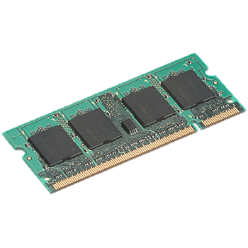
Efficient Fault Recovery via Lineage
Maintain a reliable log of applied operations
iter. 1
iter. 2
. . .
Input
Recompute lost partitions on failure
query 1
one-time processing
query 2
query 3
Input
. . .

Slide 23
Generality of RDDs
Despite their restrictions, RDDs can express many parallel algorithms
These naturally apply the same operation to many items
Unify many programming models
Data flow models: MapReduce, Dryad, SQL, …
Specialized models for iterative apps: BSP (Pregel), iterative MapReduce (Haloop), bulk incremental, …
Support new apps that these models don’t
Enables apps to efficiently intermix these models
Notes:
Similarity to GFS/HDFS: large blocks, append only.

Slide 24
Stream Processing

Slide 25
Simple stream processing
Single node/process
Read data from input source (e.g., network socket)
Process
Write output

Slide 26
Examples: Stateless conversion
CtoF
Convert Celsius temperature to Fahrenheit
Stateless operation: emit (input * 9 / 5) + 32

Slide 27
Examples: Stateless filtering
Filter
Function can filter inputs
if (input > threshold) { emit input }

Slide 28
Examples: Stateful conversion
EWMA
Compute EWMA of Fahrenheit temperature
new_temp = ⍺ * ( CtoF(input) ) + (1- ⍺) * last_temp
last_temp = new_temp
emit new_temp

Slide 29
Examples: Aggregation (stateful)
Avg
E.g., Average value per window
Window can be # elements (10) or time (1s)
Windows can be fixed (every 5s)
Windows can be “sliding” (5s window every 1s)

Slide 30
Stream processing as chain
CtoF
Avg
Filter

Slide 31
Stream processing as directed graph
sensor
type 1
CtoF
Avg
Filter
alerts
sensor
type 2
KtoF
storage

Slide 32
The challenge of stream processing
Large amounts of data to process in (near) real time
Examples
Social network trends (#trending)
Intrusion detection systems (networks, datacenters)
Sensors: Detect earthquakes by correlating vibrations of millions of smartphones
Fraud detection
Visa: 2000 txn / sec on average, peak ~47,000 / sec

Slide 33
Scale “up”: batching
Tuple-by-Tuple
Micro-batch
input ← read
if (input > threshold) { emit input
}
inputs ← read
out = []
for input in inputs {
if (input > threshold) {
out.append(input)
}
}
emit out

Slide 34
Scale “up”
Tuple-by-Tuple
Micro-batch
Lower Latency
Lower Throughput
Higher Latency
Higher Throughput
Why? Each read/write is an system call into kernel. More cycles performing kernel/application transitions (context switches), less actually spent processing data.

Slide 35
Scale “out”

Slide 36
Stateless operations: trivially parallelized
C
F
C
F
C
F

Slide 37
State complicates parallelization
Aggregations:
Need to join results across parallel computations
CtoF
Avg
Filter

Slide 38
State complicates parallelization
Aggregations:
Need to join results across parallel computations
CtoF
Sum
Cnt
Filter
Avg
CtoF
Sum
Cnt
Filter
CtoF
Sum
Cnt
Filter

Slide 39

Parallelization complicates fault-tolerance
Aggregations:
Need to join results across parallel computations
CtoF
Sum
Cnt
Filter
Avg
CtoF
Sum
Cnt
Filter
CtoF
Sum
Cnt
- blocks -
Filter

Slide 40
Can parallelize joins
Compute trending keywords
E.g.,
portion tweets
Sum
/ key
portion tweets
Sum
/ key
Sum
/ key
Sort
top-k
portion tweets
Sum
/ key
- blocks -

Slide 41
Can parallelize joins
Hash
partitioned
tweets
merge
sort
top-k
portion tweets
Sum
/ key
Sum
/ key
Sort
top-k
portion tweets
Sum
/ key
Sum
/ key
Sort
top-k
portion tweets
Sum
/ key
Sum
/ key
Sort
top-k

Slide 42
Parallelization complicates fault-tolerance
Hash
partitioned
tweets
merge
sort
top-k
portion tweets
Sum
/ key
Sum
/ key
Sort
top-k
portion tweets
Sum
/ key
Sum
/ key
Sort
top-k
portion tweets
Sum
/ key
Sum
/ key
Sort
top-k

Slide 43
Popular Streaming Frameworks
Various fault tolerance mechanisms:
Record acknowledgement (Storm)
Micro-batches (Spark Streaming, Storm Trident)
Transactional updates (Google Cloud dataflow)
Distributed snapshots (Flink)

Slide 44
Popular Streaming Frameworks
Record acknowledgement (Storm)
At least once semantics
Ensure each input “fully processed”
Track every processed tuple over the DAG, propagate ACKs upwards to the input source of data
Cons: Apps need to deal with duplicate or out-of-order tuples
Micro-batches (Spark Streaming, Storm Trident)
Transactional updates (Google Cloud dataflow)
Distributed snapshots (Flink)

Slide 45
Popular Streaming Frameworks
Record acknowledgement (Storm)
Micro-batches (Spark Streaming, Storm Trident)
Each micro-batch may succeed or fail
On failure, recompute the micro-batch
Use lineage to track dependencies
Checkpoint state to support failure recovery
Transactional updates (Google Cloud dataflow)
Distributed snapshots (Flink)

Slide 46
Popular Streaming Frameworks
Record acknowledgement (Storm)
Micro-batches (Spark Streaming, Storm Trident)
Transactional updates (Google Cloud dataflow)
Treat every processed record as a transaction, committed upon processing
On failure, replay the log to restore a consistent state and replay lost records
Distributed snapshots (Flink)

Slide 47
Popular Streaming Frameworks
Record acknowledgement (Storm)
Micro-batches (Spark Streaming, Storm Trident)
Transactional updates (Google Cloud dataflow)
Distributed snapshots (Flink)
Take system-wide consistent snapshot (algo is a variation of Chandy-Lamport)
Snapshot periodically
On failure, recover the latest snapshot and rewind the stream source to snapshot point, then replay inputs

Slide 48
Graph-Parallel Computation

Slide 49
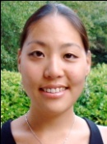

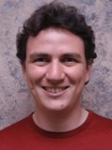



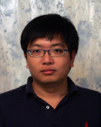
Properties of Graph Parallel Algorithms
Dependency
Graph
Factored
Computation
Iterative
Computation
What I Like
What My Friends Like
Notes:
Taking a step back – the big picture here is that this is one example of many GRAPH PARALLEL algorithms that have the following properties.
There is significant information in the dependencies between different pieces of data, and we can represent those dependencies very naturally using a graph.
As a result computation factors into different local vertex neighborhoods in the graph, depends directly only on those neighborhoods.
And because the graph has many chains of connections, we need to ITERATE the local computation, PROPAGATING information around the graph.

Slide 50
ML Tasks Beyond Data-Parallelism
Data-Parallel Graph-Parallel
Map Reduce
?
Feature
Extraction
Cross
Validation
Graphical Models
Gibbs Sampling
Belief Propagation
Variational Opt.
Semi-Supervised Learning
Label Propagation
CoEM
Computing Sufficient
Statistics
Collaborative
Filtering
Tensor Factorization
Graph Analysis
PageRank
Triangle Counting
Notes:
There’s a large universe of applications that fit nicely into graph-parallel algorithms
What kind of framework would be a good target for these applications?

Slide 51
Pregel: Bulk Synchronous Parallel
Let’s slightly rethink the MapReduce model for processing graphs
Vertices
“Edges” are really messages
Compare to MapReduce keys → values?
“Think like a vertex”
vertex ID
vertex ID
vertex value

Slide 52
The Basic Pregel Execution Model
A sequence of supersteps, for each vertex V
At superstep S:
Compute in parallel at each V
Read messages sent to V in superstep S-1
Update value / state
Optionally change topology
Send messages
Synchronization
Wait till all communication is finished
vertex ID
vertex value
vertex value

Slide 53
Termination Test
Based on every vertex voting to halt
Once a vertex deactivates itself it does no further work unless triggered externally by receiving a message
Algorithm terminates when all vertices are simultaneously inactive
Vote to halt
Active
Inactive
Message received

Slide 54
Distributed Machine Learning

Slide 55
Machine learning (ML)
ML algorithms can improve automatically through experience (data)
Most common approaches
Supervised learning: train the model first, then use it
Unsupervised learning: the model learns by itself
Reinforcement learning (RL): model learns while doing
Training
Feed the ML model data, so that it can learn how to make decisions
Inference (or model serving)
ML model in use, to process live data

Slide 56


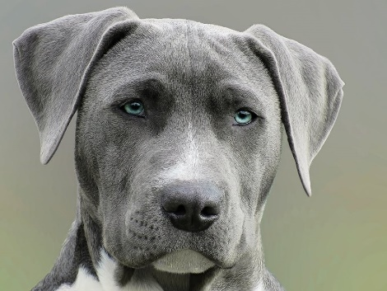

ML training
Training dataset
DOG
CAT
DOG
Loss function
100% WRONG
Δ
DOG
CAT

Slide 57


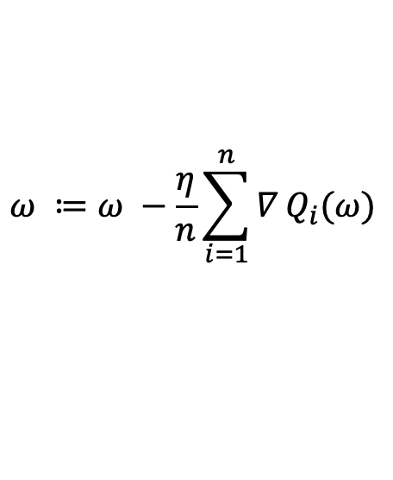
Distributed ML training Data parallel
Mini-batch
Amount of data processed by a single worker during 1 iteration
Global batch
Amount of data processed by all workers during 1 iteration
WORKER 1
Training dataset
Δ₁
DOG
CAT
Δ
WORKER 2
+
Training dataset
Δ
Stochastic gradient descent (SGD)
Δ₂
DOG
CAT
$$ω ≔ω −\frac{η}{n}\sum_{i=1}^{n}{∇}Q_{i}(ω)$$

Slide 58




Distributed ML training Model parallel or hybrid
Model parallel
Hybrid model-data parallel
WORKER 1
WORKER 1
WORKER 3
Training dataset
Training dataset
Training dataset
DOG
CAT
DOG
CAT
DOG
CAT
DOG
CAT
WORKER 2
WORKER 2
WORKER 4
Training dataset
Training dataset
Training dataset
DOG
CAT
DOG
CAT
DOG
CAT
DOG
CAT

Slide 59
Weak scaling and strong scaling
Weak scaling
Fixed local batch size per-worker fixed
More workers can process a larger global batch in one iteration
Same iteration time, fewer iterations
Same data transfers at each iteration
Time to accuracy does not scale linearly with the number of workers
Strong scaling
Fixed global batch size
With more workers, the local batch size per-worker decreases
Reduced iteration time (for computation)
Same data transfers at each iteration
More frequent synchronizations among workers (more network traffic)

Slide 60
Beyond training: AI applications
Different applications of AI have their specific computational tasks
Based on these tasks, they impose some system requirements
Ex. supervised learning application:
The stateful training task
Impose system requirements (training stage):
Tensorflow, MXNet and Pytorch
The stateless prediction task
Ack: Saber Malekmohammadi (Waterloo)

Slide 61
ML Ecosystem
Distributed System
Distributed System
Distributed System
Hyperparameter Search
Distributed Training
Model Serving
Vizier, many internal systems at companies
Horovod, PyTorch DDP, distributed TensorFlow
Clipper, TensorFlow serving
Distributed System
Distributed System
Distributed System
Streaming
Simulation
Data Processing
Flink, many others
MPI, simulators, custom tools
Spark, Hadoop

Slide 62
ML Ecosystem
Distributed System
Distributed System
Distributed System
Hyperparameter Search
Distributed Training
Model Serving
Vizier, many internal systems at companies
Horovod, PyTorch DDP, distributed TensorFlow
Clipper, TensorFlow serving
Distributed System
Distributed System
Distributed System
Streaming
Simulation
Data Processing
Flink, many others
MPI, simulators, custom tools
Spark, Hadoop
Emerging AI Applications require stitching together multiple disparate systems to satisfy diverse computation requirements

Slide 63
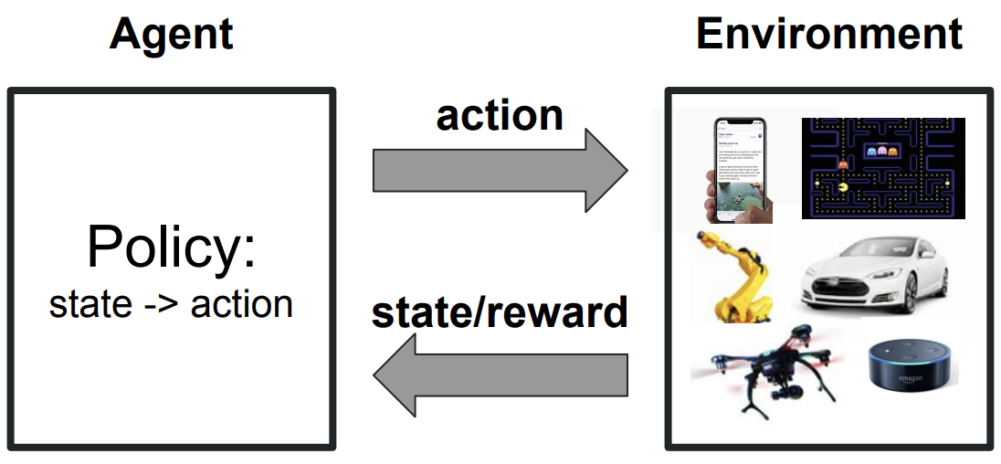
Ray: unified framework for AI apps
Goal: do all the tasks of training, serving and simulation together by a single framework
Motivating Example: Reinforcement Learning
Requirements:
Distributed training: fine-grained computations, heterogeneous computations
Serving: latency-sensitive, fine-grained computations, heterogeneous computations
Simulations: dynamic execution
Ack: Saber Malekmohammadi (Waterloo)

Slide 64
Ray: unified framework for AI apps
Provides a general programming model supporting task-parallel and actor-based computations
Supports a range of computations: from lightweight and stateless computations (simulations) to long and stateful computations (training)
Provides low latency, high scalability and fault tolerance
Ack: Saber Malekmohammadi (Waterloo)

