Slide 1

CS 345 Introduction
Marco Canini

Slide 2
This Class
Learn about research in Distributed and Networked Systems
Be exposed to the state-of-the art solutions to active areas
Work on an exciting project
Hopefully start next generation of impactful projects

Slide 3
About the Instructor
Marco Canini
  Professor, joined KAUST in Aug ’16
  https://mcanini.github.io
Research interests span
  Distributed and Networked systems in the context of cloud computing, large-scale data analytics, and machine learning
Head of SANDS Lab
  Software-defined Advanced Networked and Distributed Systems Laboratory
  https://sands.kaust.edu.sa/

Slide 4
Guest Co-Instructor
Zafar Ayyub Qazi
  Visiting Associate Professor, KAUST
  Associate Professor of Computer Science, LUMS
  Director Distributed & AI Systems Lab
  https://web.lums.edu.pk/~zafar/
Research interests span
  Distributed and Networked Systems, Machine Learning, Online Safety

Slide 5
SANDS Lab research
Distributed Systems
Security
Formal Methods
Networking
Machine Learning
Optimization Theory
Software Engineering
Programming Languages
The goal of our research is to build reliable and efficient distributed infrastructure that make application development easier and enhance the computing environment by aligning user needs with system capabilities.

Slide 6
Challenges
#1 Challenge: Complexity
Hard to reason about behavior as systems scale to large numbers of components and users
  Poorly understood connections
  Need predictability to ensure scalable performance, reliable operation, etc.
Notes:
Networked systems researchers tackle specific challenges of the design and implementation of a particular systems solution to a given problem.
However, if I were to identify a challenge that stands out and presents itself recurrently, it is complexity

Slide 7
Systems Approach
Formulate problem
Get idea
Build prototype
Measure & analyze
Adjust prototype … repeat previous step
Principles of system construction
  modularity, hierarchy, layering, abstraction, end to end
Notes:
Big problem is that there is really no theory of building systems. It appears these artifacts are way too complex to have a rigorous, constructive approach to dealing with them
In some sense it is like dealing with a biological organisms. They are some of the most complex systems that exist.
We understand how tiny disconnected pieces operate on their own but we know little about how they interact.
In the absence of a constructive theory the typical systems person will formulate a problem, get an idea, build a prototype, measure and analyze it, tweak it, go back to building, measure again and repeat these steps over time. This is the approach that many systems people have used in the past and has lead to highly treasured principles of building systems, which is for now the closest we can get to a rigorous, constructive approach.
These include concepts such as modularity, layering, abstraction.

Slide 8

Building SANDS @ KAUST – Vision
https://sands.kaust.edu.sa
marco@kaust.edu.sa
Principled construction of distributed/networked systems
Make it easy to produce and manage key software systems that are
worthy of society’s trust and achieve specific objectives:
High performance and scalability
High reliability and future-proof
Low power consumption
…
We build prototypes that directly improve the lives of real users
We learn general principles and lessons of what works in practice
Photo CC by Rui Ornelas

Slide 9
2012-2018 circa: Focused on SDN foundations
Develop
Programming abstractions
FatTire [HotSDN’13], STN [INFOCOM’15], Cocoon [NSDI’17],
ez-Segway [SOSR’17]
Debug
Systematic validation and testing
The three “D”s of Software-Defined Networking
NICE [NSDI’12, Computer Networks 92(2) ’15],
SOFT [CoNEXT’12], OFTEN [EWSDN’12]
Deploy
Principled deployment and operation
Panopticon [ATC’14], iSDX [NSDI’16], Medieval [DISN’16],
Empowering IXPs [IEEE Comm. 54(10) ’16], SIXPACK [CoNEXT’17],
ENDEAVOUR [IEEE JSAC 35(11) ’17], Dynam-IX [CoNEXT’18]
See https://mcanini.github.io/ for additional publications

Slide 10






2015-now: Predictable Performance in Clouds
Distributed applications running in the Cloud must be able to cope with performance outliers, meet deadlines & adaptively regulate load
Our research empowers organizations to confidently run their applications in the Cloud while enjoying significant cost reductions
Approach: Building blocks must meet strict service-level objectives
Storage systems
Micro services
Data analytics clusters
C3 [NSDI’15], Rein [EuroSys’17], Kurma [SoCC’18], Assise [OSDI’20]
Wisp [SoCC’18]
AutoTune [SoCC’18], BBO Arena [VLDB’20], Vanir [SoCC’10]
C3 tested at:
C3 adopted by Elasticsearch

Slide 11
2016-now: In-Network Computing
Driver: As networks become deeply programmable and capable of computation, what kinds of computation should networks perform?
Approach: Judicious in-network computing through composable and reusable primitives across applications
Consensus
In-network aggregation
Measurements
NetPaxos [SOSR’15], P4xos [SIGCOMM CCR 46(2) ’16, IEEE/ACM ToN ’20]
DAIET [HotNets’17], SwitchML [NSDI’21],
OmniReduce [SIGCOMM’21]
Sonata [SIGCOMM’18], MAFIA [INFOCOM’19]
Proposer
Proposer
Match
Counter
Sample
Sketch
Tag
…
Coordinator
Coordinator backup
+
data
aggregation
Paxos
logic
Acceptor
Acceptor
Acceptor
Learner
Learner

Slide 12
2018-now: ML Systems
Models and systems co-design and co-optimization
  Exploit specialized AI hardware
  Develop models optimized for the specific hardware
  Build ML systems that make use of the above points
MLSys provides a holistic approach to combining ML, data, systems, and hardware techniques to solve problems
Examples

Slide 13







2024-now: Agentic AI
Google estimates $1T market by 2040 https://cloud.google.com/blog/topics/partners/sharing-new-report-on-the-potential-of-agentic-ai
Prompt-only Models
Agentic AI
MAS
(Multi-Agent System)
Multi turn conversations & team coordination
One-shot conversation with chatbot-like interfaces
Decompose task, plan, and execute with autonomy.
GPTSwarm
…
Ecosystem
ADAS
MAS-ZERO
ChatGPT
Claude
AutoGen
Gemini
Agno
2022
2023
2024

Slide 14
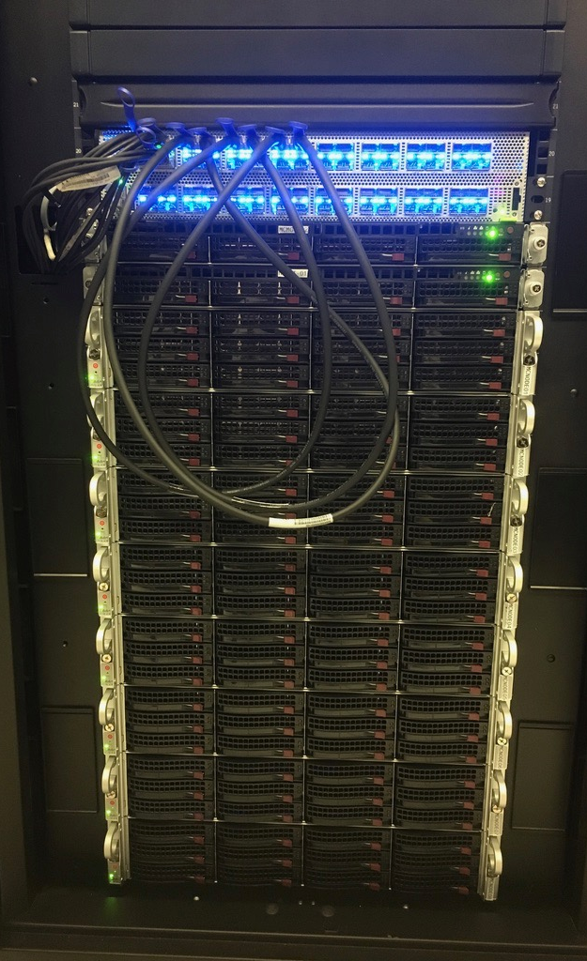


Scaling Distributed ML with In-Network Aggregation
https://sands.kaust.edu.sa/project/switchml/
Distributed ML training scales poorly due to communication costs
Designed and built SwitchML
Workers stream model updates to a 6.4 Tbps programmable switch that aggregates and redistributes combined updates
Aggregate model updates in-network
Worker 1
Worker 2
…
Worker N
Key idea: co-design ML and networking to maximize communication efficiency
SwitchML speeds up training by up to 5.55×

Slide 15
Crack Open the (Neural) Nets
[NetAI’19, INFOCOM’21]
How do we ensure that learned models behave reliably and as intended?
Build systems to test & interpret ML models, detect misbehaviors and correct them
AI agents trained with DNNs are black boxes
In [NetAI’19] we demonstrated several anomalous behaviors in Pensieve [Mao et al., SIGCOMM’17]
We built a formal verification framework for NNs and enabled verification of high-level properties of neural agents [INFOCOM’21]
We developed range explanations, which overcome the inherent limits of post-hoc explanations, to aid with model interpretability (preparation)
Input
Model
Output
Interpretable ML
Explanation
Detection
Correction
Domain Knowledge
Properties / Conditions

Slide 16
Federated Learning (FL)
https://sands.kaust.edu.sa/project/fairfl/
An emerging ML paradigm where models are trained across millions of devices and data does not leave the devices due to privacy concerns
Heterogeneity
Communication control
Attacks
FL devices are not equal and their availability varies greatly. Bias in device selection impacts model quality.
How to quantify and reduce bias?
Communication can be a severe bottleneck to training FL models.
How to adapt gradient compression in reaction to varying network conditions?
There’re many attacks on FL models.
How does model and gradient compression mitigate them?

Slide 17
What About You?
Please introduce yourself!

Slide 18
About this class

Slide 19

Course Schedule
Webpage: http://sands.kaust.edu.sa/classes/CS345/S26/
  CampusWire: use the invite link!
Meetings
  1PM – 2:20PM (Sun/Wed for lectures and discussions)
Pay attention to the online announcements and schedule
  On average, two meetings per week
  Makeups will be added on a need-to-add basis
https://campuswire.com/p/GA50451D5
Code: 4883

Slide 20
Prerequisites
CS 240 (Computing Systems and Concurrency)
  Basics of OS organization, threads, memory management, file systems, scheduling, networking, etc.
  Equivalent course of CS 240 is acceptable as well
Basic knowledge of networking: e.g., CS 244 (Computer Networks)
  Basics of packet switching, Internet architecture and protocols, etc.
Good programming skills
  Build substantial systems for course project
Questions
  Have you taken a grad-level systems (e.g., OS, networking) course before?
  Have you worked on large systems-building project?

Slide 21
Course Requirements
Paper Reviews | 15%
Paper Presentation | 20%
Active Participation | 15%
Project | 50%
Checkpoint #1: initial proposal | 10%
Checkpoint #2: midterm progress report | 15%
Final report | 25%

Slide 22
Paper Reviews
This is a paper-reading course
  Paper reviews account for 15% of the total grade
15-20 summaries to write
What goes in a good summary?
  Highlight strengths
  Highlight weaknesses
  Describe the entire paper in few sentences
  See detailed guidelines on course website (or next slide)

Slide 23
Critical Reading
What is the problem addressed by the paper? Is the problem real? Why is this problem important?
What is the hypothesis of the work?
What is the proposed solution’s main idea, and what key insight guides their solution?
Why is the solution different from previous work?
  Are system assumptions different?
  Is workload different?
  Is problem new?
Does the paper (or do you) identify any fundamental/hard trade-offs?
What is one (or more) drawback or limitation of the proposal, and how will you improve it?
Do you think the work will be influential in 10 years?
  Why or why not?

Slide 24
What are Hard/Fundamental Tradeoffs?
Brewer’s CAP conjecture: “Consistency, Availability, Partition-tolerance”, you can have only two in a distributed system
In a in-order, reliable communication protocol cannot minimize overhead and latency simultaneously
Hard to simultaneously maximize evolvability and performance

Slide 25
How to Review
You will see a section for describing a paper summary, its strengths, its weaknesses, and detailed comments
In the summary section, please directly address:
  What problem the paper is addressing (1-2 sentences or bullets)
  The core novel ideas or technical contributions of the work (1-2 sentences or bullets). Put another way, what's the 30 second elevator pitch, or, five years from now, what should one remember about this paper?
  A longer description (3-5 sentences) that summarizes the paper's approach, mechanisms, and findings
For the other sections, please include 2-4 bullet points for the strengths and weaknesses, while a much longer exposition in the detailed comments (according to template on slide 16)
Remember to be constructive: don't only focus on the paper's shortcomings, but also on what it could have done differently or as the next steps. Imagine that you are having a conversation with the authors: What would you tell them?

Slide 26
Reviewing Tips
Read (if you haven’t already!)
How to Read a Paper by S. Keshav
How to read a research paper by Michael Mitzenmacher
Writing Reviews for Systems Conferences by Timothy Roscoe

Slide 27
Paper Reviews
Reviews must be submitted electronically 24 hours before the class
  Submission site: https://hotcrp.kaust.edu.sa/cs345
You can miss at most 2 without any penalty
  Each missing one beyond that will result in 25% decrease in grade for this segment
  Meaning, missing 6 or more will result in 0% for the “Paper Reviews” segment of your grade
At the end of the term, 2 of your reviews will be randomly selected and graded
  The higher grade of the two will be used for grading

Slide 28
Paper Presentation
This is a seminar-style course
  Each student must present at least once
  Paper presentation account for 20% of the total grade
Presenter to read mandatory and companion paper
Presentation should last 45 minute without interruptions
  Though expect interruptions and questions
  Followed by discussion anchored by the presenters
What should go in a useful presentation?
  See next slide
Lead the discussion
  Go through the strengths and weaknesses from the paper review

Slide 29
Presentation Guidelines
Motivate the paper and provide background
Present the high-level idea, approach, and/or insight (using examples, whenever appropriate)
Discuss technical details so that one can understand the key details without carefully reading it
Explain the difference between this paper and related work
Raise questions throughout the presentation to generate discussion

Slide 30
Presentation Structure
Your oral description of the paper should follow a much similar format:
System name (e.g., "VL2") | Institution and/or authors (e.g., "Microsoft Research") | Conference (e.g., "SIGCOMM 2009")
Problem
Core ideas
Descriptive summary, technical details and main results
Related work
Strengths
Weaknesses/limitations
Further discussion, including proposals for follow-up work

Slide 31
Paper Presentation
Email your slides to the instructor 24 hours before the class
Prepare early
Practice a lot
Also, read
  How to Give a Bad Talk by David A. Patterson
  Pointers for Leading Paper Discussions by Randy H. Katz
Also, see
  How to Give a Great Research Talk by Simon Peyton Jones

Slide 32
Paper Review Website
We will use the HotCRP conference software
  http://www.read.seas.harvard.edu/~kohler/hotcrp/
It is a system used by many real-word conferences, including USENIX conferences and many ACM SIGCOMM and SIGPLAN conferences
Submission site: https://hotcrp.kaust.edu.sa/cs345

Slide 33
Participation
Attend all lectures
  Can miss at most two with legitimate reasons
Read all the papers and participate
  Ask questions!
We evaluate class participation by observing how prepared students are to discuss the covered paper when they come to class
  I will be asking questions of students at random in class
  Your answers to these questions form a part of your overall grade, so it is important that you both show up to class as well as read the papers carefully

Slide 34
Project
The biggest component of this course
  Original research
    Pick an interesting open problem. Why is it important?
    What has already been done? Why are they not enough?
    Develop a hypothesis about how you’d improve it
      Intuitively, why will your approach work?
    Build a substantial prototype
      Experiment, measure, and compare against the state-of-the-art
  Reproduce a result from a systems paper
Aim at producing a conference/workshop-quality research paper
  Can be related to your research topic but it is expected to be distinct!

Slide 35
Projects
This is a research-oriented course!
  The final project accounts for 50% of total grades
  Individual or group projects. Ideally groups of 2 students. Find your peers!
What can and cannot be a project?
  Just surveys are not allowed. In fact, each project must include a survey of related work and background
  An ideal project should answer the questions you asked during paper reviews and points you cared about for presentations
  Measurements of new environments or of existing solutions on new environments are acceptable upon discussion

Slide 36
Project theme: Agentic AI systems research
For Spring’26, main course theme is to focus on Agentic AI systems research
Next few lectures will cover relevant tech trends, LLM infrastructure and a gentle introduction to Agentic AI
Also syllabus includes influential and contemporary papers on the topic
You can take one of two main angles: Systems for Agentic AI or Agentic AI for Systems
  You can align your existing research project while matching one of these
You will be asked to work with MAESTRO, our evaluation suite for benchmarking LLM-based AI agents
  It could be an assignment if the match is not a fit

Slide 37
Original Research: How to Approach It?
Find a problem and motivate why this is worth solving
Survey background and related work to get a sense of your (friendly!) competition
  Might require you to go back to the first step
Form/update your hypothesis
Test your hypothesis
  Go back to 3 until you are happy
Present your findings in a presentation and in writing
  Discuss known limitations

Slide 38
Reproduction: How to Approach It?
Pick an interesting paper
Ask what kind of “reproduction” is appropriate?
Does the primary result of the paper hold up?
What happens if you vary a parameter the original experimenter didn’t consider?
Having reproduced the primary result, can you now extend or improve the work?
What was difficult to reproduce?

Slide 39
Milestones
* Week of
Date | Milestone | Details
19/2/26 | Form Group Submit paper prefs | Find like-minded students Choose at least 3 preferred papers to present
26/2/26 | Draft Proposal | Send your 2-page proposal by email
1/3/26 | Finalize Proposal Checkpoint #1 (10%) | After a back-and-forth discussions with the instructor
30/3/26 | Midterm Progress Report Checkpoint #2 (15%) | 4-page report should read like parts of a research paper
1/4/26 | Midterm Presentation | Define and motivate a problem, survey related work, and form initial hypothesis and idea
6/5/26 | Final Presentation | Present your findings in a presentation
11/5/26 | Final Report (25%) | 8-page final report similar to the papers you read

Slide 40
Draft Proposal
Read: The Heilmeier’s Catechism
2 pages including references that ideally includes
  The particular results you would like to replicate
  Or the overall goal of your original project
    What is the problem? | Why is it important to solve?
    What you will do in some detail?| How would you evaluate your solution?
  A brief outline of incremental steps to do to finish the project as well as a timeline
    The goal is to convince both us and yourself that your project is neither too small nor too big
Include group members, if any
Schedule via email a 15-minute meeting to discuss

Slide 41
Finalized Proposal
4 pages including references that must include
  Have the structure of the final report
  Complete introduction written
  Status of the project
  Plan for the remaining time
Approved by the instructor and agreed upon by you
  Forms the basis of expectation

Slide 42
Midterm Presentation
In-class short presentation over one day (or two days if necessary)
  This is to make sure you are making progress
Must include
  What is the problem?
  Why is it important?
  What are the most related work?
  What’s your hypothesis so far?
  How are/will you evaluate it?

Slide 43
Final Presentation and Report
Presentation
  It will follow a format similar to other presentations given in the class (20 min)
Research paper
  The key part
  Should be written similar to the papers you’ve read
  Your goal is to do publishable quality systems research
  Up to five “best projects” will be earmarked for expedited submission to a renowned conference, with the help of the instructor
Also, submit self-contained code as a zip file
Read: How to Write a Great Research Paper by Simon Peyton Jones

Slide 44
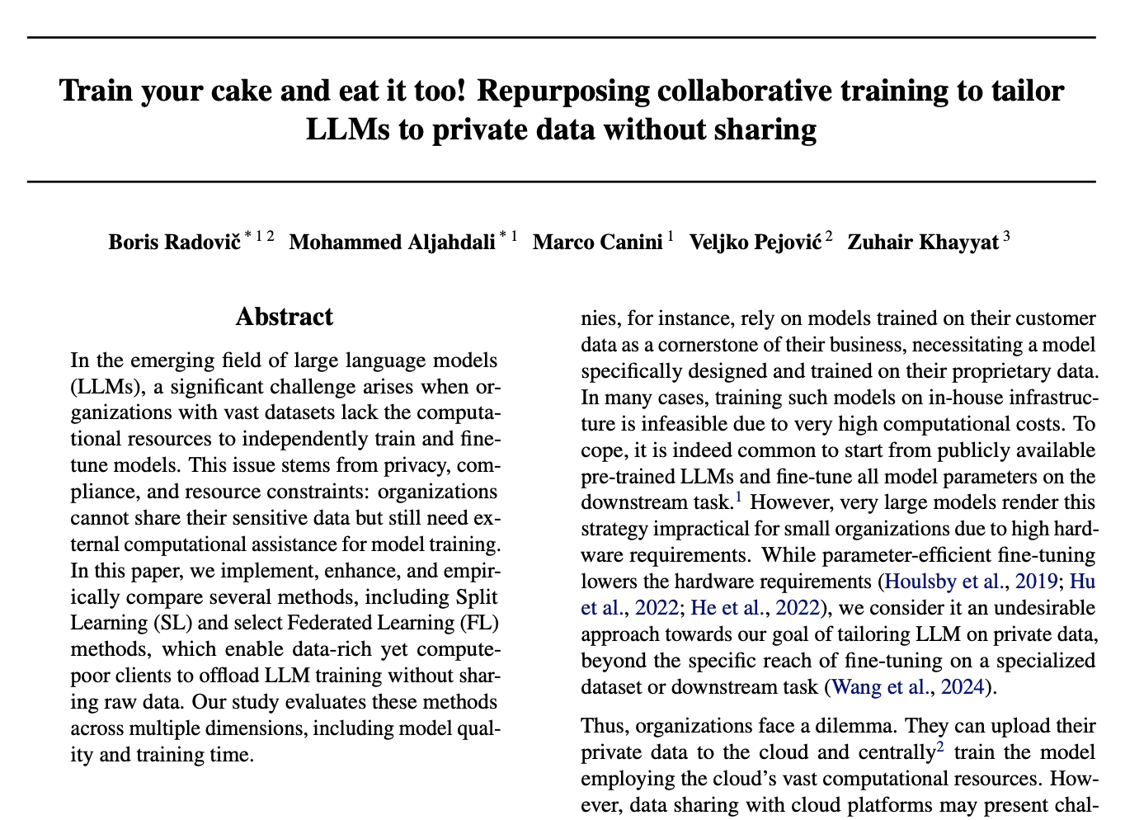
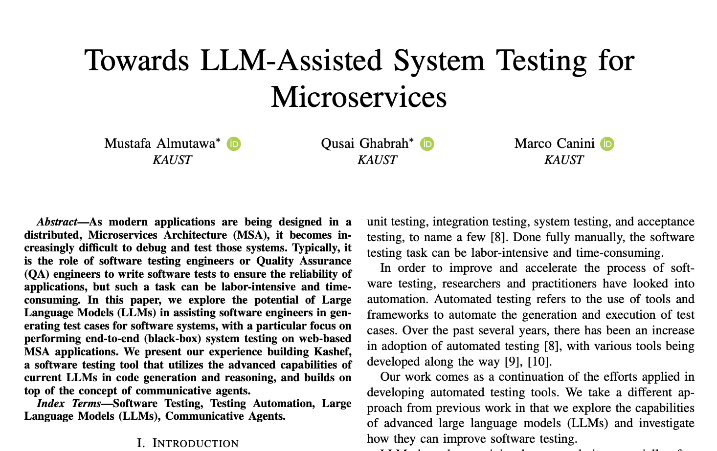
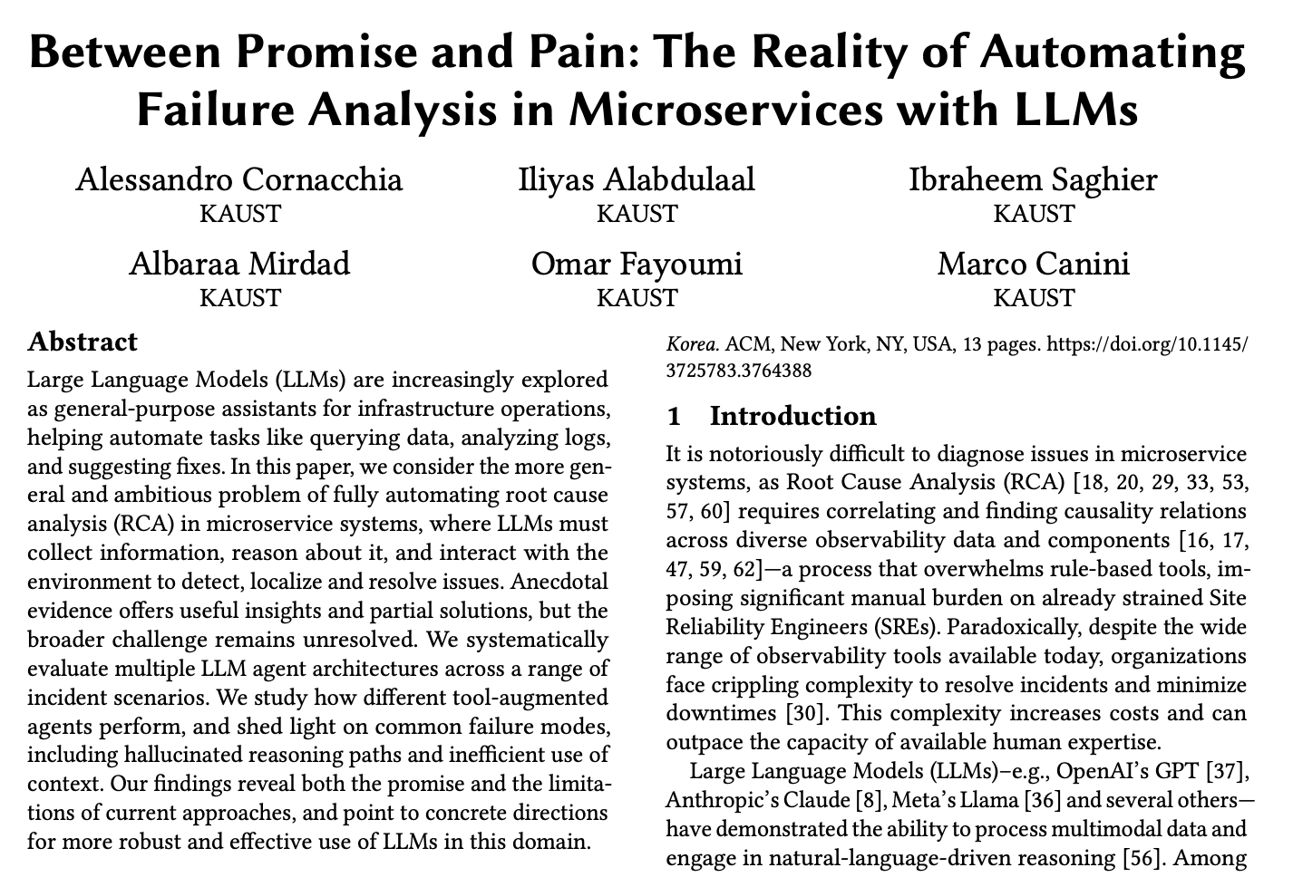
Up to five “best projects” …
Some examples from recent courses
ES-FOMO’24
AI-DCS’24
APSys’25

Slide 45
Rough Outline
Abstract
Introduction (Highlight the importance and give intuition of solution)
Motivation (Use data and simple examples)
Overview (Summarize your overall solution so that readers can follow later)
Core Idea (Main contribution w/ challenges and how you address them)
Implementation (Discuss non-obvious parts of your implementation)
Evaluation (Convince readers that it works and when it fails)
Related Work (Let readers know that you know your competition!)
Discussion (Know your limitations and possible workarounds)
Conclusion (Summarize and point out future work)

Slide 46
Regular Check-ins and Meetings
Mandatory meeting around the time each milestone is due
  By appointment
Also, send an update each week to the instructor
  what you did this week
  which papers you read this week
  what you need to do next week to stay on track
These updates will not be graded; the idea is to make sure you are making incremental progress

Slide 47
Lectures
Course will cover 5 lectures inspired from
“How to Do Great Research,”
originally developed by Nick Feamster and Alex Gray at GA Tech
Goal is to teach you many skills that you will keep in your “research toolbox” for the rest of your career
Live lectures were offered in Spring 2024 (jointly with CS356); this term you will access the vide taped version – Of course, ask questions you may have!

Slide 48
Before We Move On…
Late work policy: no extensions
  Any exceptional circumstances, talk to us early
Zero tolerance for academic misconduct
  Cheating, plagiarism, any form of dishonesty will be handled with maximum severity
Slides will be posted after the class
  Everyone must come after reading all the assigned papers
Class meeting format
  Quick summary by the instructor
  Presentation of typically two papers
  Followed by a short break
  Presenter leads discussions on the papers and related topics

Slide 49
Before We Move On… GenAI policy
The use Generative AI tools such as ChatGPT, Claude, or Gemini is by default not allowed in deliverables
This means paper reviews, presentation and reports must be your own writing
  Why? We already know these tools can help you polish deliverables; we seek to give feedback on your own skills instead!
The use of tools is allowed for specific tasks: coding, experimentation analysis (typically plotting), brainstorming, and literature survey; outside if these, the only exception is if you have received explicit permission from the instructor to use such tools for a specifically identified task
If you are found to have violated this policy, you (and your teammates if applicable) will receive a zero on the course components that you used Generative AI for

Slide 50
Before We Move On… More Resources
Check out the Resources page on the course website
https://sands.kaust.edu.sa/classes/CS345/S26/resources.html
and as said, you can use AI tools for brainstorming and literature survey

Slide 51
Systems Research

Slide 52
What is systems research?
Core areas:
  Operating systems
  Storage systems
  Networked systems
  Distributed systems
And also their interactions with:
  Computer architecture
  Programming languages / compilers
  Theory and semantics (formal methods)
  Human-Computer Interaction
  Social science
  …

Slide 53
Systems-research methodology
Pursue hypotheses
  This protocol change will improve performance under packet loss
  This filesystem change will improve performance on flash devices
Analyze, extend, or build artefacts
  Real systems (e.g., an OS kernel or storage system)
  Simulations (e.g., of a network topology or processor)
  Analytic models (e.g., of a scheduling algorithm or protocol)
Evaluate behavior of the artefacts
  Compare to baselines / other hypotheses
  Measure quantitatively and qualitatively
  Performance, scalability, complexity, robustness, energy, security, …

Slide 54
Experimentation for exploration vs. evaluation
Similar methodologies, very different activities
Exploration
  Understand and explain the behavior of a system
  Develop hypotheses about causal effects, potential changes
  Consider performing a limit study early in the project
Evaluation
  Measure/explain [non-]conformance to hypotheses
  Clearly compare with competing approaches and control
  Explain why the approach worked (or didn’t)

Slide 55
Thinking about evaluation
Avoid existence proofs (“We built it. The end.”)
Compare with other approaches
  Related work is not just a list of citations!
  Intellectual comparisons with approaches
  Compare experimentally
Argue about benefits and costs of your approach
  Present tradeoffs – very little is unconditionally better!
  Bad: “We only looked at workload A and always win there”
  Good: “Approach X improves important workload A, but not B”
Realism
  How realistic must experiments be to convince the reader?

Slide 56
The experimental method (Bacon, ...)
Make observations
Form hypotheses about causality
Make predictions
Perform an experiment:
  Manipulate independent variables
  Hold other variables constant
  Measure dependent variables
  Compensate for random error (e.g., variance such as timer ticks)
  Control for confounding variables (e.g., in-production experiments)
  Focus on reproducibility
Analyze results of experiment
Draw a conclusion
Report results
Read (if you haven’t):
Repeatability in computer systems research
by C. Collberg and T. A. Proebsting

Slide 57
Some easier things you can measure
Performance
  Throughput and/or latency?
  Scalability as cores/disks/nodes/links/packets... increase?
  Energy use?
Resilience / robustness
  Packet loss? Network partition?
  Node failures? Disk failures?
Compatibility / deployment realism
  Source-code / binary impact on affected applications?
  Protocol / format deployment scenarios?

Slide 58
Some harder things to measure
Security
  Effect on past vulnerabilities?
  Trusted Computing Base (TCB) size?
  Automated reasoning / proofs?
  Services enabled by new security features?
Maintenance burden / debuggability
  Potential costs of adoption / deployment?
  New kinds of bugs – and mitigations for them?
User experience
  User studies – but they are hard!
  Identify proxies through real-system traces – e.g., latency?

Slide 59
Bias, error, fidelity, and generality
Analyze, minimize, and document error:
  Experimenter bias
  Random error / sampling effects
  Confounding variables / controls
  Probe and measurement effects
  Simulation fidelity / configuration realism
  Workload / benchmark realism
  Generality and scope of results
Real-system measurements are samples in distributions
  Use statistics to interpret significance of results

Slide 60
Q&A
That was a short introduction to systems research
Read How to be a computer systems graduate student
by Richard Martin
Read Low-level advice for systems research
By Lalith Suresh

Slide 61
Credits
In designing and running this course, I acknowledge inspirations from
UIUC CS 525 by Indranil Gupta (Indy)
Michigan EECS 582 by Mosharaf Chowdhury
UCB CS 294 by Ion Stoica and Ali Ghodsi
Cambridge Adv. Topics in Comp. Systems by Richard Mortier
Lecture on “Practical experiments in systems performance research” by Robert N. M. Watson

